Slide 1
Unit 5B Notes World War 2
Burial at sea for
USS Intrepid1944

Slide 2
Title: Homefront
Discuss some of the ways that World War 2 changed the everyday lives of people in the United States. You can discuss the average American, or minorities or women, your choice.

Slide 3
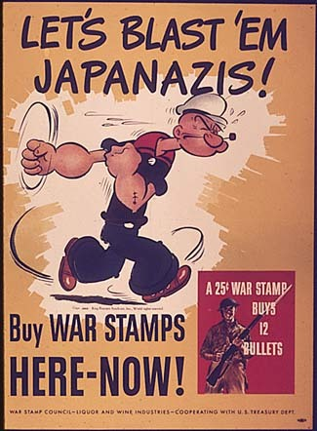
Title: WWII Posters
During wartime, the government often uses media to encourage people to participate in the war effort. During World War II, the government produced posters, most of which encouraged young men to enlist for active duty. Other posters urged women to work in factories or show support in other ways.
Sketch aWWII poster.
At the top write the Message, what you are trying to persuade others to do, and the Audience, who you are trying to persuade.

Slide 4
Title: Believing the Reports
The American public did not truly take in the horror of Adolf Hitler’s regime until years after the existence of concentration camps was first reported in American newspapers. Partly this was the fault of the media, which did not give prominent placement to news of the Holocaust.
What other factors do you think contributed to the long delay in understanding the Holocaust?

Slide 5
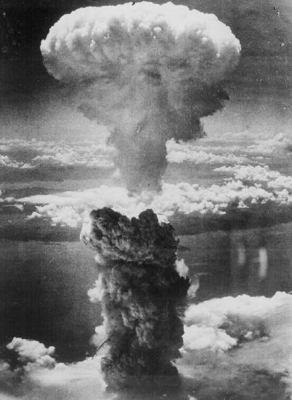
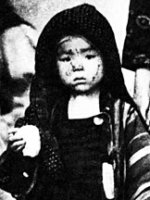
Title: A Million Lives or the Bomb
The year is 1945 and the Japanese have not yet surrendered. You are President Harry Truman. Your advisors have informed you that forcing a Japanese surrender through continued conventional fighting may cost as many as one million American lives.
You have another option: dropping the newly developed atomic bomb on Japan, thereby killing hundreds of thousands of Japanese.
Which option do you choose? Why?

Slide 6
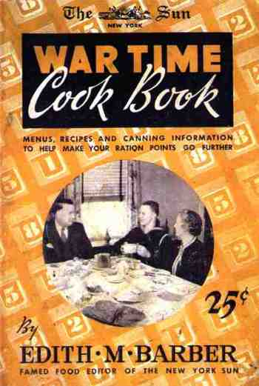
I. The Homefront
A. Industrial & Farm Production
1. War Production Board halted non-essential building to conserve materials for war purposes.
2. Rationing goods to consumers reached major levels as goods became scarce--gasoline, butter, rubber, shoes, sugar, and meat were rationed.

Slide 7
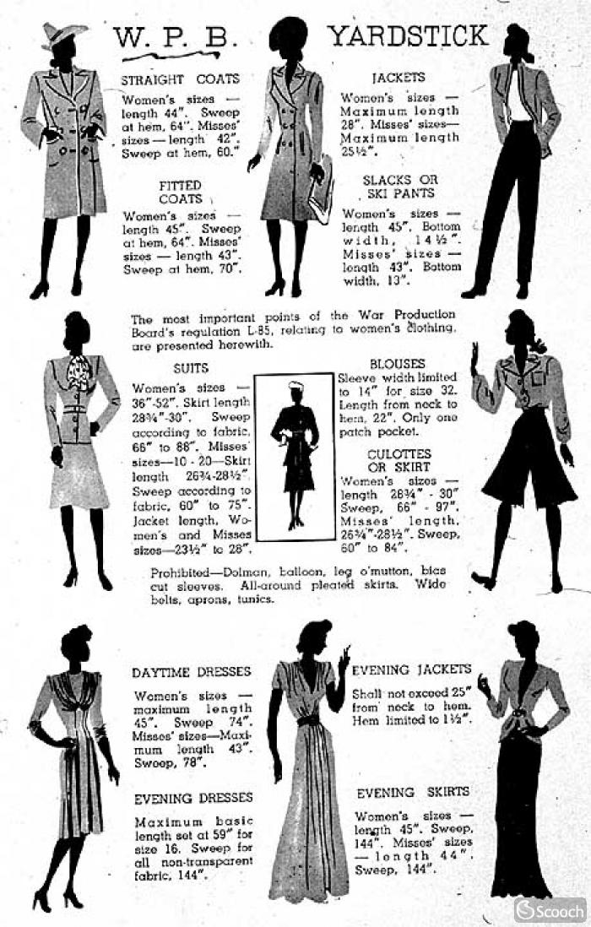
No French cuffs or sleeves.
No pockets of wool.
No interlinings containing any virgin or reprocessed wool.
No cuffs on coats.
No belts wider than 2 inches.
No hoods or scarves for blouses.
For men and boys, "no second pair of trousers of matching material, no outside patch pockets of wool."

Slide 8
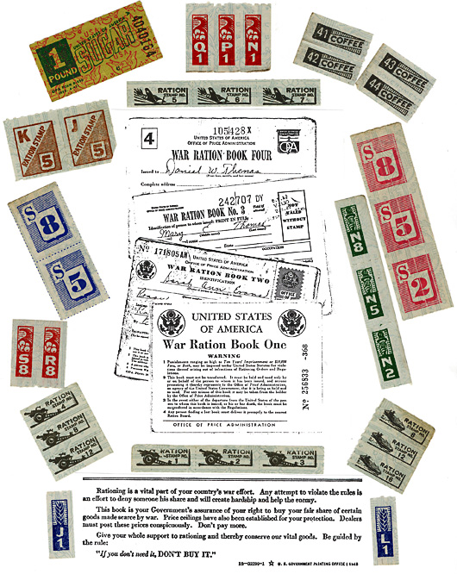
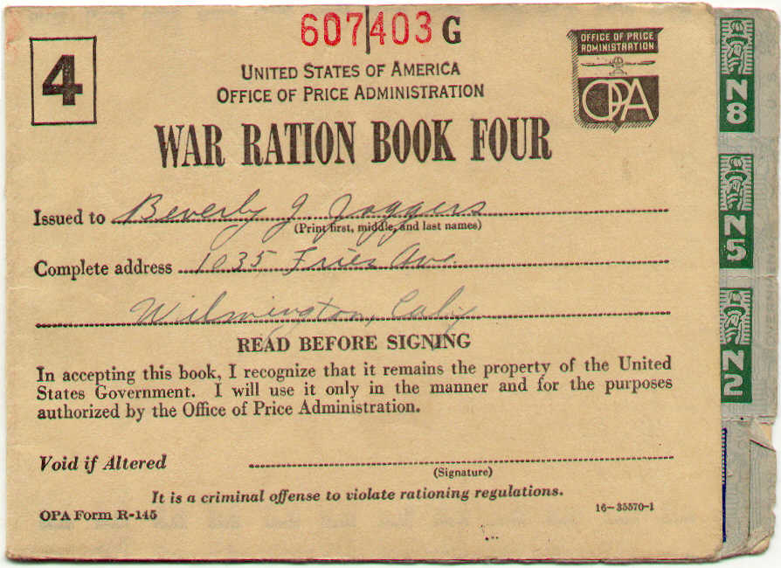
Ration
books

Slide 9
3. Labor groups made no-strike pledges, but some wildcat strikes broke out, particularly among miners.
a. Except for brief work stoppages, American workers chose not to strike (less than 1% of working time during the war was lost, a record better than England's).

Slide 10
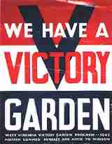
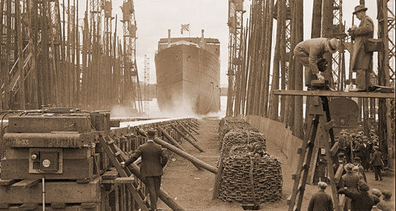
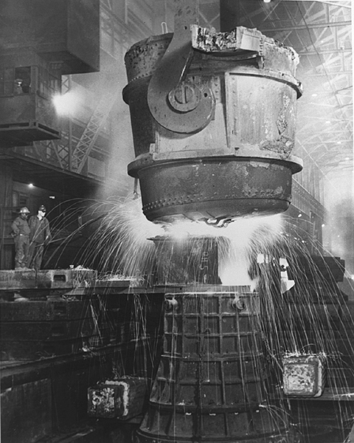
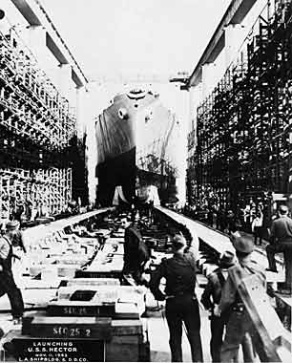
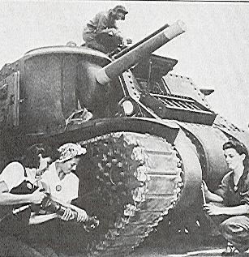
4. Farm income doubled, as in World War I. Victory gardens were replanted.
5. Industries switched to war production very quickly. One ship was completed by Henry Kaiser's workers in five days.

Slide 11
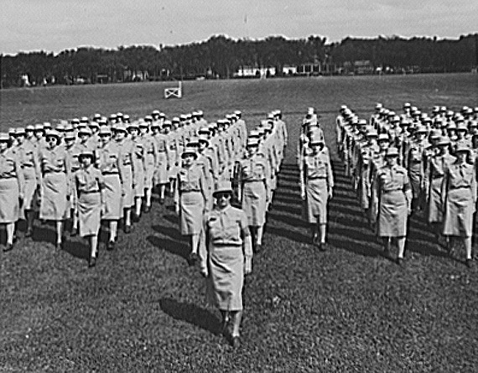
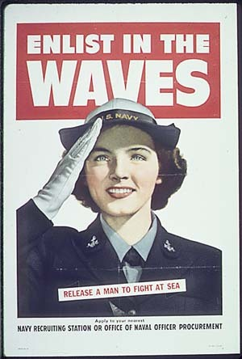
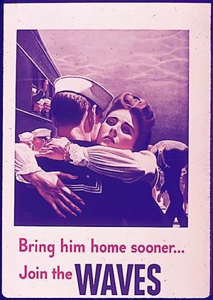
B. Women in the Work Force
1. Women joined the armed forces in record numbers, though not in combat roles. Most took clerical jobs in the various branches (WAVES and WAACS).

Slide 12
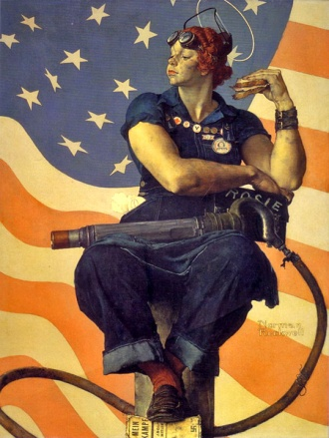
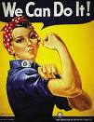
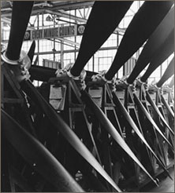
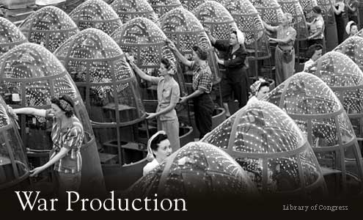
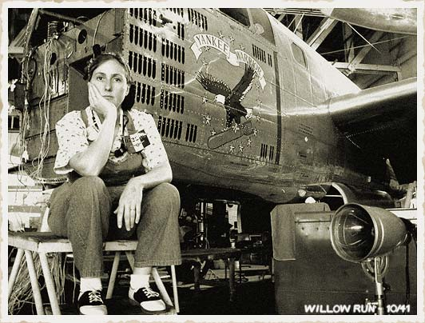
2. Women (characterized as "Rosie the Riveter") took many jobs in heavy industry, such as shipbuilding and aircraft production.

Slide 13
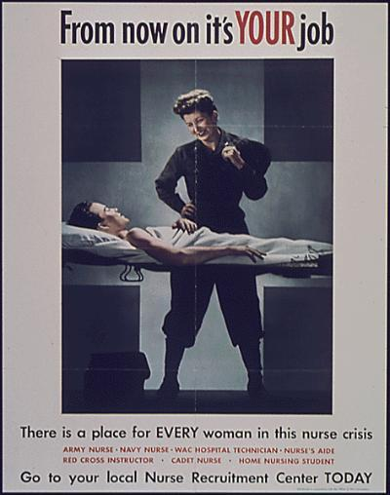
3. Popular opinion opposed women working and some private contractors refused to hire women.
a. Office of War Information supported a domestic propaganda campaign to make women's work seem patriotic.
b. Between 1941 and 1945, 6.5 million women entered the work force, a 57% increase.

Slide 14
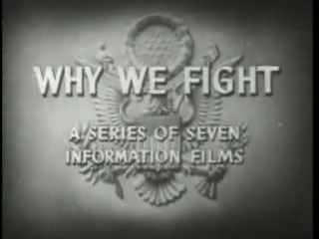
C. Propaganda
1. As in World War I, the government promoted pro-war messages. a. The “Why We Fight” movie series by Frank Capra was produced by the gov’t and was very popular.
b. Commercial movies were blatantly patriotic and emphasized the “melting pot” nature of American forces.

Slide 15
2. While Nazis and Japanese were portrayed as ruthless barbarians, Italians were treated more generously in films and written propaganda. a. FDR wanted to de-emphasize anti-German hysteria and distinguished between Nazis and other Germans.

Slide 16
b. Nazi stupidity became a common stereotype, as viewers were encouraged to laugh at Hitler and his followers.
c. Japanese were portrayed as subhuman, partly in response to atrocities committed by the Japanese and partly because of racism.

Slide 17
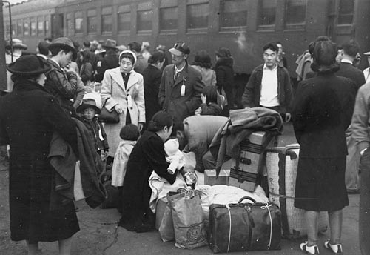
D. Civil Rights Issues
1. On the West Coast Japanese-Americans were arrested, housed in concentration camps, and forced to endure the length of the war in remote locations (Topaz, UT e.g.)

Slide 18
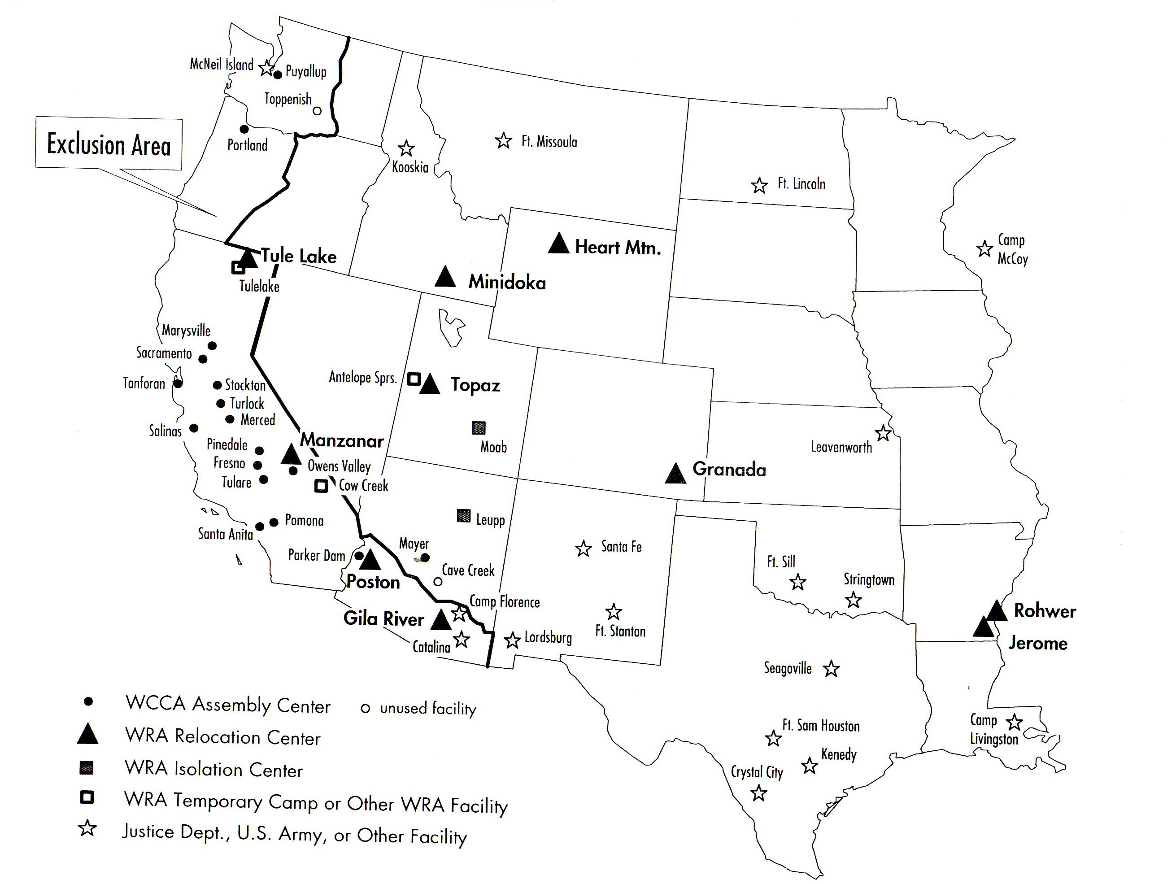
bbbb

Slide 19
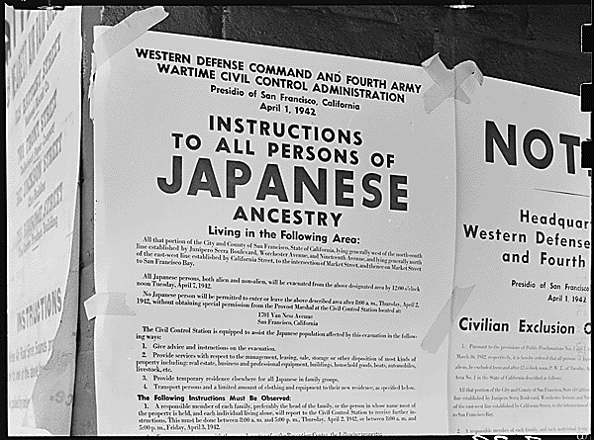

Slide 20
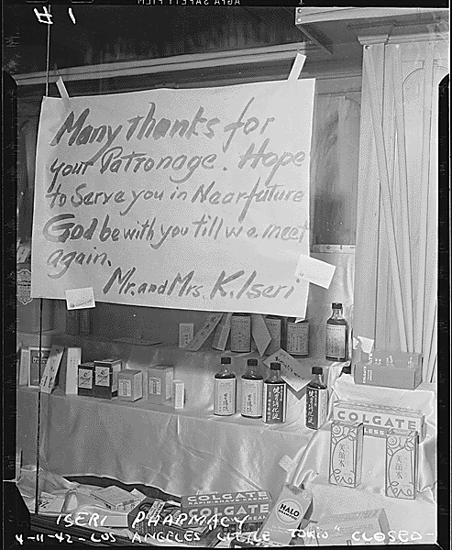

Slide 21
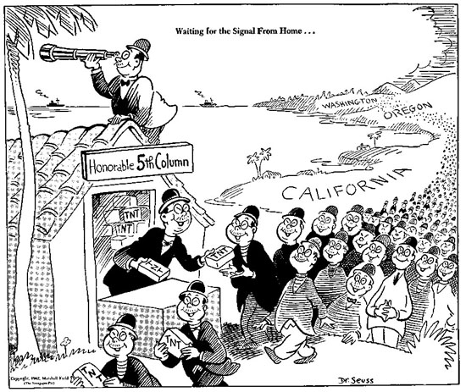

Slide 22
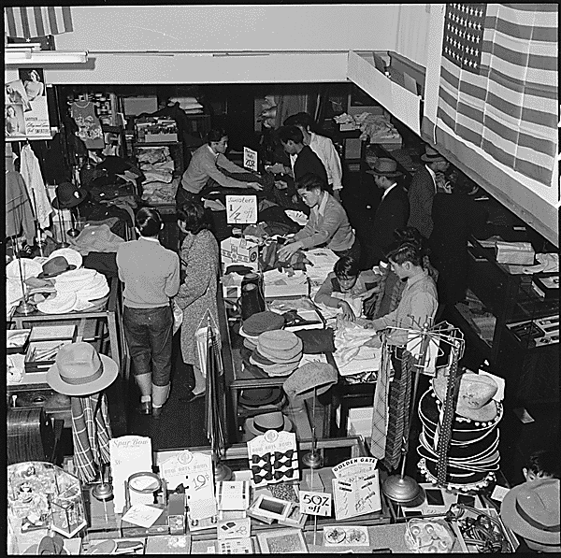
a. Executive Order 9066 (1942) required the internment and relocation of all Japanese in the Western U.S.
b. In the 1944 Korematsu decision, the Supreme Court upheld the relocation on the grounds of military necessity.

Slide 23
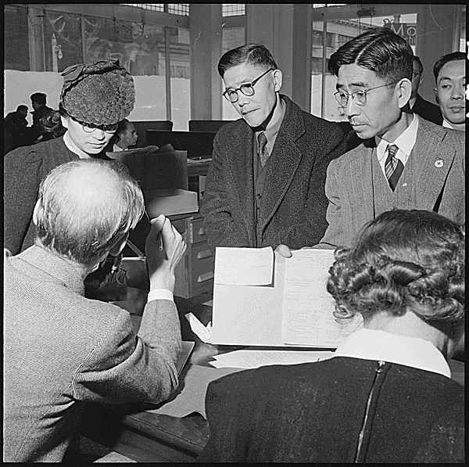

Slide 24
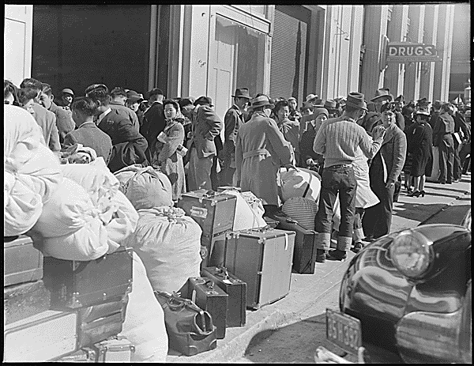

Slide 25
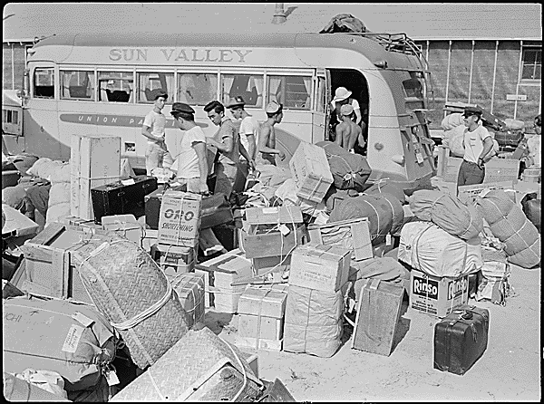

Slide 26
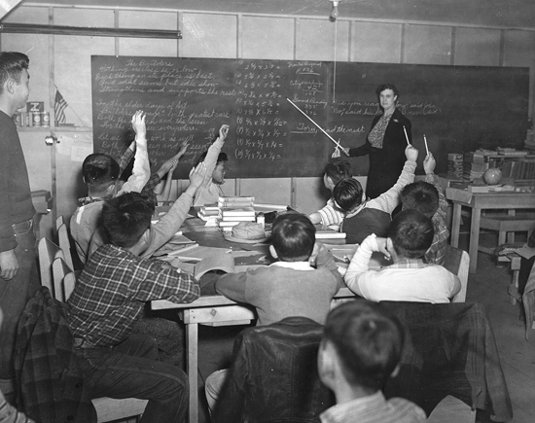
Junior high school students at Tule Lake, CA.

Slide 27
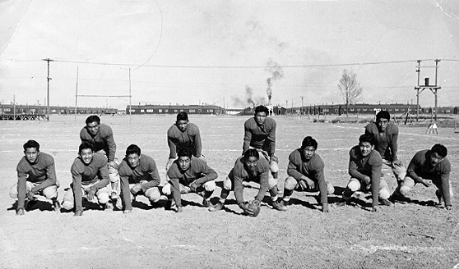
Topaz internment camp high school football team.

Slide 28
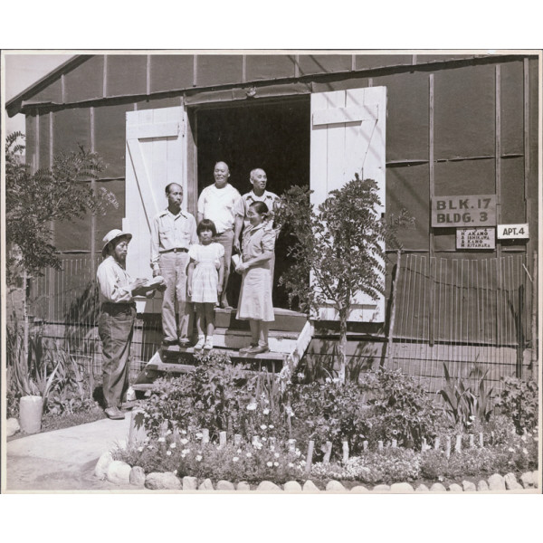

Slide 29
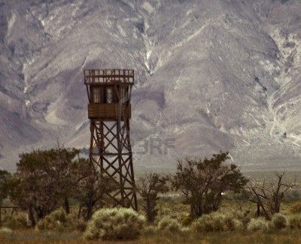
One of the most stunning ironies in this denial of American civil liberties was articulated by an internee who, when told that the Japanese were put in those camps for their own protection, countered,
"If we were put there for our protection, why were the guns at the guard towers pointed inward, instead of outward?"

Slide 30
During the Reagan-Bush years Congress moved toward the passage of Public Law 100-383 in 1988.
It acknowledged the injustice of the internment policy, apologized for it, and provided a $20,000 cash payment to each person who was interned.

Slide 31
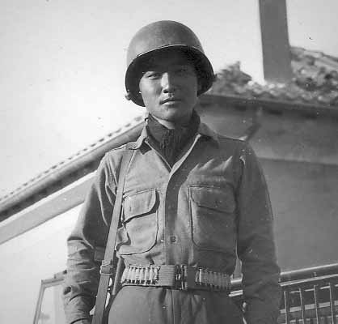
c. Despite this treatment, 18,000 Nisei volunteered for military service. Nisei regiments earned a high number of decorations.

Slide 32
2. African-Americans challenged race prejudice during the war in several ways. a. Civil rights organizations expanded their membership during the war.
b. Repudiation of Nazi racism by the U.S. strengthened civil rights efforts.

Slide 33
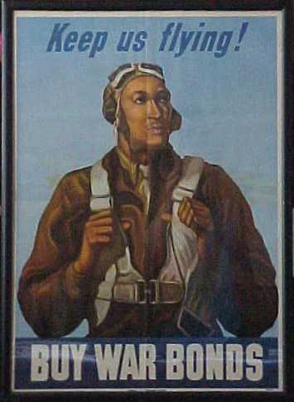
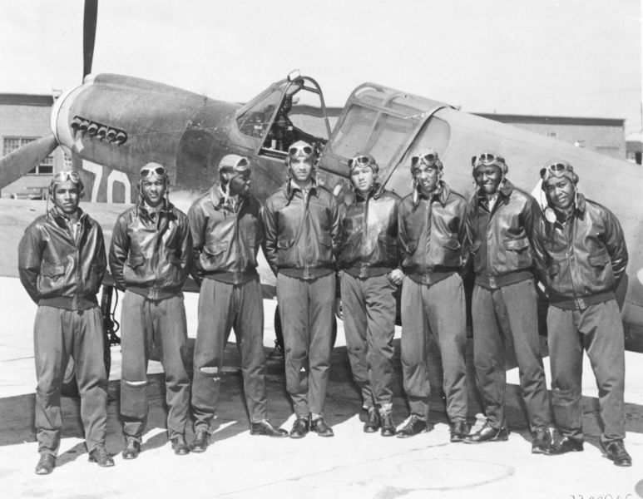
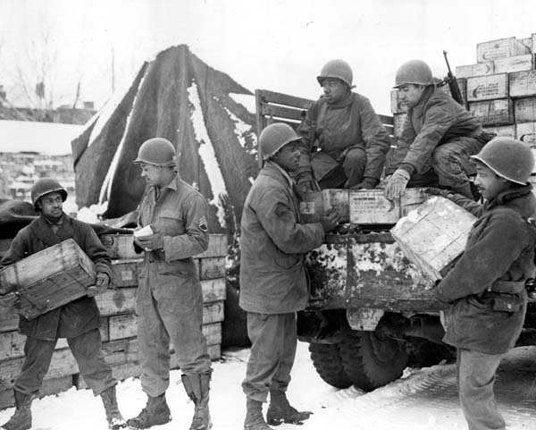
c. African-Americans were not allowed to serve in integrated units.
d. Many African American units served with distinction and were recognized for their bravery in battle, like the Tuskegee Airmen

Slide 34
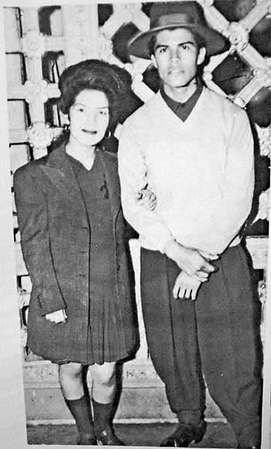
3. Mexican-Americans, particularly in California, faced segregated housing, high unemployment, and low wages.
a. Pachuco gangs of young Mexican-Americans, wearing zoot suits, challenged conformity to white standards.
Zoot Suit explanation

Slide 35
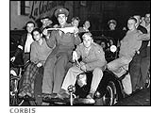
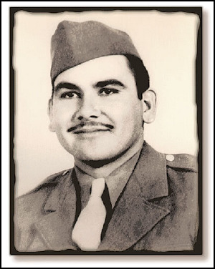
b. Zoot Suit Riots broke out in Los Angeles in 1943 as servicemen and Mexican- Americans fought for four days.
c. Many Mexican Americans also fought in the war, but not in segregated units.

Slide 36
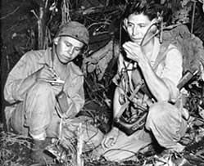
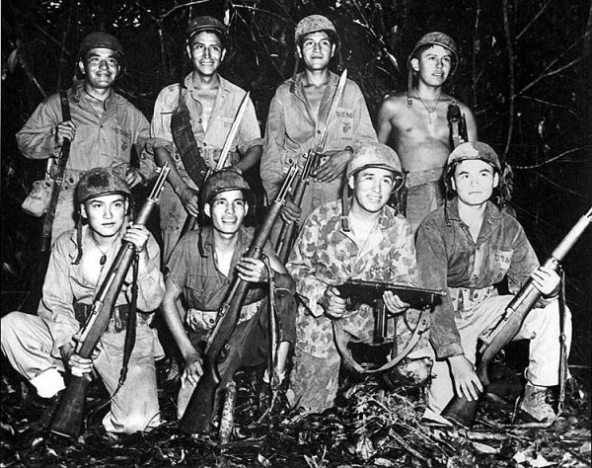
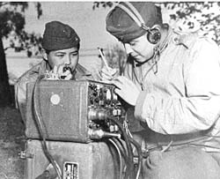
4. Native Americans served in proportionately high numbers in the military.
a. Windtalkers- The communication codes of the Navajo were used very effectively(oral, not written language; impossible for the Japanese to break).
On Iwo Jima, the Marines fought an entrenched enemy, from one end of the island to the other. During the first 48 hours on Iwo Jima, 6 Code Talkers, working 24-hour shifts, sent and received over 800 messages, all without error. Major Howard, the 5th Marines Division Signal Officer, stated succinctly that, 'Were it not for the Navajos, the Marines would have never taken the island.'

Slide 37
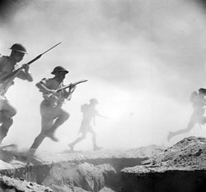
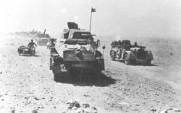
II. Major Battles and Military Turning Points
A. North Africa Mussolini had invaded the Allied colonies of Africa and Britain attempted to regain them.
1. El Alamein – German forces threatening to seize Egypt and the Suez Canal were defeated by the British.

Slide 38
2. This defeat prevented Hitler from gaining access to Middle Eastern oil supplies and potentially attacking the Soviet Union from the South.

Slide 39
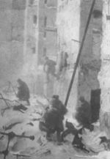
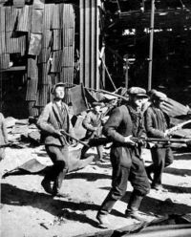
B. Europe
1. Stalingrad—Hundreds of thousands of German soldiers were killed or captured in a months-long siege of the Russian city of Stalingrad.
2. This defeat prevented Germany from seizing the Soviet oil fields and turned the tide against Germany in the East.

Slide 40
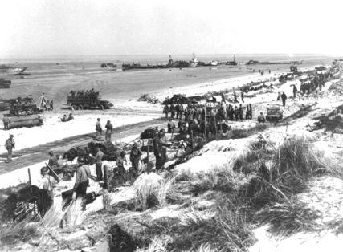
3. Normandy Landings (D-Day)—American and Allied troops under Eisenhower landed in German-occupied France on June 6, 1944.
4. Despite intense German opposition and heavy American casualties, the landings succeeded and the liberation of western Europe from Hitler had begun.
Notes:
Robert Capa [American soldier landing on Omaha Beach, D-day, Normandy, France], June 6, 1944 Gelatin silver print © Cornell Capa International Center of Photography

Slide 41
Calais
As you can see
by the symbols
most of Hitler’s
defenses were
here
Normandy
Utah
beach
Omaha
Beach
Gold
Beach
Juno
Beach
Sword
Beach

Slide 42
5. The Germans will make one major attempt to stop the Allied advance at the Battle of the Bulge.
a. The counterattack will eventually be stopped by American bombers and the troops will continue to move to Berlin.

Slide 43
6. By April of 1945 the German Third Reich was in ruins, the Soviets were occupying most of Eastern Germany and the British and Americans were right behind them.

Slide 44
a. Hitler and his closest supporters committed suicide on April 30th. The war was over.

Slide 45
C. Pacific
1. Midway—In the “Miracle of Midway,” American naval forces defeated a much larger Japanese force as it prepared to seize Midway Island in June 1942.

Slide 46
a. Coming only a few months after Pearl Harbor, a Japanese victory at Midway would have enabled Japan to invade Hawaii.
b. The American victory at Midway ended the Japanese threat to Hawaii and began a series of American victories in the “island hopping” campaign that carried the war closer and closer to Japan.

Slide 47
2. Iwo Jima and Okinawa—The invasions of the islands of Iwo Jima and Okinawa in the spring of 1945, were the first US troops on Japanese soil and brought our forces closer to mainland Japan.
a. Both invasions cost thousands of US lives and even more Japanese lives, as Japanese soldiers fought fiercely over every square inch of the islands and Japanese soldiers and civilians committed suicide rather than surrender.

Slide 49
3. Use of the Atomic Bomb—Facing huge casualties on both sides if US forces had to invade Japan itself, President Truman ordered the use of atomic bombs on the cities of Hiroshima and Nagasaki to force the Japanese to surrender.

Slide 50
a. Hundreds of thousands of people were killed in both cities.

Slide 51
4. Shortly after the bombs were used, the Japanese leaders surrendered, avoiding the need for American forces to invade Japan.

Slide 52
IV. Atrocities of War
A. The conduct of war often reflects the social and moral codes of a nation.

Slide 53
B. The treatment of prisoners of war often reflected the savage nature of conflict and the cultural norms of the nation.
1. The treatment of prisoners of war in the Pacific Theater often reflected the savagery of the fighting there.

Slide 54
a. In the Bataan Death March, American POWs suffered brutal treatment by the Japanese after the surrender of the Philippines
b. Japanese soldiers often committed suicide rather than surrender.

Slide 55
2. The treatment of prisoners in Europe more closely followed the ideas of the Geneva Convention.

Slide 56
C. The Geneva Conventions were supposed to ensure the humane treatment of prisoners of war by establishing rules to be followed by all nations- but we can see that not all nations follow them..

Slide 57
D. The Holocaust- the genocide of millions of people by the Nazis to ethnically or politically cleanse Europe.
1. “The Final Solution”—Germany debated what to do about the “Jewish question” and finally decided to exterminate all Jews.

Slide 58
2. There were many groups sent to the concentration and death camps:
a. Jews
b. Poles
c. Slavs
d. Gypsies
e. “Undesirables” (homosexuals, mentally ill, political dissidents)

Slide 59
3. The brutality of the Holocaust led to increased demand for a Jewish homeland.

Slide 60
3. Significance
a. Trials were held for War Crimes in Tokyo and in Nuremburg.

Slide 61
“What is shocking about Nuremberg is the ordinariness of the defendants: men who may be good fathers, kind to animals, even unassuming--yet committed unspeakable crimes.” -Douglas O. Linder
b. The Nuremberg trials emphasized individual responsibility for actions during a war, regardless of orders received.
Chief prosecutors for the U.S. and the Soviet Union
As Director of the Four Year Plan, Hermann Goering bore responsibility for the elimination of Jews from political life and for the destruction and takeover of Jewish businesses and property.

Slide 62
c. This first time that the actions of soldiers might be considered a crime after a war was over.

Slide 63
IV. Results of the War
A. World War II solidified America’s role as a global power and would start a series of social changes and reforms that would occupy the US for the remainder of the 20th century.

Slide 64
B. Women entered into previously male job roles as African Americans and others struggled to obtain desegregation of the armed forces and end discriminatory hiring practices.

Slide 65
C. The post-war struggle for power left the world split between communism and non-communism on a political, social and economic divide, the “Cold War”.
D. The world learned its lessons and after this war no one country was punished, instead the focus was on reconstruction and rebuilding.

