Slide 1
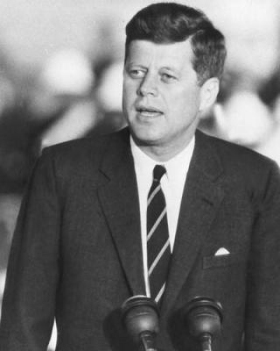
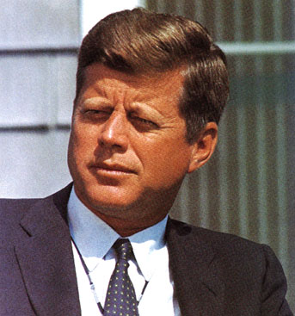
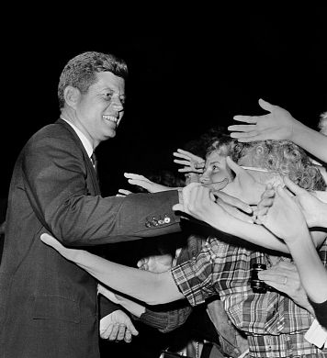
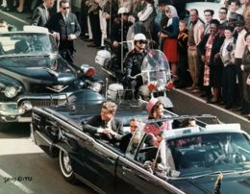
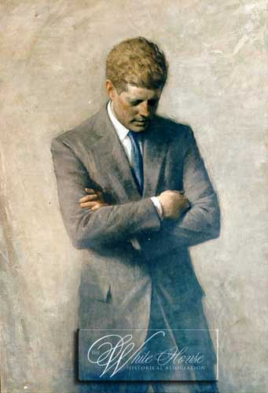
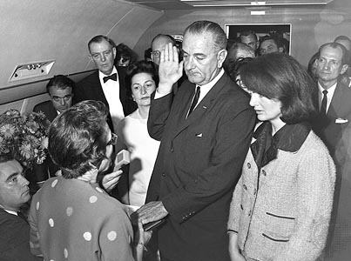
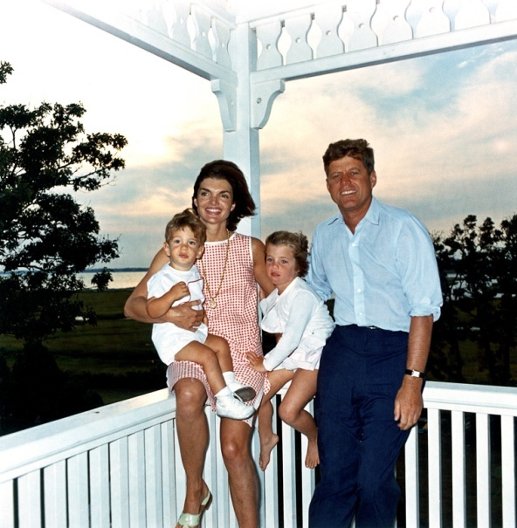
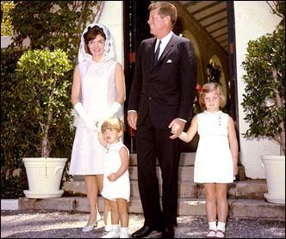
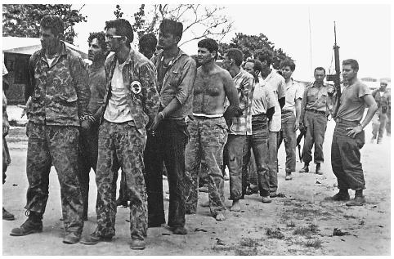
John F. Kennedy
Unit 8B: The 1960s

Slide 2
13 Days
Notes:
(11:04 to about 17:10)

Slide 3
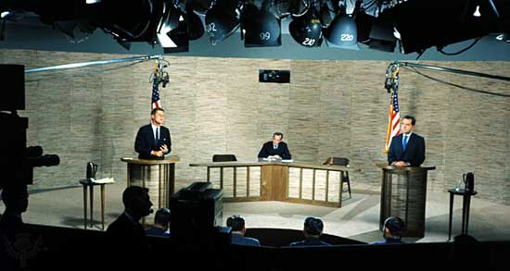
I. The New Frontier of John F. Kennedy (1961-1963)
A. JFK defeated Richard Nixon in 1960 in a very close election, partially decided by a series of televised debates.
Why was it a close race?
Kennedy was:
-43 yrs old
-youngest ever elected
-Catholic
September 26, 1960-Kennedy and Nixon square off in 1st televised presidential debate! 70 million TV viewers deemed Kennedy the winner, yet radio listeners thought Nixon won. Issue still debated.

Slide 4
Nixon-Kennedy Debates

Slide 5
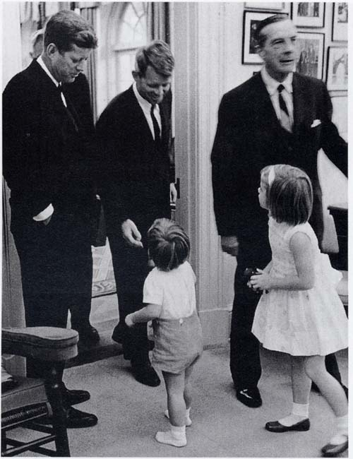
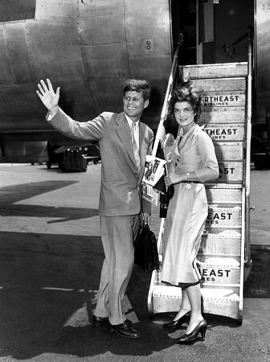
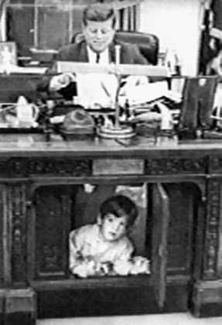
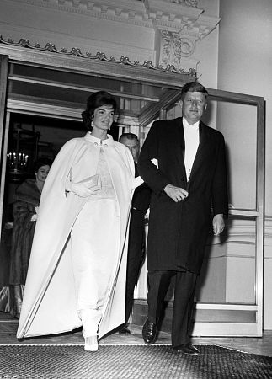
B. The nation had a spirit of optimism and “Camelot-image” that inspired Kennedy's supporters and frustrated his opponents.

Slide 6
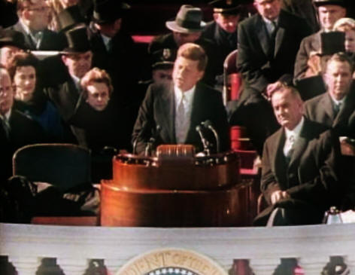
C. His inauguration speech heralded new approaches.
1. "Ask not what your country can do for you, ask what you can do for your country."
2. Promised a landing on the moon by the end of the decade.

Slide 7
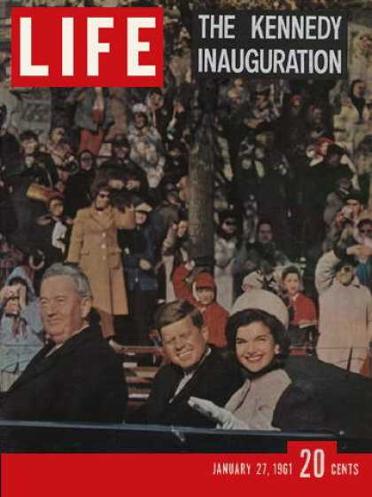
3. Strong challenge to the Soviet bloc to respect human rights.
4. Committed to ending poverty, “We pledge our best efforts to help them help themselves.”

Slide 8
JFK Inauguration January 20th, 1961 Read along with your copy of the inauguration looking for the main themes of his speech and what he does to make his speech more powerful.

Slide 9
Lyrics to “Camelot” from the Broadway musical
ARTHUR: It's true! It's true! The crown has made it clear. The climate must be perfect all the year. A law was made a distant moon ago here: July and August cannot be too hot. And there's a legal limit to the snow here In Camelot. The winter is forbidden till December And exits March the second on the dot. By order, summer lingers through September. In Camelot. Camelot! Camelot! I know it sounds a bit bizarre, But in Camelot, Camelot That's how conditions are.
The rain may never fall till after sundown. By eight, the morning fog must disappear. In short, there's simply not A more congenial spot For happily-ever-aftering than here In Camelot. Camelot! Camelot! I know it gives a person pause, But in Camelot, Camelot Those are the legal laws. The snow may never slush upon the hillside. By nine p.m. the moonlight must appear. In short, there's simply not A more congenial spot For happily-ever-aftering than here In Camelot.

Slide 10
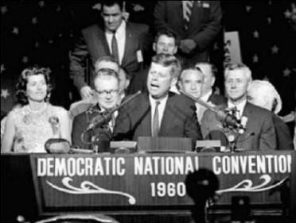
D. Success and failures of New Frontier- Kennedy’s policies
“We stand at the edge of a New Frontier—the frontier of unfulfilled hopes and dreams. It will deal with unsolved problems of peace and war, unconquered pockets of ignorance and prejudice, unanswered questions of poverty and surplus.” DNC 1960
Notes:
1. Domestic
a) Promoted economic expansion by cutting taxes and holding down prices. Economy boomed through the 1960s.
b) Many domestic programs proposed to address civil rights, Medicare, education issues. Very few actually won Congressional approval.

Slide 11
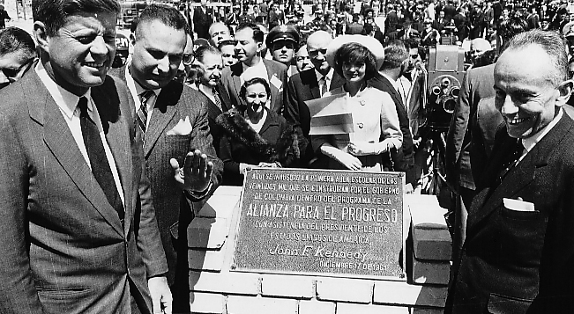
1. Foreign
a) Alliance for Progress--economic aid for Latin American nations.

Slide 12
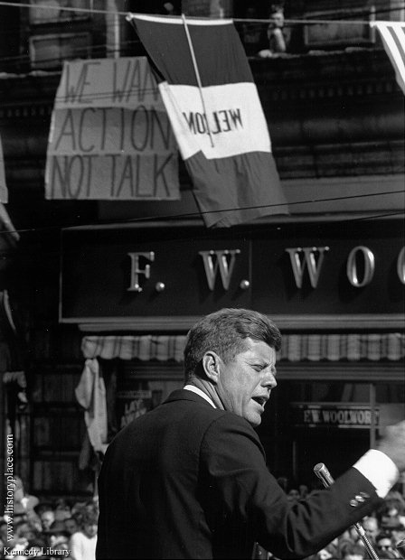
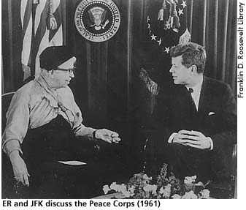
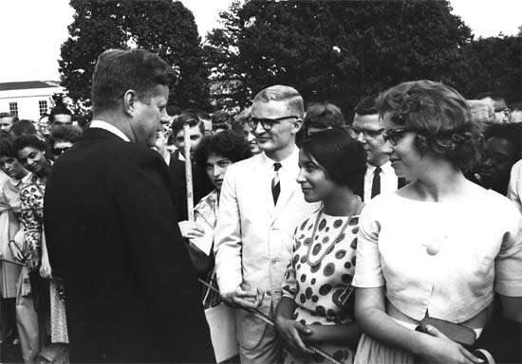
b) Peace Corps--paid volunteers 11¢ a day to assist underdeveloped nations with education, economic, and health programs.

Slide 13
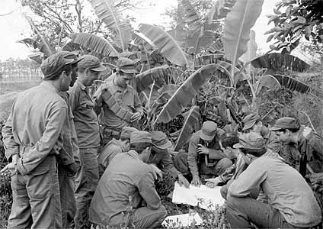
c) Bay of Pigs invasion (April 1961)-- Failed invasion by anti-Castro Cuban- Americans embarrassed JFK as the CIA had trained and financed the mission.

Slide 14
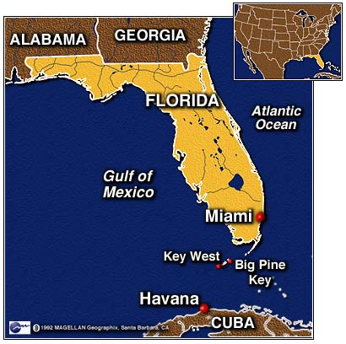

Slide 15
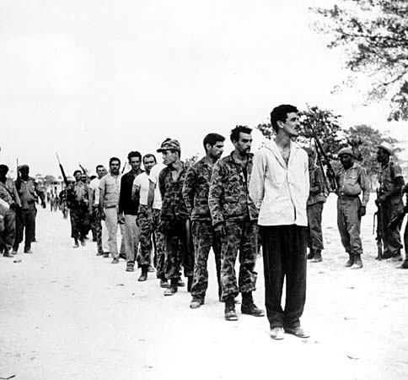
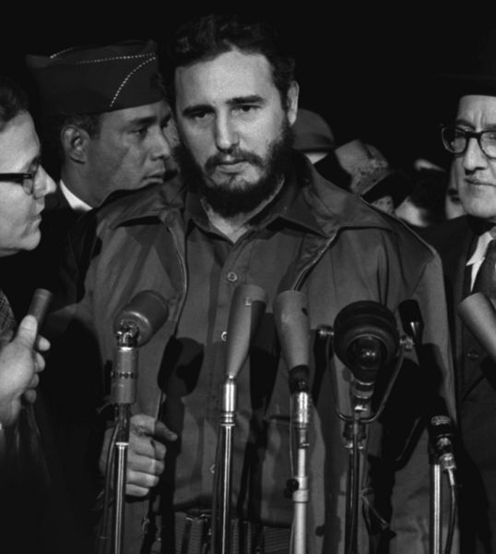

Slide 16
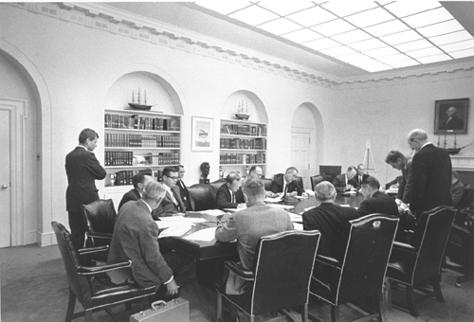
d) Cuban Missile Crisis (October 1962)- -Soviets placed offensive missiles in Cuba. U.S. used diplomatic and military pressure (embargo of ships bound for Cuba). After tense two-week period, Soviets removed missiles.

Slide 17
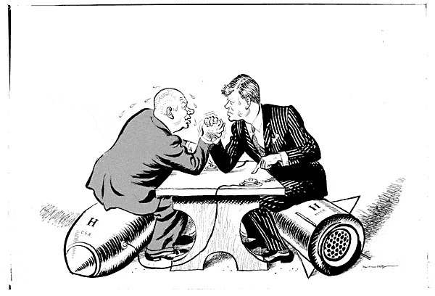
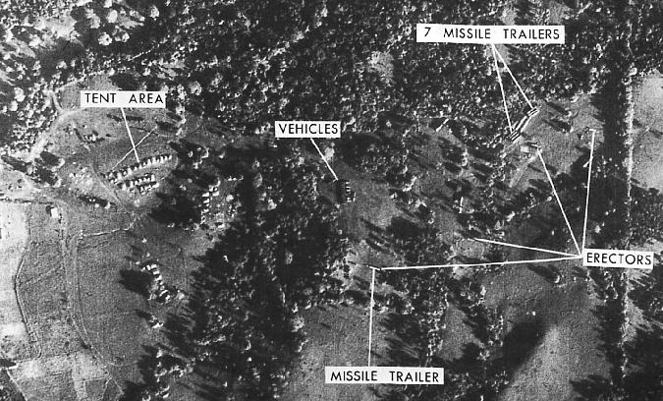

Slide 18
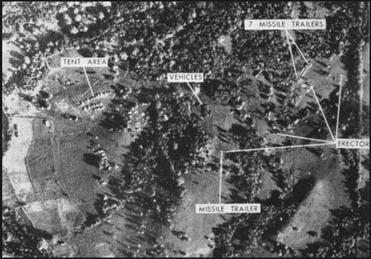
San Cristobal, Cuba Oct. 15, 1962

Slide 19
MRBM or SS4

Slide 20
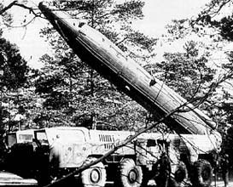
IRBM or SS5

Slide 21
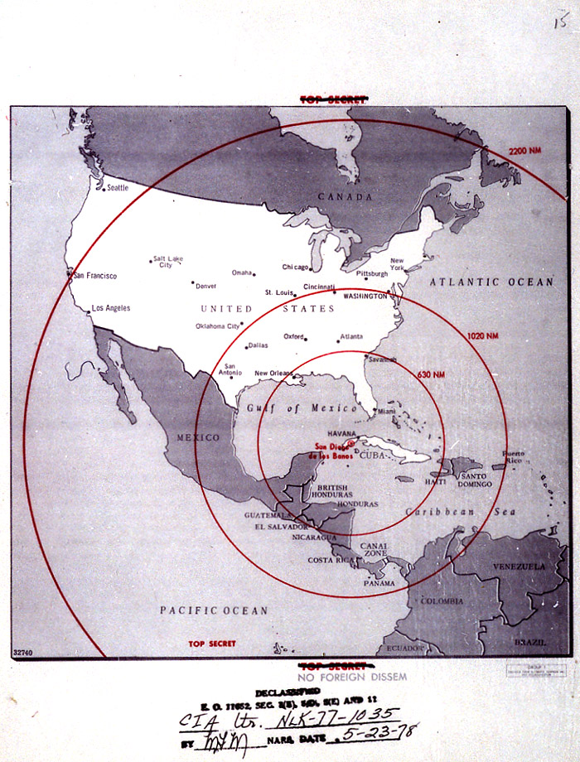
Range of missiles

Slide 22
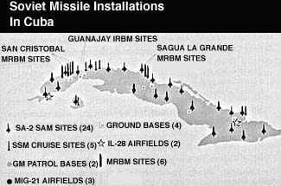

Slide 23
Air strike/invasion of Cuba
The US bombs and invades Cuba
The Soviet Union attacks and takes over West Berlin
NATO (including the US) go to war with the Soviet Union
Both the Soviet Union and the US launch their nuclear missiles against each other

Slide 24
Estimated results of Nuclear War
Each explosion produces a fireball which radiates intense light (flash) for about 10 seconds: all exposed combustible material ignites up to ranges of 2 to 5.5 miles; second degree burns to exposed skin and fires are produced up to 4 to 11.5 miles away. The atmospheric shock wave (blast) from each explosion causes partial or complete destruction of all buildings within 1 to 3 miles and causes moderate damage and 50% injuries or deaths at 3.5 to 9.5 miles in the 10 to 40 seconds following detonation.
Ten hours later, in the U.S. about 110,000,000 people have died altogether. In the U.S.S.R. about 40,000,000 have been killed.
A month later a total of 140,000,000 Americans have died

Slide 25
Diplomacy
Khrushev realizes that he can push the US without the US responding
He decides to test the US further and takes West Berlin
NATO(including the US) declare war
Both the Soviet Union and the US launch their nuclear missiles

Slide 26
Blockade-the actual decision
If you were Khrushev, how would you respond to the US blockade?
Khrushev denounced as act of war
All ships carrying missiles were turned back
Krushev sent a letter to JFK proposing that the USSR would dismantle its missiles in Cuba if the Americans removed their missile installations in Turkey.
Secret communications between both leaders led to a diffusion of the situation.

Slide 27
What Now?
Negotiations
What does the US have to negotiate?
Missiles in Turkey
Remove blockade
Promise not to invade Cuba

Slide 28
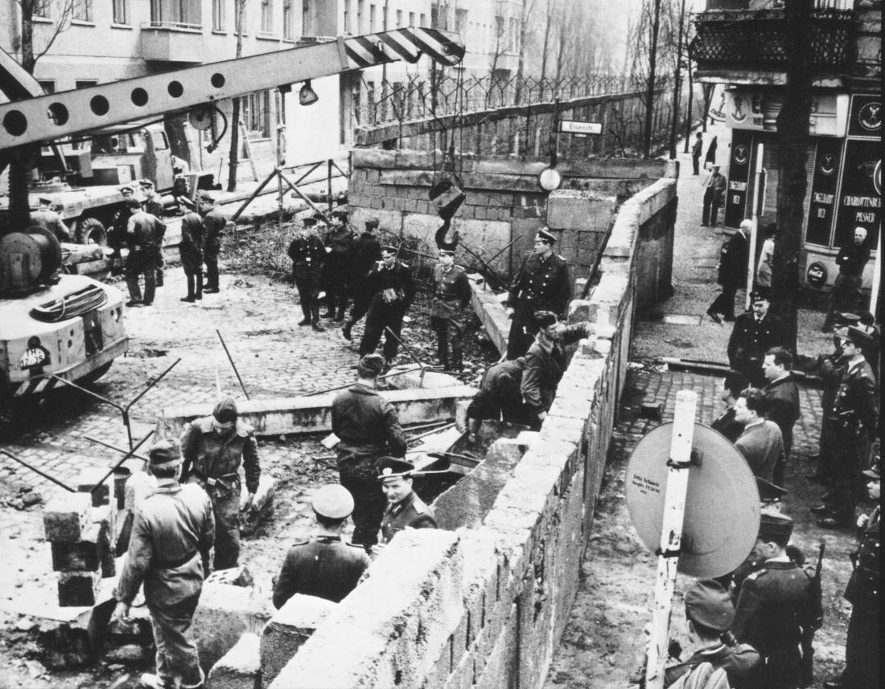
e) Berlin Visit (1962)--JFK declared "Ich bin ein Berliner" to huge crowd in a challenge to Soviet presence and response to building of the Berlin Wall ("For those who say communism is a better system, let them come to Berlin.")

Slide 29
f) Vietnam Quagmire- JFK continued Eisenhower's policy of support for anti communist forces in Southeast Asia to prevent "domino effect" of nations falling under communist control.

Slide 30
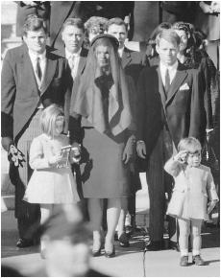
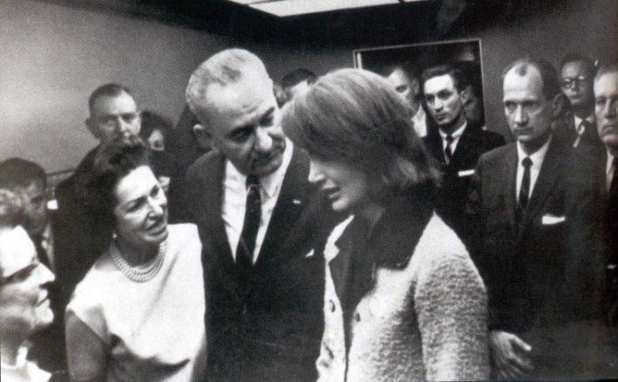
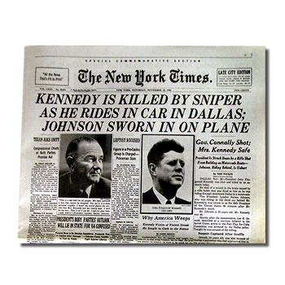
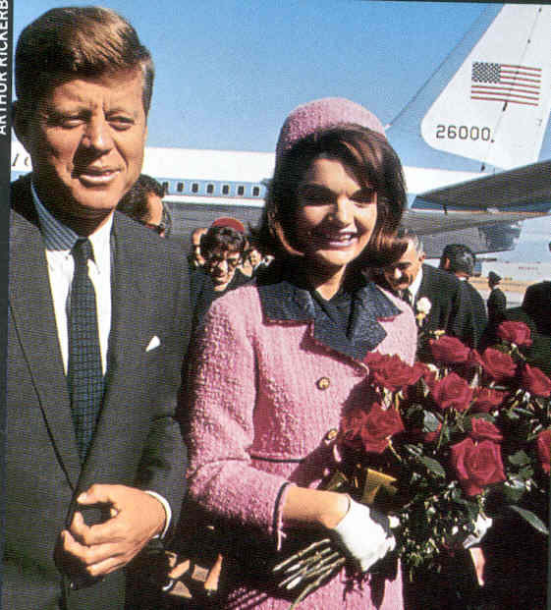
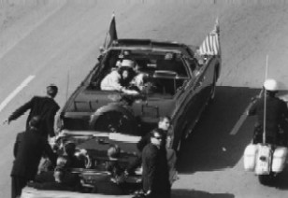
D. Kennedy's assassination (November 22, 1963) in Dallas, Texas by Lee Harvey Oswald (a pro-Castro malcontent) ended his presidency, about which historians have widely differing assessments.

Slide 31
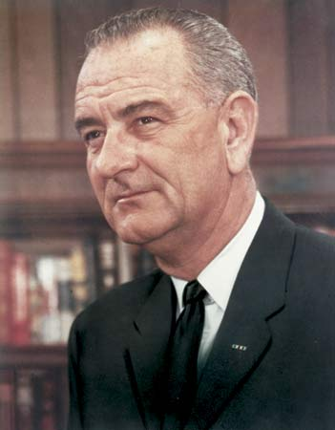
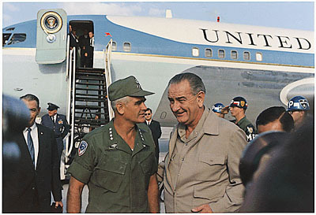
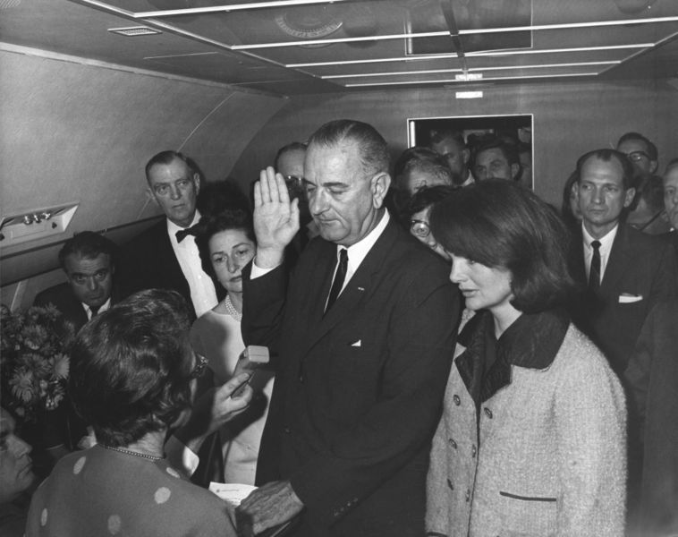
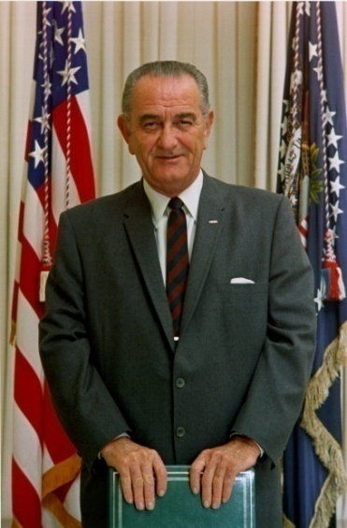
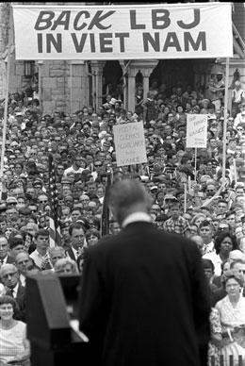
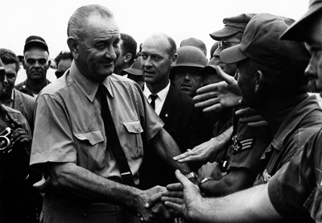
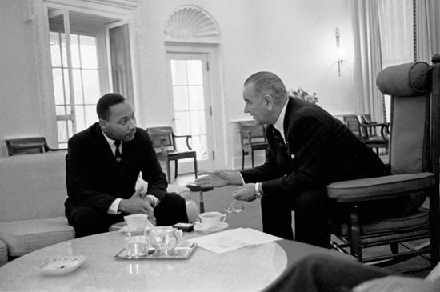
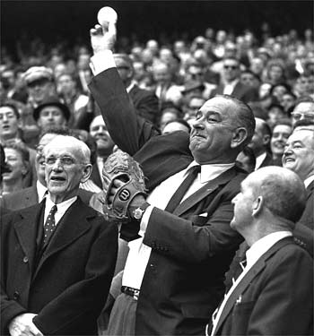
Lyndon B. Johnson

Slide 32
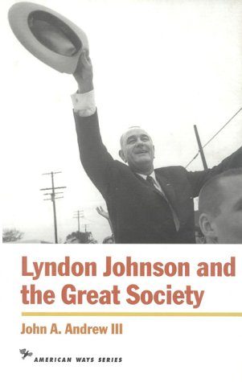
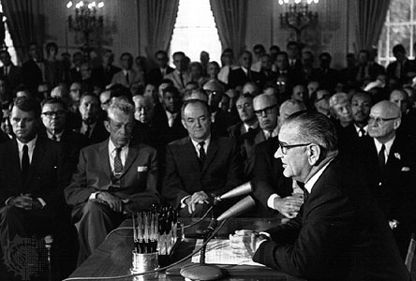
II. Johnson Presidency (1963-1969)
A. LBJ pushed through more domestic legislation than any 20th century president except FDR.

Slide 33
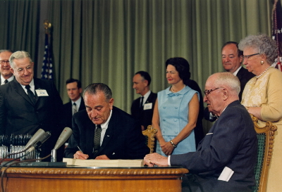
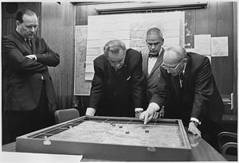
1. Declared a war on poverty and creation of a “Great Society”
a) Medicare and Medicaid programs
b) VISTA--domestic Peace Corps

Slide 34
c) New cabinet offices created in Transportation and Housing and Urban Development.
d) Head Start programs to aid underprivileged children.
e) Food Stamp aid to help poor families.

Slide 35
2. Significant civil rights legislation passed through Congress, including Voting Rights Act and Civil Rights Acts.

Slide 36
3. Martin Luther King's assassination in April 1968 further antagonized racial tensions. National Commission concluded "Our nation is moving towards two societies, black and white, separate and unequal."

Slide 37
C. Foreign problems
1. U.S. invasion of Dominican Republic to bolster pro-American dictator put down revolt but weakened LBJ's credibility in foreign affairs.

Slide 38
2. Vietnam - Because of criticism, LBJ announced on March 31, 1968 he would not seek second full term as president in 1968 election.

Slide 39
III. Countercultural Movements
A. Port Huron Statement (1962)--group of young intellectuals formed the SDS (Students for a Democratic Society)
Notes:
and set out an agenda for societal reform, that included student rights, economic justice, and anti-nuclear war views.

Slide 40
B. Free Speech Movement (1964) begun at UC Berkeley
Notes:
by Mario Savio in protest of university policies spread to other universities as general student unease focused on anti-establishment sentiments.

Slide 41
C. Radicalization of American students led to challenge to Establishment norms and laws
1. Youth culture openly scornful of middle class values.
2. Increased and public use of hallucinogenic drugs.

Slide 42
3. Rise of hippies ("tune in, turn on, drop out") led to development of communes and other counterculture movements.

Slide 43
4. Rock and folk music reflected iconoclastic views of the counter culture.
a) Rock groups such as the Beatles, the Rolling Stones, and the Doors expressed mystical approach that embraced drugs and Eastern religions as well as themes of anger, frustration, and rebelliousness.

Slide 44
b) Folk singers (Joan Baez, Bob Dylan) expressed explicit radicalism and challenged traditional mores.

Slide 45
AIM- American Indian Movement activists occupy Alcatraz for 19 months starting in November of 1969.
D. New militancy among ethnic groups (Native Americans and Hispanics) and feminists also challenged values and laws.
1. Affirmative action and university programs focused on correcting past abuses.

Slide 46
Birth Control 1960s

Slide 47
Colored Theatre Leland, Mississippi June 1937. Photograph by Dorothea Lange.

Slide 48
Title: 1960s
Write a paragraph about what you know about the 1960s. What happened? Who was involved, etc.

Slide 49
Title: On the Brink
For 14 days in 1962, the US and the USSR teetered on the brink of nuclear war. Soviet leader Khrushchev positioned Soviet missiles in Cuba, and US President John F. Kennedy demanded that the Soviets withdraw them. Both sides seemed ready to start a nuclear war.
Imagine that you are either an American or a Russian student during the Cuban missile crisis. Write a diary entry about what you’re feeling.

Slide 50
Title: Against Poverty
President Lyndon Johnson launched what he called the War on Poverty.
If you were in charge of war on poverty, what would you do?
What measures would you take to combat poverty?

Slide 51
Title: Lunch Counter Protest
In 1960, a few black college students protested against segregated restaurants by staging a sit-in at a lunch counter in Greensboro, North Carolina. The nonviolent tactic proved effective.
What other nonviolent protest tactics can you think of?
Which do you consider most useful?
Which would you employ if you wanted to protest something?
Explain your answers.

Slide 52
Title: Wallace for Segregation
In June of 1963, Alabama Governor George Wallace stood in the doorway an Alabama university to physically prevent two African-American students from entering the school. The governor actually proclaimed, “Segregation now! Segregation tomorrow! Segregation forever!”
Write a letter to Governor Wallace criticizing his position on segregation.

Slide 53
Title: Vote
During the 1960s, civil rights activists traveled throughout the South to help citizens register to vote. President Lyndon Johnson aided the Civil Rights Movement by sending federal voting registrars to the South and by pushing through legislation that outlawed literacy test for potential voters.
Minority citizens already had the right to vote, so why do you think civil rights activists had to work so hard to get out the vote?

Slide 54
Title: Hippie Culture
During the 1960s, a counterculture emerged in the United States unlike any the country had seen before. Hippies and students across the country questioned authority, pushed social boundaries, and explored new religions and philosophies. These new attitudes were reflected in the music, art, and fashion of the era.
How did the counterculture impact society and culture then and now?

