Slide 1
Cold War Unit 5B

Slide 2
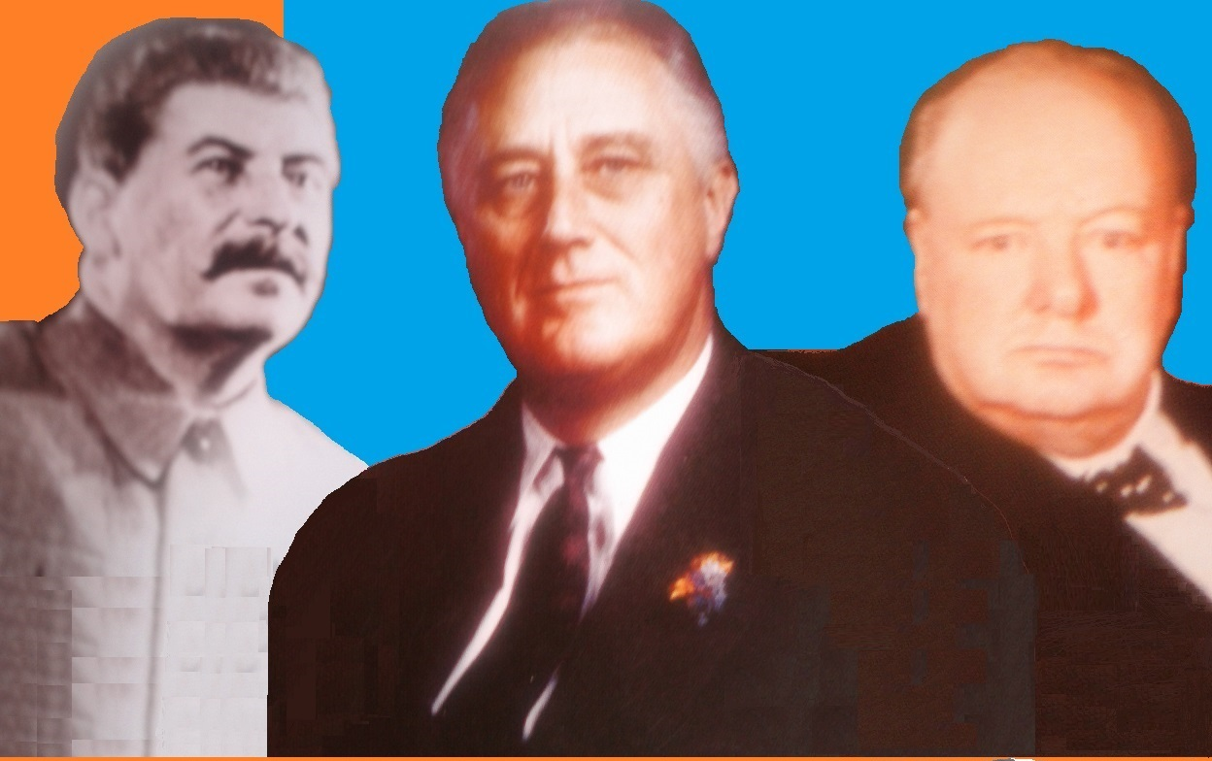
I. Opposing Perspectives
A. Alliance of BR & U.S. with U.S.S.R during WWII was pragmatic
Notes:
They needed to defeat Germany.
After WWII we were determined to be mightier than the U.S.S.R.
We spent huge sums of money on our our military forces
Huge stockpiles of weapons (more than enough to blow up he world)

Slide 3
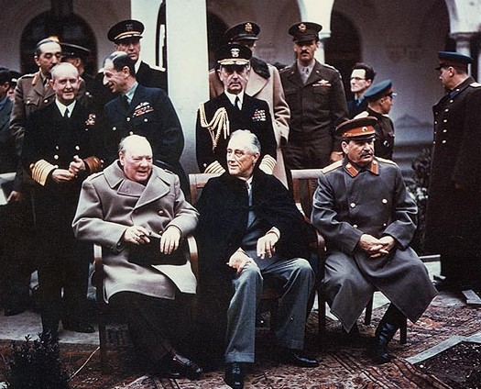
Yalta Conference 1945
1. The West didn’t trust Stalin.
2. Soviets & U.S. are the only powerful nations left.
Notes:
Neither Churchill nor FDR told Stalin about the atomic bomb.
All other nations were weakened by the war

Slide 4
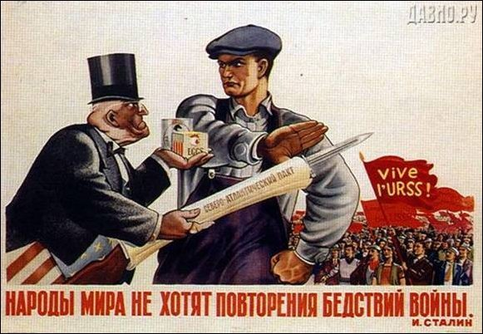
B. Communist leaders feared capitalist nations.
Notes:
1.They expected a natural progression of European and then world domination by communism. 2. Communists hoped for a collapse of capitalist economies and societies.
While “Communism” was still being established, the major fear was that the “infected” would cause damage to the still fragile “new order” within the communist state. A person with affiliation to Capitalism would become a spy, he would export state secrets or actually damage equipment, and of course spread “capitalist vices” amongst the population.
This poster is of a Soviet worker refusing to fall for the temptations of American Capitalism. A major fear for the Soviet Union.
In those times the general population in the East did indeed fear “capitalism”, as it was seen as a damaging force within their everyday life. For example, a factory breakdown would often be attributed to a spy damaging the equipment. Same for a crop blight, etc.
To counter this growing affection for “western joys”, the political leaders started to emphasize on the negative issues of capitalism, such as racism, unemployment, the homeless, the street violence, and of course the nuclear threat and general warmongering.

Slide 5
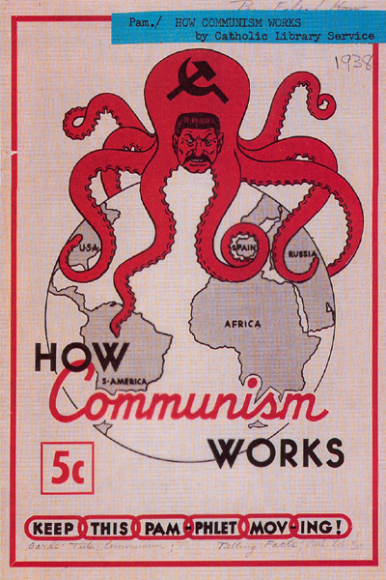
C. Comparison of the Soviets and the U.S.
1. U.S. & U.S.S.R. are both continental-size powers.

Slide 6
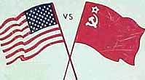
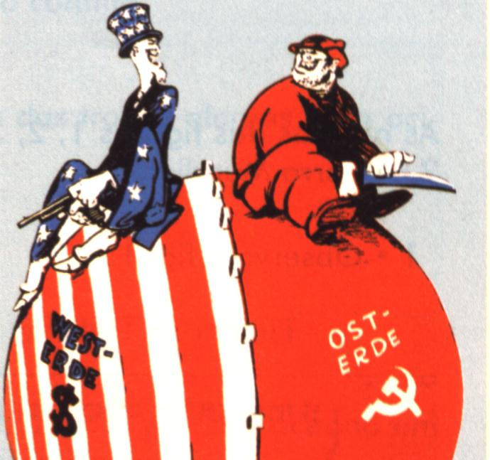
2. Very different political systems:
a. U.S. gov’t is decentralized & liberal
vs. U.S.S.R gov’t t is centralized and
authoritarian.

Slide 7
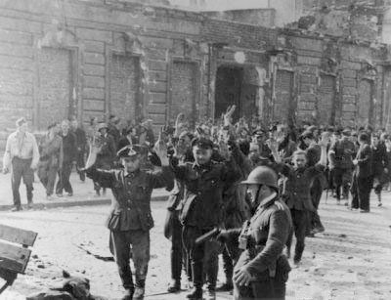
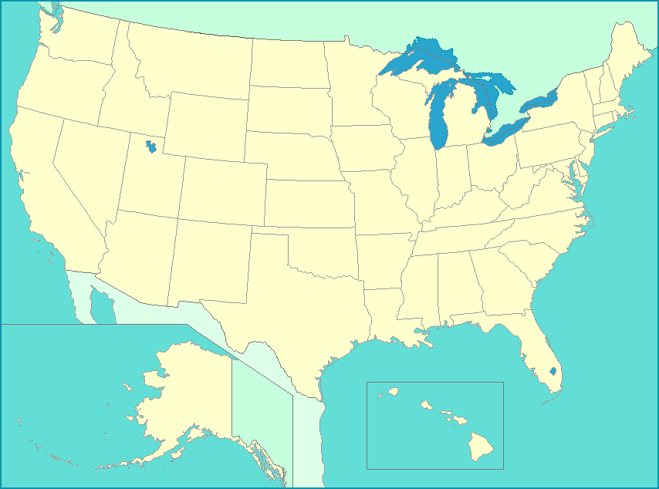
3. Very different attitude towards foreign relations:
Notes:
The U.S. is protected by an ocean and didn’t fight either World Wars on their home soil.
b. The Soviet Union was invaded twice in the twentieth century by Germany and suffered devastating losses to their armies and civilians.

Slide 8
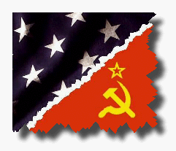
4. Opposing economic ideologies:
a. U.S. is the foremost capitalist power vs. Soviets communist policies.

Slide 9
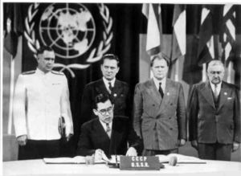
II. United Nations Formed
A. U.S., BR, China, and U.S.S.R. met in 1944 to discuss plans for new organization to replace League of Nations .

Slide 10
B. In April 1945, the San Francisco Conference formed United Nations. 1. Security Council (10 members) with veto power plus permanent seats for 5 major powers (U.S., FR, BR, China, and U.S.S.R.) and a Secretary-General, to handle day-to-day affairs.
Notes:
2. General Assembly with delegates from each nation. Three votes to USSR as result of Yalta Conference promise
3. International Court of Justice to deal with legal disputes between members

Slide 11
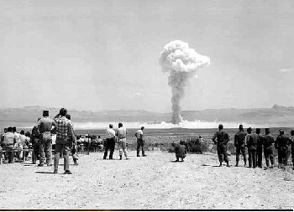
III. Confrontation in Europe
At the end of WWII, not every country demobilized
1. The U.S. has a monopoly on atomic weapons
Notes:
There were perceptions of a military threat:
We continued nuclear testing after the war is over.
2. The Soviets continued to maintain the largest army in the world, occupying Eastern Europe.

Slide 12
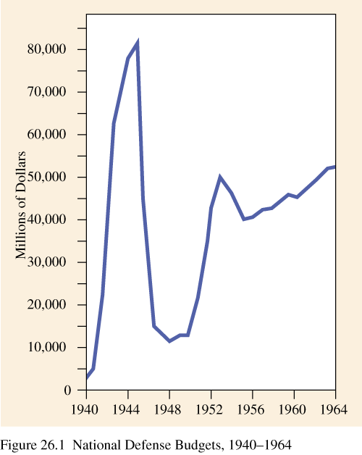
American Defense Budget [1940-1964]

Slide 13
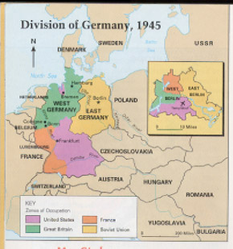
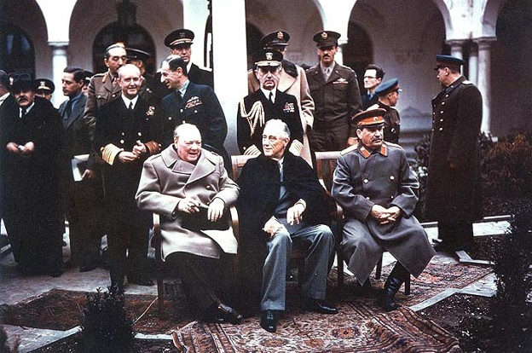
B. Yalta Agreement (Feb. 1945) divided Germany into occupied zones, intended to be temporary, but became permanent.
Notes:
B. Once the war was over, each side went back to distrusting each other and further agreements were very difficult. (1945-1946)
2. There are sharp disagreements between U.S., U.K., and U.S.S.R. over selection of postwar government in Poland.

Slide 14
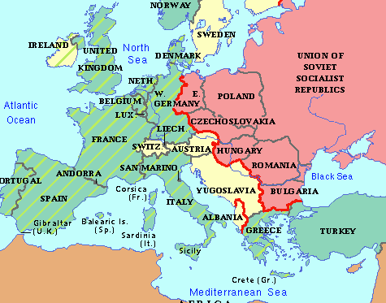
C. Actions on both sides (1946-1949) increased tension:
1. Europe is split along ideological lines, an "iron curtain" is established from Stettin to Trieste.
Notes:
In 1946 Truman asked Churchill to speak at Westminster College in Fulton, Missouri
Churchill warned of a dangerous dictators and an ominous form of gov’t
Iron curtain blocked truth and freedom
2. Soviets initially refused to withdraw their military from Iran until pressured through diplomatic action in the UN Security Council.
3. CIA involved in Italian elections to assure the defeat of the Italian Communist Party.
4. Soviets pressure Turkey; demanding access for warships through the Bosporus Straits.
5. British, facing serious economic problems, withdrew from Greece, where the government they supported faced a Greek Communist guerilla movement aided by Yugoslavia.

Slide 15
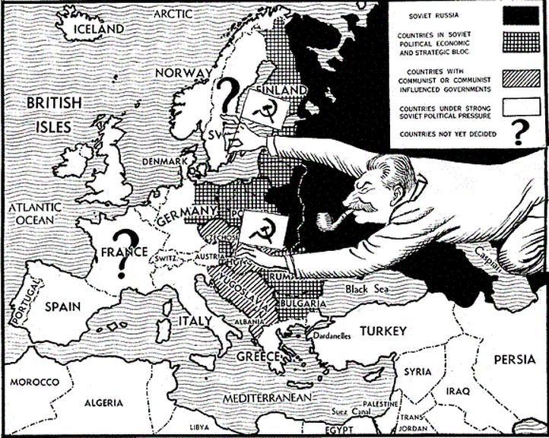
2. The U.S. announced the Truman Doctrine to contain Communism all over the world.
3. U.S. commenced the Marshall Plan aid to war-torn Europe in 1948. Soviets refused to cooperate.
Notes:
Allied nations promised to help liberate allies, hold open elections and form free govt’s. Allied armies left after stability was in place.
Russia wouldn’t leave→Poland, Romania, Bulgaria, Czechoslovakia, Latvia, Lithuania, Estonia, E. GR
2. We gave aid ($$ and food) to Greece and Turkey to keep them from becoming communist.
3. a. W. European economy began to recover, while E. European economy stagnated.
Truman said, “You can’t be vindictive after a war. You have to be generous. You have to help people get back on their feet. People were starving, and they were cold bc there wasn’t enough coal, and TB was breaking out. There had been food riots in FR and IT. We were in a position to keep people from starving and help them preserve their freedom and build up their countries and that is what we did.”
IT & FR saw the communist party get strong.
b. A "Brain Drain" through Berlin threatened E. European economy. Soviets tried but failed to re-open Berlin treaty arrangements which divided the city into occupied sectors.

Slide 16
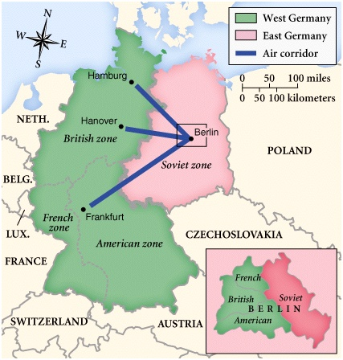

Slide 17
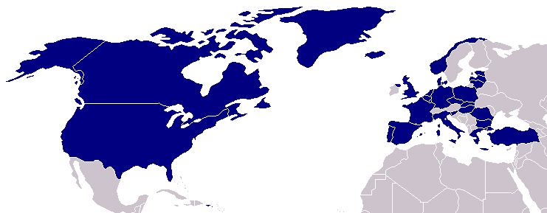
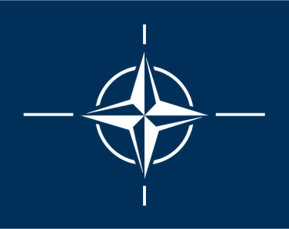
North Atlantic Treaty Organization (1949)
United States
Belgium
Britain
Canada
Denmark
France
Iceland
Italy
Luxemburg
Netherlands
Norway
Portugal
1952: Greece & Turkey
1955: West Germany
1983: Spain

Slide 18
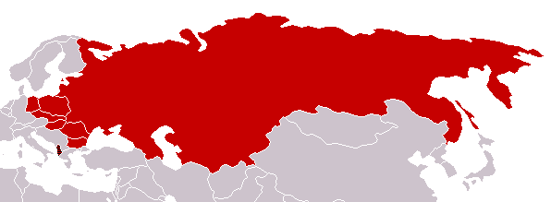
Warsaw Pact (1955)
U. S. S. R.
Albania
Bulgaria
Czechoslovakia
East Germany
Hungary
Poland
Romania
Notes:
Stalin bragged the whole world would eventually go communist.

Slide 19
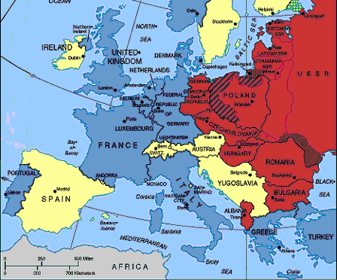
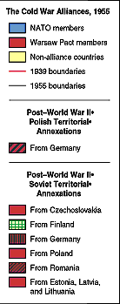

Slide 20
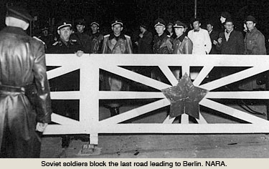
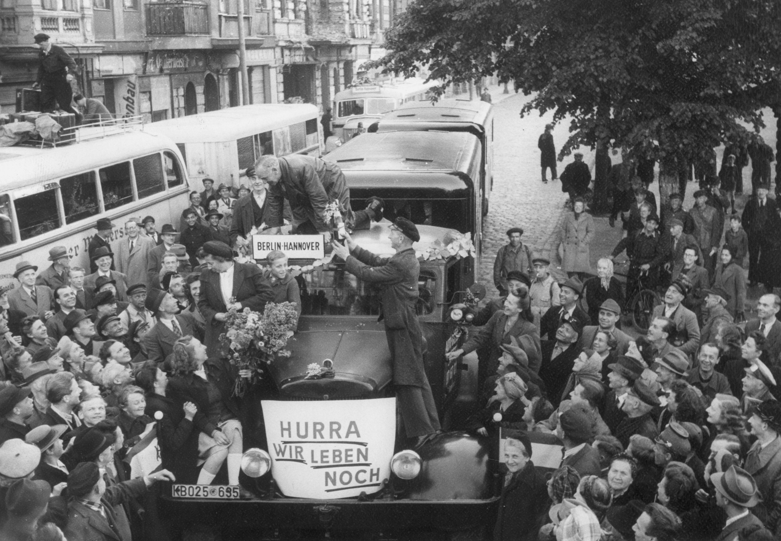
4. In June 1948, the Soviets blockaded West Berlin and halted all traffic into the city.

Slide 21
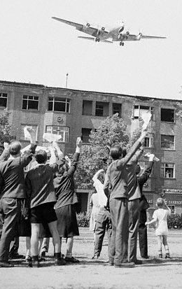
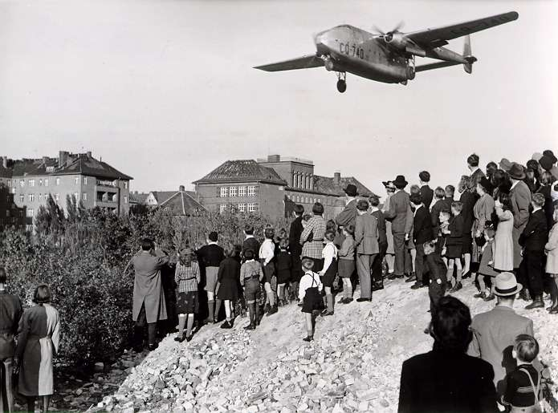
Berlin Blockade & Airlift (1948-49)
Notes:
The former Allies (U.S., France, and England) responded by airlifting massive amounts of food, coal, and other supplies to keep West Berlin open.
2. After 11 months, the Soviets backed down and allowed rail traffic to resume

Slide 22
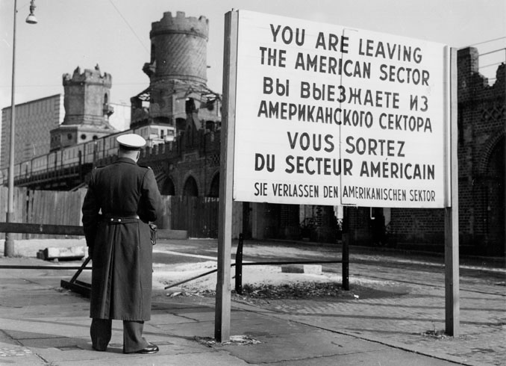
8. The geography and ideology of E. vs. W. Europe was sealed in August,1961 when Berlin wall was built.
Notes:
a. Early in the morning of August 13th the East Berlin government constructed a barbed wire fence and established guard posts.

Slide 23
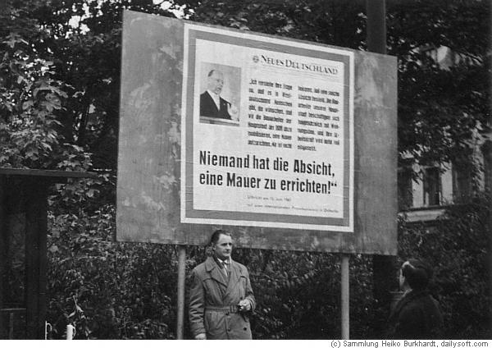
E. German gov’t, “We have no intention building a wall.” 1961

Slide 24
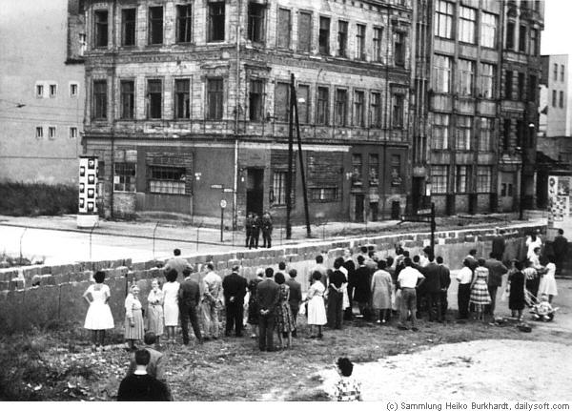
West Berliners watching the wall go up,
Notes:
b. Within a few weeks the fences are replaced with concrete and steel walls that will remain a visible symbol of the Cold War.
c. When the Berlin Wall is pulled down by the people of Germany in 1989 it signals the end of the Cold War, and of communism in Europe.
Most people didn’t stay behind the iron curtain willingly. At every Soviet border, armed guards kept people captive.
Hungary & Yugoslavia rebelled, but opposition leaders were killed and Communist party remained in power.

Slide 25
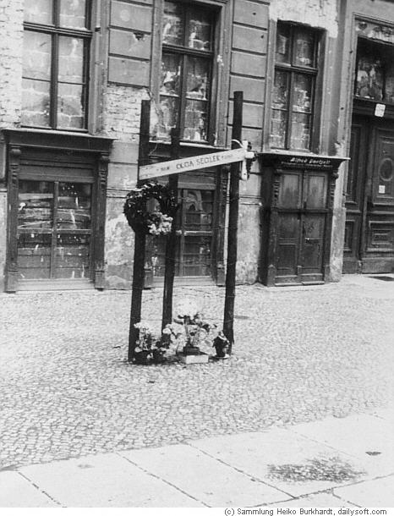
Memorial to Olga, who died when attempting to escape
Notes:
Olga Segler was born to parents of German descent in 1881 in a town called Prischt that later belonged to Ukraine. No other official documents providing information about her life exist. She was eighty years old in 1961 and lived at Bernauer Strasse 34, near Brunnenstrasse, in the East Berlin district of Mitte.
Her building, like the other ones on that side of the street, formed the border to the western part of the city. Consequently, the elderly woman found herself in an unusually precarious situation when the border was sealed on August 13. For one, she was separated from her daughter, who lived just a short distance away on the West Berlin side of the sector border.
Moreover, she experienced the East German authorities’ increasingly ruthless treatment of Bernauer Strasse residents. For almost six weeks Olga Segler endured life in a barricaded building with watch guards posted in the corridors and staircases to prevent people from escaping to the West. They monitored the movement and behavior of the residents 24 hours a day.
According to an East Berlin situation report, in September 1961 the most common method of escape included “jumping from apartment buildings located directly on the state border into rescue nets held by the fire department, or roping down the fronts of buildings.”[2]
Within the first three months after the Wall was built, more than 150 people reached the neighboring West Berlin district of Wedding through escapes of this kind. Many were injured during the dangerous undertaking and had to be treated by a doctor.[3] The first fatality occurred on August 22 when Ida Siekmann, a 58-year-old woman, was fatally injured while jumping from her apartment.
Olga Segler decided to jump from the window of her second story apartment on September 24. Her daughter waited down below on the sidewalk, encouraging her to jump. The firemen caught the eighty-year-old woman in their rescue net but she injured her back on impact and had to be taken by ambulance to the nearby Lazarus Hospital. Olga Segler died the next day.[6] Her heart had given out as a consequence of the overexcitement she experienced during the escape.[7] The East German authorities registered Olga Segler’s escape attempt as a “border breach,” and the official report referred to her successful “flight from the republic.”[8] Believing that the fatally injured old woman had survived, they opened an investigation against her.[9] Meanwhile, on the other side of the Wall, Olga Segler was being publicly mourned. Her funeral was held at the municipal cemetery in Berlin-Reinickendorf. A memorial was dedicated at the site of her fall in November 1961.

Slide 26
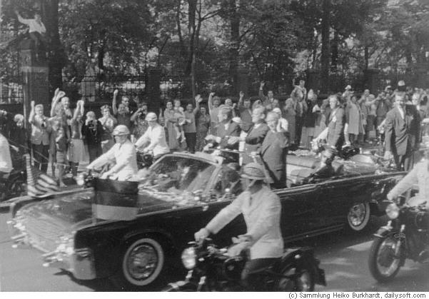
JFK in 1963

Slide 27
Ich Bin Ein Berliner

Slide 28
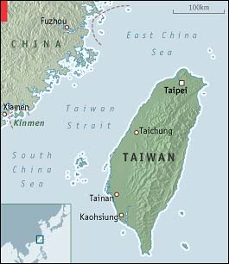
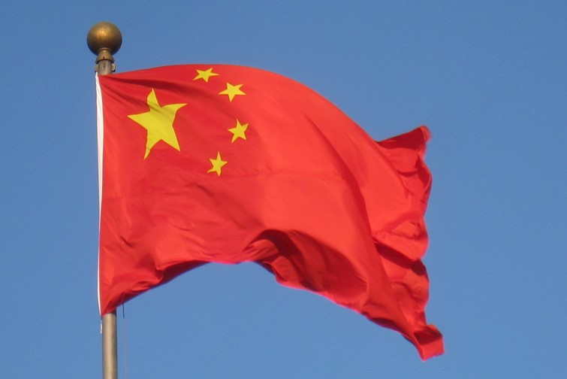
IV. Confrontation in Asia (1945-1949)
A. Chinese Communists, led by Mao Zedong, defeated the Kuomintang nationalists) in a civil war.
Notes:
The Nationalists retreated to the island of Taiwan and set up an independent China.
U.S. sent a naval fleet to prevent the invasion of Taiwan by mainland Communist Chinese.
2. China negotiated a 10-year treaty of alliance and aid with their fellow communists, the Soviets.

Slide 29
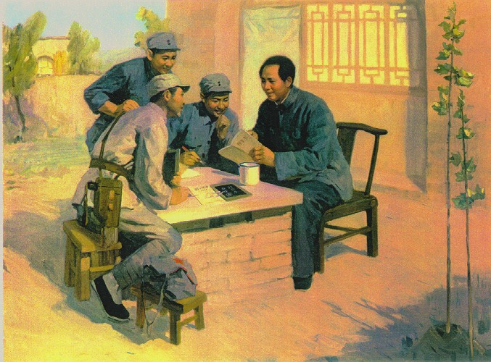
Mao’s Revolution: 1949
There is now a second Communist power in the world

Slide 30
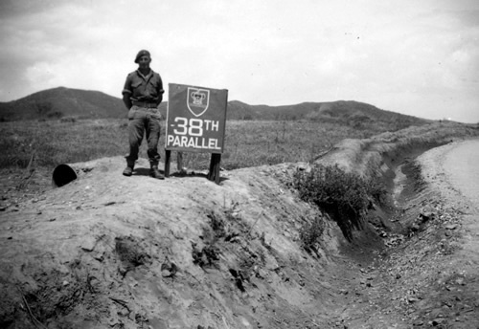
B. U.S. occupied Japan and southern Korea at end of World War II.
1. Soviets occupied northern Korea. Korea was divided at 38 degrees north.

Slide 31
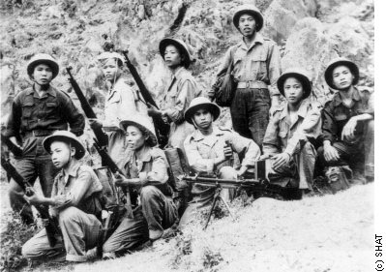
C. Vietnamese Viet Minh, proclaimed the independence of Vietnam (communist).
1. FR attempted to restore colonial rule over Indochina (Vietnam)
Notes:
C. After the withdrawal of the defeated Japanese at the end of WWII.
1. A war between the French and the Viet Minh broke out in November, 1946. The U.S. was not involved.

Slide 32
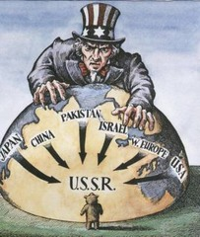
V. American Reaction to Communism
A. The United States had internal disagreements over how to treat communism:

Slide 33
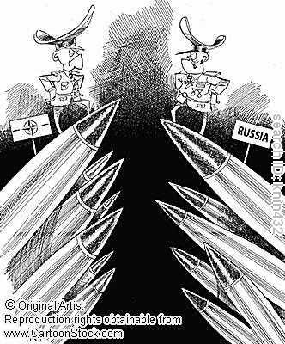
1. “Containment” of Soviets
2. National Security Council called for a military buildup.
Notes:
2. Defined the threat as a military threat by the "Communist Bloc”

Slide 34
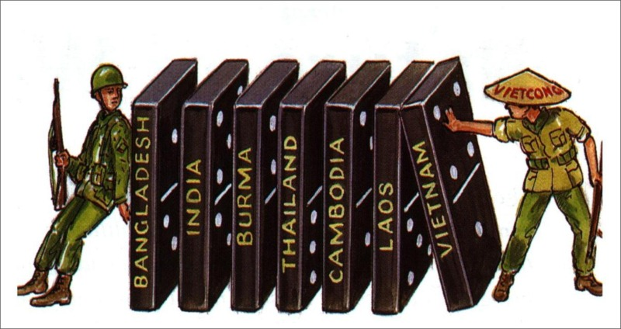
3. The domino theory
Notes:
- if one country falls to communism, it is likely that its neighbors will too, just like dominoes.

Slide 35
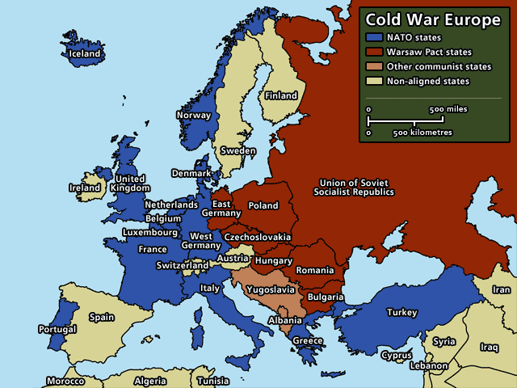

Slide 36
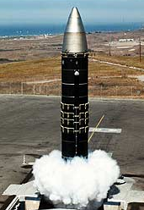
The Arms Race: Was there a
“Missile Gap?”
Two nuclear superpowers after U.S.S.R. tested their first bomb in 1949
Notes:
C. In 1949, Soviets conducted their first atomic test explosion. President Truman decided to go ahead with H-bomb development.
DOT GAME WITH STUDENTS

Slide 37
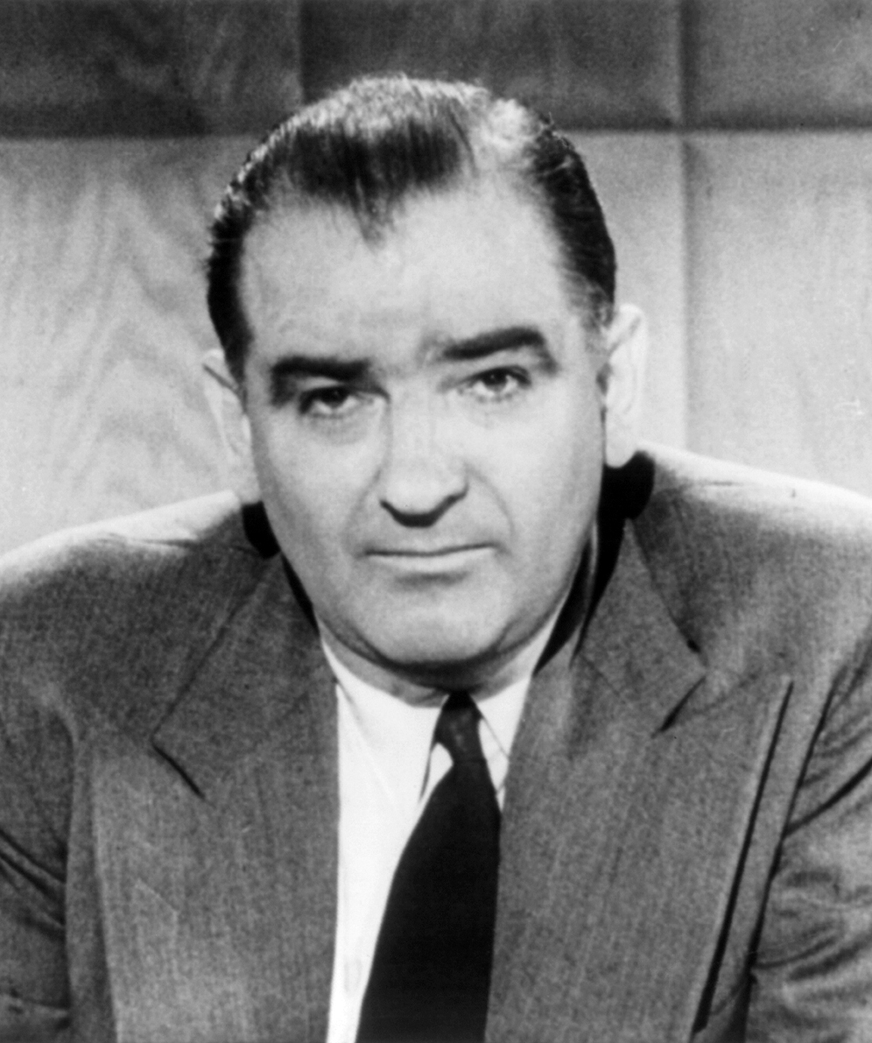
B. Growing fear of an alleged Communist conspiracy in US led to McCarthy "witch hunt".
Notes:
1. Loyalty checks of government workers began in 1947 because of fear of communist infiltration.
2. Sen. Joseph McCarthy began to speak out against communist influence in the government with a speech in February 1950 in which he contended that the State Dept. was riddled with communists

Slide 38
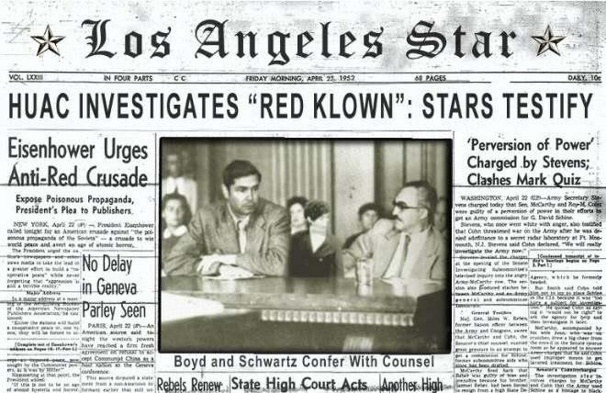
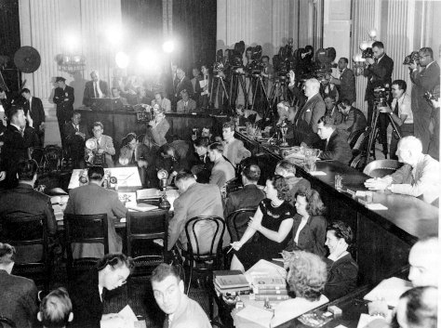
1. House Un-American Activities Committee
Notes:
held numerous public hearings and ruined reputations of blacklisted individuals, including many from TV, radio, and the movies.

Slide 39
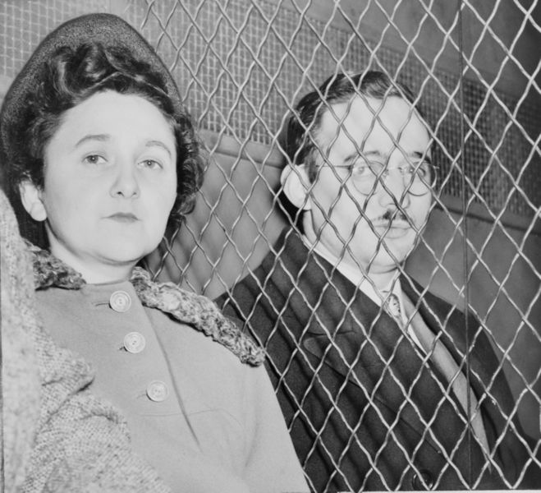
2. Ethel and Julius Rosenberg arrested, tried, and executed in 1951 for providing atomic secrets.

Slide 40
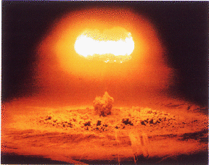
VI. Nuclear Arms Race (1950-1961):
The first test of an H-bombby U.S. in 1952
Soviet tested one year later.
Notes:
Explosive yields now 50x that of Hiroshima bomb.
B. The continued testing of H-bombs by both the U.S. and Soviets begins to raise global radiation levels and pose a serious health risk.
1. England successfully tested its first nuclear weapon in 1952.
2. Anti-nuclear protests began in England and spread to the U.S.

Slide 41
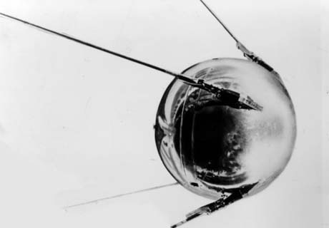
Sputnik I (1957)
The Russians have beaten America into space—they have the technological edge!
Notes:
C. Soviets launched the first artificial satellite, Sputnik, in 1957, demonstrating their capability to develop ICBM’s.

Slide 42
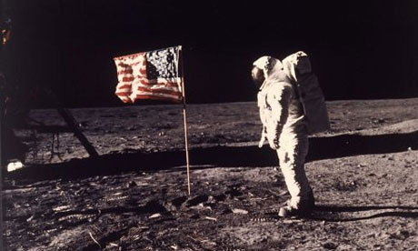
C. The U.S. is farther ahead with bomber delivery systems
D. We land a man on the moon in 1969.
Notes:
The government accelerated missile development in reaction to Sputnik,

Slide 43
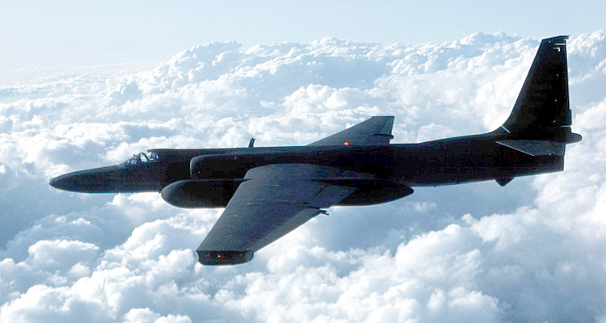
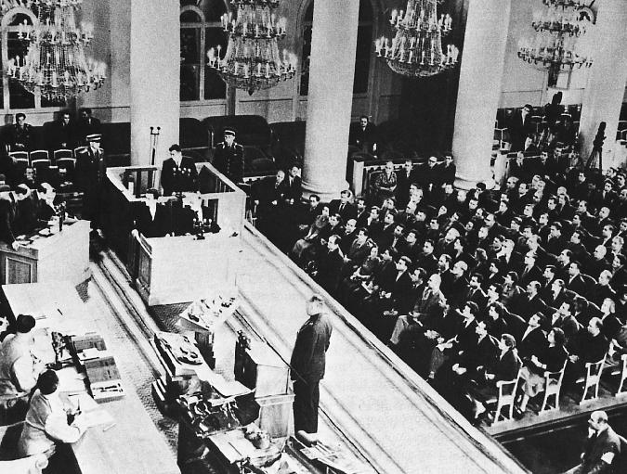
U-2 Spy Incident (1960)
Col. Francis Gary Powers’ plane was shot down over Soviet airspace.
Notes:
In 1960 a U.S. U-2 spy plane shot down over the Soviet Union, heightened tensions, and prevented a once-promising negotiating effort.

Slide 44
VII. The Cold War Turns Hot- Korean War (1950-1953)
A. Gov’t in northern Korea (an ally of the Soviets), & in southern Korea (a U.S. ally), both tried to re-unite Korea under their leadership.

Slide 45
The Korean War: A “Police Action” (1950-1953)
Kim Il-Sung
Syngman Rhee
“Domino Theory”

Slide 46
Notes:
B. North Koreans were well-supplied militarily by the Soviets. The U.S. had not built up the South Korean army. Northerners invaded the south in June 1950.
C. U.S. intervened militarily and sought a UN Security Council resolution to condemn the actions of North Korea.

Slide 47
C. Soviets boycotting the UN Security Council
1. Soviets not present to veto, so the U.S. effort gained UN support.
Notes:
C. Boycott over the issue of admitting the mainland Chinese government as the representative of China in the UN.

Slide 48
D. U.S. went to war without a Congressional Declaration of War as required by the U.S. Constitution. How? President Truman called it a “police action.”
Notes:
F. U.S. turned the tide of war, advanced into North Korea and approached the Chinese border.

Slide 49
E. China intervened because they felt threatened by the U.S. presence on their border with Korea.
Notes:
1. The U.S. was thrown back to the vicinity of the 38th parallel, where the fighting continued.
2. A war of attrition, with U.S firepower pitted against Chinese manpower, was ended by a cease fire in 1953.

Slide 50
The Shifting Map of Korea [1950-53]

Slide 51
I. Consequences of the Korean War:
1. A permanent peace settlement was not achieved. U.S. military & South Korean army have manned a fortified cease fire line to this date.
Notes:
2. Korea was devastated by the war. Millions of lives were lost. Unification of Korea was postponed indefinitely.
3. A global arms race and military buildup by the U.S. bloc and the Soviet bloc was greatly stimulated.
4. U.S. changed its policy towards Vietnam, beginning to give aid to the French.

Slide 52
VIII. The Background of Vietnam (1946-1954)
A. The Viet Minh waged guerilla war to gain independence from FR.
1. 1950, France received aid from the U.S., and Viet Minh received aid from China.
Notes:
B. France was ready to negotiate a withdrawal after their defeat at Dien Bien Phu, a besieged outpost in the interior of northern Vietnam.
C. The Geneva Treaty (1954) provided for temporary division of Vietnam at 17˚ north. The French and allies to the south, and the Viet Minh in the north. In 1956, nationwide elections were supposed to re-unite Vietnam, and the French were to withdraw completely.

Slide 53
IX. Vietnam War (1954-1975) Repression and a Police Action
A. The U.S. supported Ngo Dinh Diem as ruler in the south.
Notes:
Diem refused to allow elections in the south in 1956 because Ho Chi Minh, the communist Viet Minh leader, was expected to win.
A Vietnamese independence movement, the National Liberation Front, had popular support in the south and fought to gain independence.
2. The U.S. supported Diem until his government was overthrown by the generals of the southern Vietnamese army in November, 1963.

Slide 54
B. In spite of growing U.S. involvement, the NLF was on the verge of overthrowing the southern Vietnamese government by 1965.

Slide 55
C. Nov. 1964, U.S. reported its warships in the Tonkin gulf were attacked by North Vietnamese gunboats.
D. U.S. sent ground forces and took over a fighting role in 1965, mostly bombing North Vietnam.
Notes:
C. U.S.S. Maddox The incident was used by the Johnson administration to get Congressional support for expansion of U.S. role in the war.

Slide 56
Vietnam War: 1965-1973

Slide 57
E. The war became a stalemate- a deadly guerilla war- which provoked a protest movement in the U.S. by Americans opposed to U.S. involvement in the war.
Notes:
1. The North Vietnamese’s Tet Offensive (January, 1968), though defeated by U.S. forces, showed the depth of support of the NLF.

Slide 58
F. The War was. President Johnson announced he would not run for re-election in 1968.
1. Republican candidate, Nixon, pledged to get out of the war.
Notes:
1. After an election campaign marred by anti-war protests, civil rights demonstrations, and violent police reaction, Nixon was elected.

Slide 59
2. President Nixon intensified U.S. bombing and expanded the war to Cambodia w/o authorization from Congress.
Notes:
2. Protests continued in the U.S. while the war intensified.

Slide 60
3. Nixon began withdrawing U.S. ground troops while giving increased military aid to the South Vietnamese army, called “Vietnamization”.
Notes:
C. Under the terms of an agreement with the Viet Minh, the U. S. completed its withdrawal from the south in1973. In 1975, renewed fighting led to a quick collapse of the U.S. supported army in the south, and the reunification of Vietnam by the Viet Minh.

Slide 61
X. Consequences of Vietnamese War:
A. Devastation of Vietnam with loss of millions of lives.
B. Devastation of neighboring Cambodia and Laos by U.S. bombing and the rise to power in Cambodia of the Khmer Rouge
Notes:
B. , Communist regime, which killed more than a million of its own people.

Slide 62
C. Loss of trust by U.S. citizens in their own gov’t
D. Reluctance of U.S. gov’t and military to become involved overseas
Notes:
C. Sharpening of domestic political differences, re-allocation of resources to war at expense of domestic programs, onset of inflationary cycle.
D. Disillusionment and uncertainty in foreign policy.

Slide 63
XI. Impact of the Cold War
A. Both superpowers built up an extensive spy network, both with technology and human assets to keep an eye on the enemy. (CIA vs. KGB)
B. Extensive propaganda campaigns were used to convince both peoples that their way of life was best, the enemy’s was evil.

Slide 64
C. By the 1980’s communism went bankrupt trying to keep up the U.S. and by 1989-1993 European Communism was phased out.

Slide 65
Title: A Helping Hand for Europe
After World War II, the United States invested billions of dollars in the Marshall Plan, a scheme to rebuild Europe and give financial assistance to those European nations that sustained heavy damage during the war.
Why do you think American decision-makers believed that this was a good use of American funds?

Slide 66
Title: Fighting a Cold War
In the decades following World War II, the United States and the Soviet Union fought the Cold War, which was a conflict of economics and politics, not really of weapons.
How did those two superpowers wage this Cold War and what “weapons” did each side use? Who ultimately won the Cold War?

Slide 67
Title: Cold war
We have talked about the Causes of the Cold War.
Tell me in your words, what is the Cold War?
How did it affect the history of the world?

Slide 68
Title: The Survival of Liberty
President John F. Kennedy once declared:
“We shall pay any price, bear any burden, meet any hardship, support any friends oppose any foe, to insure the survival and the success of liberty”
Do you believe the U.S. has a responsibility to follow this philosophy? What are some possible consequences of acting according to this philosophy? Explain your answers.

Slide 69
Title: Racing for Space
During the Cold War, the Americans and Soviets engaged in a Space Race. Both were bent on conquering the “final frontier”– space.
Why was the space race so important? Why was it so vital that we win?

Slide 70
Title: Technology
Read the list of the technology on the pink paper. Rank them from the most important to the least important. Explain your first two choices.

Slide 73
Title: Spies(before reading)
What type of material/information would a spy be looking for?
How did an enemy nation look for and recruit spies?

Slide 74
Title: Spies(after reading)
What did they want from an agent?
What did they do if an agent changed their mind?
What is the relationship between sex and espionage?
What is the “invisible front”?
What ethical concerns are there in the espionage business?
How useful did Wolf think espionage was to the Cold War? How useful do you think it was?

Slide 75
Title: Firing the General
In 1951, President Truman fired General Douglas Macarthur, who had publicly denigrated Truman for confining the Korean War to the Korean Peninsula.
Do you think officers deserve to be fired if they voice opinions that contradict those of their commander in chief? Why or why not?

