Slide 1
Some background information
Dr. Seuss himself said that Yertle the Turtle was modeled after the rise of Hitler. He wrote this book to express his feelings about fascism and Nazis.
Notes:
Just a little real-life information about the story. I’m sure many people read this story when they were young without realizing the political significance of it.

Slide 2
Mack says: “I know up on top you are seeing great sights, but down on the bottom we, too, should have rights!”
Title: Yertle the Turtle
What rights do we have in America?
Is it ever necessary to give up something for your country?
What rights might you have to give up to build a stronger country?
Notes:
Back to the book again! Up until this point the students haven’t used the word “rights”. They will need a lot of prompting and examples to wrap their heads around this concept.

Slide 3
Causes of World War II

Slide 4
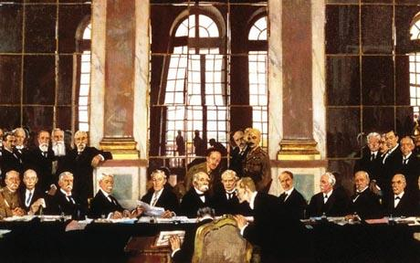
I. Build up to war began in the 1920s & 1930s
Treaty of Versailles
Countries involved in WWI mistrusted each other
FR & BR hated GR for their actions in the war
Notes:
A. wasn’t lenient enough to make Germany happy, but it wasn’t tough enough to keep them from becoming a world power again.
a.

Slide 5
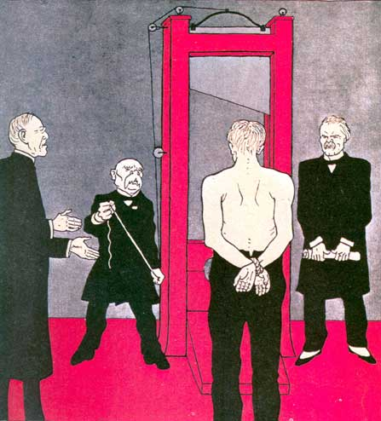
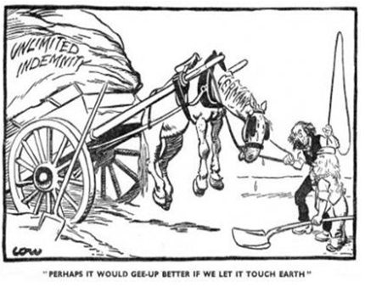
b. Treaty forced GR to pay $1 billion
war damages yearly.
1) GR never felt they should have been blamed for WWI.
Notes:
b. Germany loathed the Treaty of Versailles with a passion.
3) Germans blamed the armistice on “traitors” in their gov’t who gave up too easily.
Political Cartoon:
President Wilson is explaining (= he seems reasonable)
● Clemeceau is holding the rope (= he wishes to kill Germany)
● Lloyd George holds the Treaty (= which represents their excuse to kill Germany)
● A figure awaits execution (= Germany); he is bound (= the terms of the Armistice) and half-naked (= helpless)
The message of the cartoon is that the Treaty of Versailles is merely the means by which the victors intend to destroy Germany altogether.
GR leaders told the people of GR that GR was no more to blame for the start of WWI than any other nation, and GR believed it. GR felt picked on by the rest of the world. They were humiliated by the terms of the treaty.
GR felt like it was no more to blame for the war than others, they were furious, especially about the reparation payments.

Slide 6
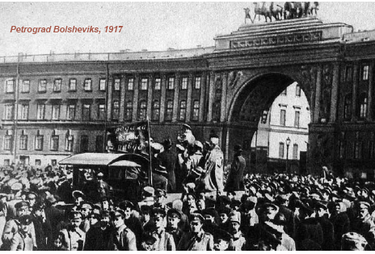
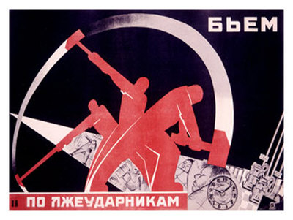
B. Bolsheviks control of RS (U.S.S.R.) scared other gov’ts.
1. U.S.S.R. wanted to spread Communism worldwide
Notes:
1. To spread Communism USSR gave support to communist parties throughout the world.
2. Established governments felt threatened by Communism, they were willing to support strong governments in Germany and Japan as buffers against this communist threat.
Joseph Staling killed millions of his own people—anyone he believed might threaten his rule. His gov’t he said would soon conquer the world.

Slide 7
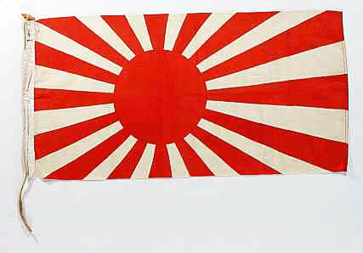
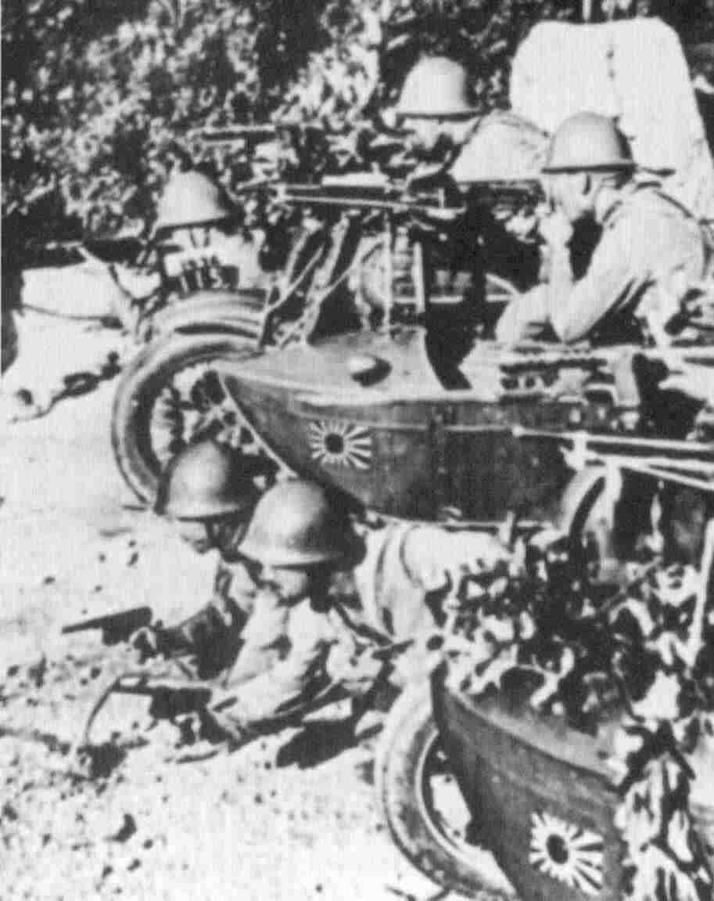
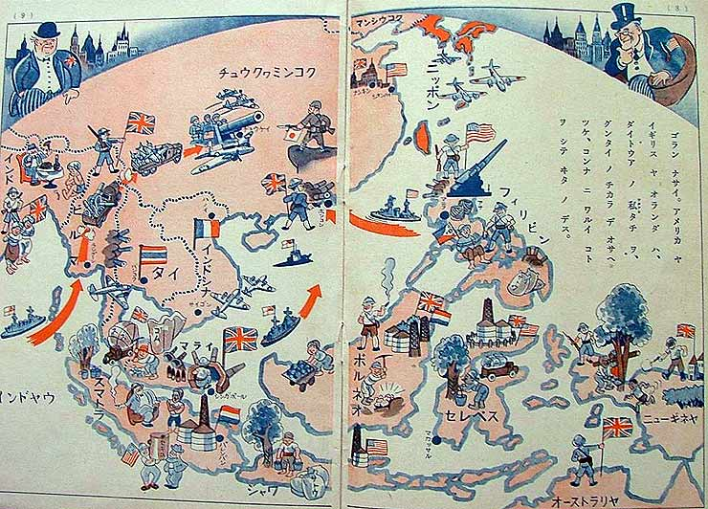
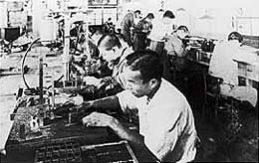
Japan felts a sense of Manifest Destiny in Asia.
1. U.S. threatens to stop supplying
raw materials if they invade
other nations.
Notes:
C. They dreamed of being “the Industrial Tiger” of Asia. A military dictatorship took control of the nation and began stomping on its neighbors.
Japan began by attacking China with a ferocity that is still hard to believe. In a massive campaign of terror, millions of civilians were tortured and killed. Just as in GR, the Japanese rulers told the people they were a superior race destine to rule others.
2. Japan feels threatened and now feels compelled to find other sources for their raw iron, rubber and oil.

Slide 8
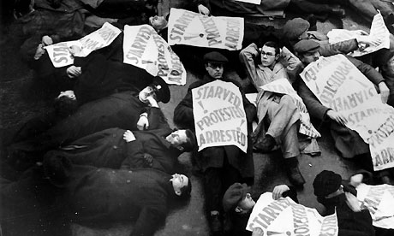
II. The Great Depression
A. European recovery from WWI became too dependent on the U.S. economy.
Notes:
B. European and Asian countries were hit very hard in the Great Depression also. People become desperate.

Slide 9
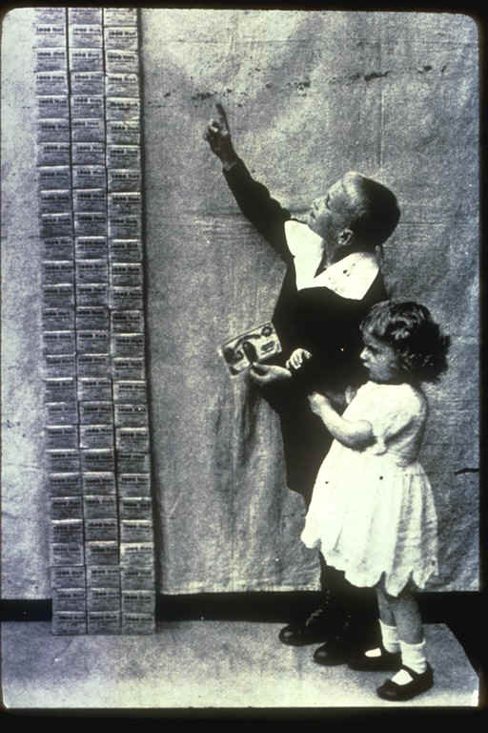
1. GR a loaf of bread cost $1 million marks ($500,000) & a stein of beer cost $4,000,000 marks ($2,000,000)
2. In Japan 3,000,000 workers were unemployed and
Notes:
GR citizens were angry and unhappy. Their country was in awful shape economically. Soon after the war, GR suffered incredible inflation. The gov’t began printing lots of money, presses ran day and night. When you print a lot of currency, soon none of it is worth much.
GR money was almost worthless. People lost their savings. They had to use up everything just to pay rent. The after inflation got more under control, the GD set in worldwide. Unemployment became a big problem.
2. Japan starving people resorted to eating tree bark and the roots of wild plants

Slide 11
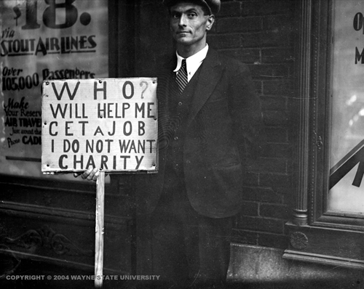
C. Hard times were blamed on gov’ts & how gov’ts acted.
1. Constitutional governments were slow to act.
Notes:
1. Constitutional gov’t have to debate issues first. So they asked for patience.

Slide 12
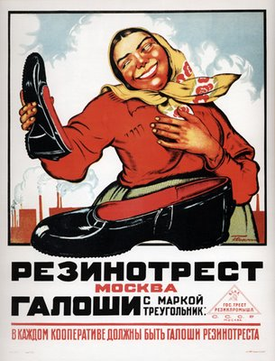
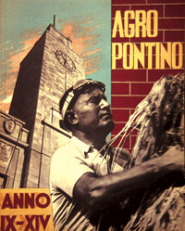
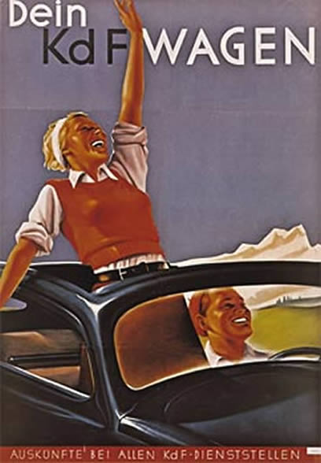
2. Communist governments said all their people would be taken care of.
Notes:
Propaganda and the fascist ideal: Benito harvests wheat, while wearing his motorcycle goggles.
Soviet galoshes- propaganda advertising the galoshes are in every store.

Slide 13
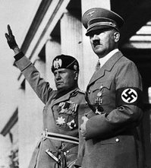
3. Fascist governments were gaining support and producing results.
Notes:
http://www.bbc.co.uk/history/british/britain_wwtwo/overview_britain_1918_1945_03.shtml
In many countries the people will turn their backs on constitutional democracies in favor of totalitarian dictatorships.
Imagine a country letting its meanest, worst people take charge. Imagine giving those people power of life and death over a whole nation. Imagine a nation where children are taught to be tattletales and tell the secret police about anyone who protests—even their parents. Imagine a nation that burns the books of its greatest writers bc it fears and hates ideas and truth. Imagine a nation that kills people bc it doesn’t like their religion or ideas, or bc they are handicapped. That is what happened in GR in the 1930s
GR no longer attempted to be a democracy. It willingly became a dictatorship.
GR wanted a leader, someone who could lead the country out of the economic mess, someone who could make them feel good about themselves.
In IT a pompous dictator named Benito Mussolini took control of the gov’t. Mussolini was a bully, and, like all bullies, he picked on those who were weak. He sent IT forces to Ethipoia

Slide 14
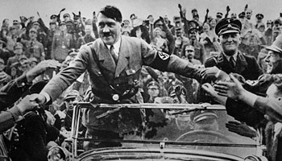
III. Fascism & Nationalism
A. Hitler joined GR government as chancellor in 1933.
1. Quickly consolidated power & ruled as a dictator, proclaimed the racial superiority of Aryans ("pure" Germans), the need for lebensraum, & anti-Semitism
Adolf Hitler, chancellor of Germany, is welcomed at Nuremberg, 1933
Notes:
Hitler—Background
4th Child
Dropped out of school at age 14 after the death of his father.
He never graduated from high school
Dreamed of becoming a priest, but went to Vienna to become an artist when his father died.
Failed as an artist
Austrian, not German
Non-drinker, nonsmoker, and a vegetarian.
Regular employment was repulsive to him.
Successful in WWI
Twice wounded
Twice decorated for bravery
Attained the rank of corporal
Earned the Iron Cross
Richard Wagner was his favorite musician
Geli-Baubal—was the only love of his life
She was his niece.
She eventually committed suicide, and he maintained her room the way it was on the day she died.
He married Evan Braum one day before their joint suicide.
The Rise of Adolph Hitler (Adolph Schlicklgruber, 1889-1945)
Hitler joined the Nazi Party (National Socialist German Workers Party)
Created the Brown Shirts (S.A.=Storm Aptielun or storm detail)
Brown shirts were led by Roehm, they were generally made up on sex perverts and convicted murderers.
Beer Hall Putsch—an attempt at political takeover for the German province of Bavaria.
Germany was not ready, Hitler was arrested and sentenced to jail.
He received a five year sentence, because this was his first offense, and because he was decorated for bravery during World War I.
He was released in nine months.
Weaknesses of the Weimer Republic:
In prison, Hitler wrote Mein Kampf; Hitler was 35 years old at the time. Original title: Four and a Half Years of Struggle Against Lies, Stupidity, and Cowardice.
Basic Ideas in Mein Kampf
Germany was not defeated in WWI
Germany’s loss was due to Jews, Catholics, and Communists They had “stabbed Germany in the back.”
Germany will rise and rule the world (Aryan race concept)
Germany needs lebensraum (living space)
The book was 792 pages long and became the #2 best seller in Germany (the Bible was #1). Not many Germans read it, but it was obligatory to present a copy of the book to newly married couples and as a graduation present.
Hitler saw life as a jungle where the fittest survived and the strongest ruled where one creature fed upon another.
The book also addressed the extermination of the Jews (the Final Solution).
Obliterated Bolshevism (communism)
Hitler learned his lesson from the Beer Hall Putsch. If one is to take over the gov’t, one should do it through legal means.
1932 Election
Social Democrats finished in first place, the Catholic Center party in second. Hindenberg was reelected president.
The Nazis were NEVER A MAJORITY party, but they were the largest single party. Germany had 24 different political parties.
At the height of their popularity, the Nazis only obtained 37% of the vote.
63% of the German population opposed the Nazis.
With Nazis in power, Hindenberg appointed Hitler as Chancellor of Germany (100,000 people protest the appointment).
Blood Purge—June 3, 1934—Hindenberg will not involve Hitler in gov’t unless he gets rid of the S.A.s (Brown Shirts).
100-1,000 killed in one night.
Hindenberg congratulated Hitler.
Hitler replaced the Brown Shirts with the SS (Shutz Staffle=protection bodyguard. They wore black shirts).
Nazis burn down the Reichstag (Germany’s Parliament building)
Blamed it on the communists. This proved the need for a political state—a strong leader was necessary to stop the spread of communism.
The net result was Hitler was popular and those against him dared not speak out due to the SS and the infamous “midnight arrests”.
Hindenberg died August 2, 1934 at the age of 87. Three hours later it was announced that on the preceding day the offices of Chancellor and President had been combined.
The Enabling Act: gave Hitler control of the armed forces, and as the president of Germany he eliminated the elections that should have been held according to Article 48 of the German Constitution.
Much opposition was silenced when Hindenberg’s son, Oscar, announced on the radio that his father verified Hitler’s appointment as President hours before his death.
Within 24 hours Oscar was appointed major general instead of a colonel.
The title of President was abolished, Hitler became known as Der Fuhrer (the leader)
The Third Reich was organized. It was to last 1,000 years.
First Reich=Otto the Great, Second Reich=Unification of Germany under Kaiser Wilhelm)
Nuremberg Laws
Nazi philosophy towards the Jew
Anti-Semitism feelings had always run high in Germany, dating back to the 1700s. The Nazis extended this tradition by establishing the Jew as a distinct biological race.
A Jewish conspiracy was blamed for Germany’s loss of WWI, domestic and int’l problems—even the high death rate from TB.
Julius Streicher told the medical officers of Germany, “The Jews have taught the Germans to smoke tobacco in order to destroy the German nation.”
In short, the Jews were symbols of everything that was frustration or evil.

Slide 15
Hitler Speech

Slide 16
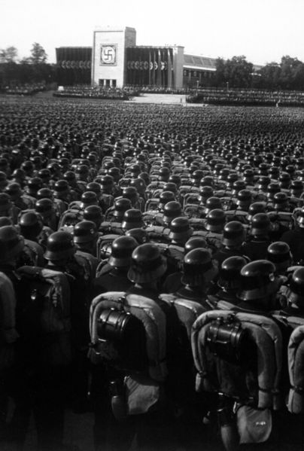
2. GR's military rebuilt in defiance of Treaty of Versailles.
Overview of the mass roll call of SA, SS, and NSKK troops. Nuremberg, November 9, 1935.

Slide 17
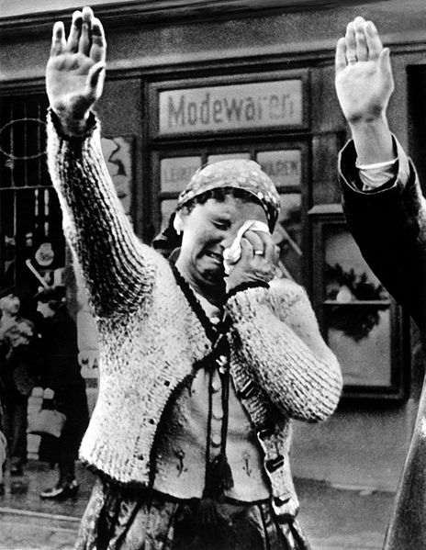
3. GR expansion →Rhineland (a FR-controlled region) in 1936 and the annexation of Austria in 1938.

Slide 18
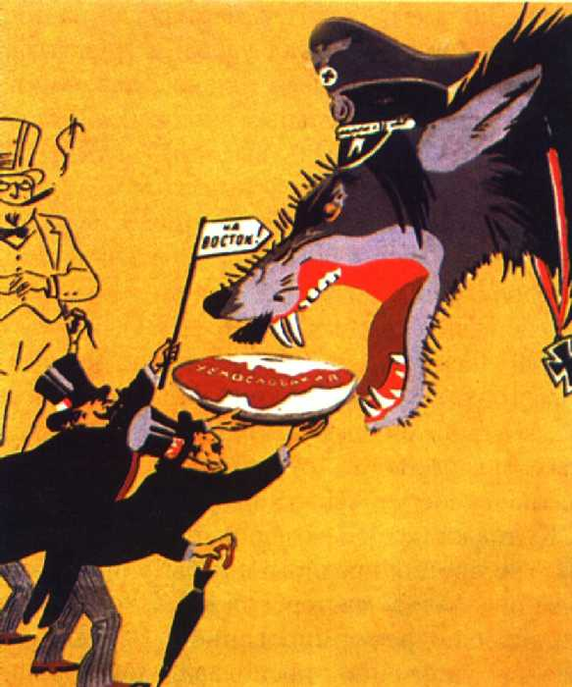
Soviet poster of 1930’s by Kukryniksy showing Western powers giving Hitler Czechoslovakia on a dish. Inscription in the flag:
"On towards the East!"

Slide 19
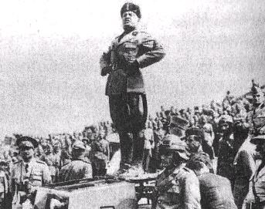
B. Mussolini seized
power in Italy as the
leader of the Fascist
Party in the 1920s.
1. He retook territories like Ethiopia in 1935. League of Nations protested, Italy resigned, & joined GR in the Axis alliance.
Notes:
. Italian invasion of Ethiopia, 1935
1. Italy gained a measure of revenge for its earlier
defeat by the Ethiopians in 1896.
· 500,000 Ethiopians died in the war compared to only 5,000 Italians.
2. League of Nations imposed sanctions on Italy, but did not include oil on the list of embargoed goods.
a. No attempt was made to prevent Italy’s navy from
using the Suez Canal on its way toward Ethiopia.
b. France and Britain were not willing to press Italy
because they needed Italy’s help in keeping Hitler in check.
· Britain, in particular, sought to appease Italy to end the crisis and only placed an embargo on the sale British weapons to Italy.
c. In 1936, the League lifted its sanction on Italy.
d. The Stresa Front was now defunct as Mussolini
clearly defied the League of Nations
Hitler was further encouraged that the international
community lacked the will to enforce peace

Slide 20
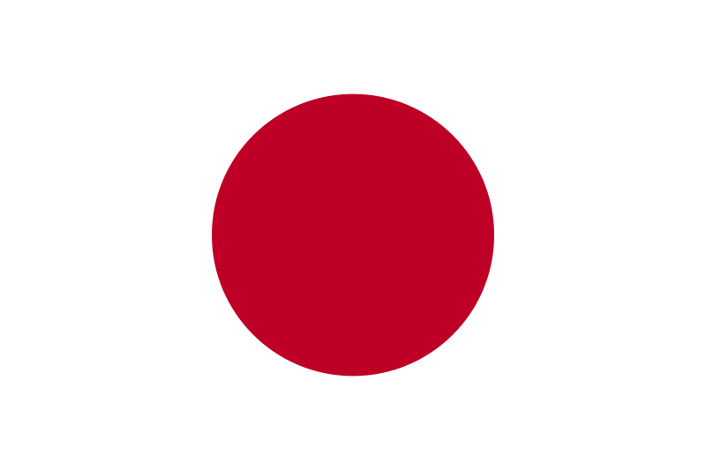
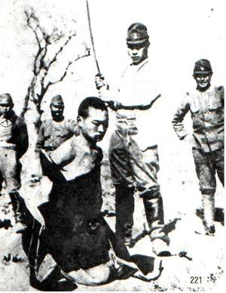
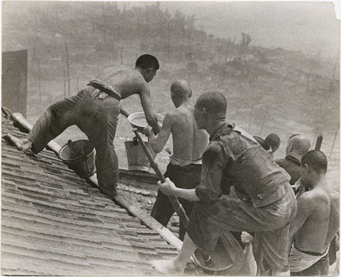
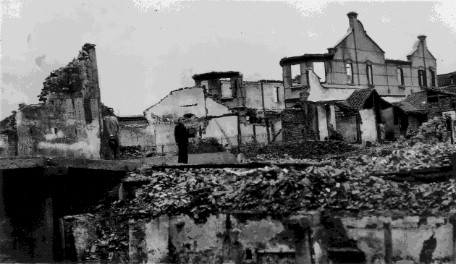
C. Japan seized Manchuria in 1931 & N. China in 1937.
1. FDR responded by calling for a "quarantine" of aggressors like Japan
Notes:
FDR was but was criticized extensively by Americans fearful of possible entanglements.

Slide 21
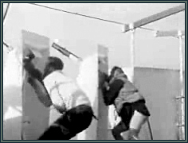
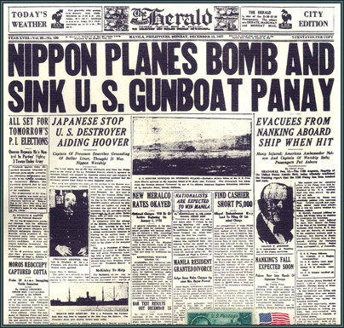
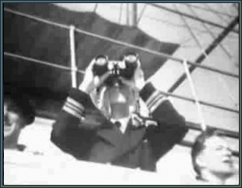
2. Japanese planes sank the American gunboat Panay on the Yangtze River in 1937
Notes:
This attack was deliberate. Once again, American isolationist sentiment pressured the U.S. to accept the Japanese explanation that this was an accident.
Chief Boatswain's Mate Mahlman, who ran out of the shower when the first bomb hit, was a little more successful. He managed to keep up a steady rate of fire, all the while dressed only in a shirt. Immortalized by Norman Alley’s movie camera, he became known as the “Pantsless Gunner”.
http://www.usspanay.org/attacked.shtml

Slide 22
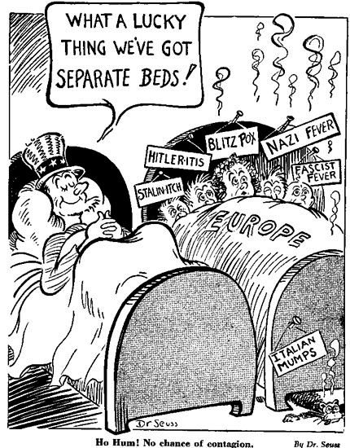
IV. Isolationism
A. The U.S., BR & FR didn’t want another war.
1. U.S. followed a policy of “Isolationism” from problems around the world.
Notes:
a. Most Americans feel strongly that “American lives should not be lost in European wars!”
b. To do this we had to ignore or not get involved in things that were happening around the world. (unless they were for our good)
In the 1930s there were strong isolationist voices in America. They said that the oceans—The Pacific and the Atlantic—protected us from danger. They said we didn’t need to pay attention to what was going on in the rest of the world.
Still others—in the military—were attached to old ways of thinking. They thought battleships could protect us. Our battleships were huge, some were 800 feet long (3 football fields), crews of 2,800 men, and guns that fire shells 20 miles or more, which was further than any other weapon of the time.

Slide 23
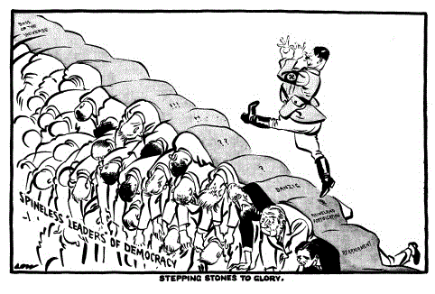
2. BR & FR willing to let Hitler get away with almost anything to keep from fighting a war.

Slide 24
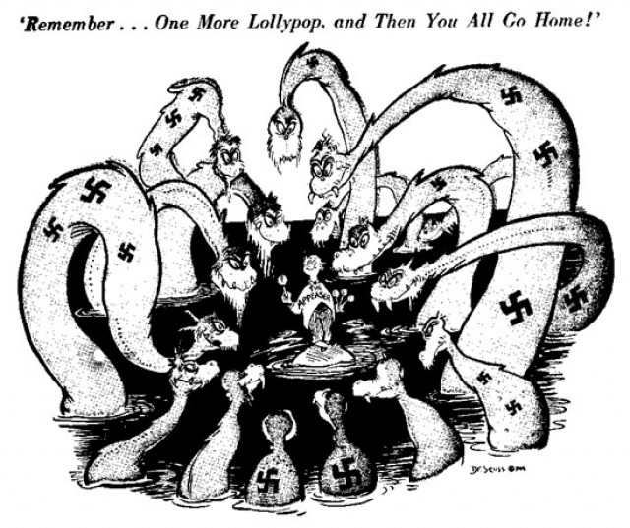
Notes:
A few voices disagreed, they said air power had changed all the rules of war. The oceans were no longer enough protection. Colonel Billy Mitchell said the U.S. Army believed we needed to build up our air force.
Congress wouldn’t listen to Bill Mitchell.
The U.S. became weak militarily. We listened to the isolationists. It was partly for a good reason, we hated war. In 1941, our military ranked 19th in the world, smaller than that of Belgium.
FDR understood that totalitarian powers were dangerous, he knew they hoped to rule the world. He took them seriously. The president wanted to build up our armed forces. It wasn’t easy to fight the isolationists in Congress.

Slide 25
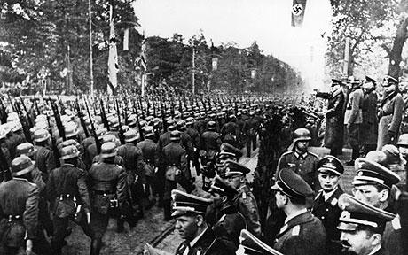
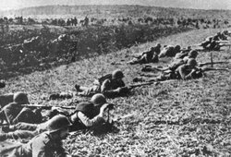
V. The War in Europe
A. World War II began with Hitler’s invasion of Poland in 1939, followed shortly after by the USSR’s invasion of Poland
Notes:
1. Hitler’s invasion was the first widespread killing of ethnic and Jewish populations in a conquered territory.

Slide 26
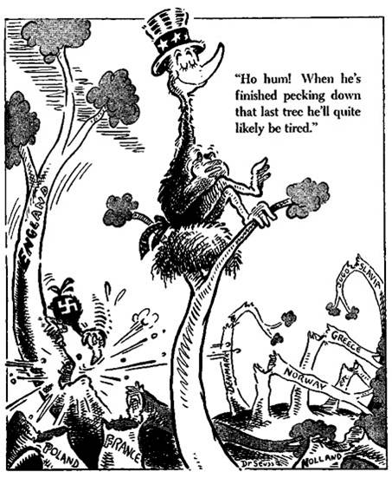
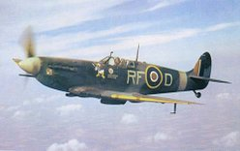
B. During the first 2 years of the war, the US stayed officially neutral

Slide 27
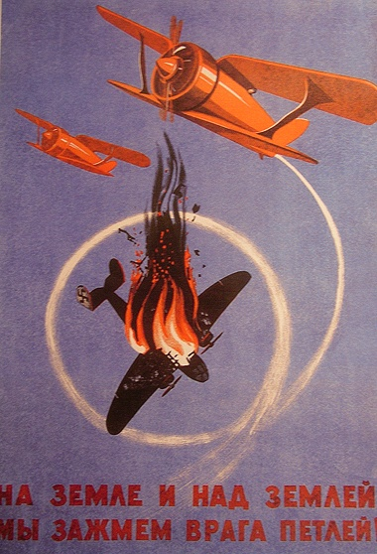
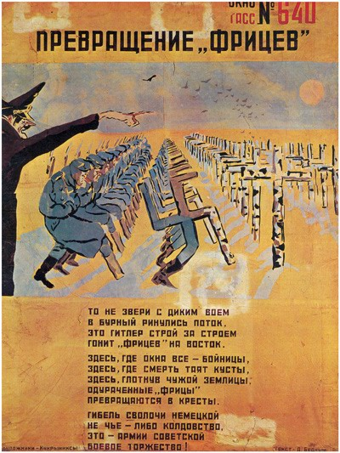
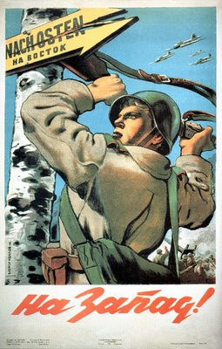
B. In mid-1941, Hitler broke his non-aggression treaty with the USSR (Operation Barbarossa)
Notes:
http://uppercase.squarespace.com/motherland/ http://sovietposter.blogspot.com/
Transformation of fritzes (The TASS Window №640) Kukriniksy, 1942
The poster verse says: These are not the animals with wild howl Crossing stormy river flow. This is Hitler kicking Troops eastward.
Here where all the windows are loop-holes, And the bushes hide death, Here after tasting the foreign ground, The fooled fritzes Transform into grave crosses.
And this death of German bastards Have no magic whatsoever. This is military triumph of The Red Army
The Russians were a threat to Hitler’s goal of world domination. When some of Hitler’s generals told him not to go to Russia he didn’t listen. Hitler needed oil and wheat and other resources from the USSR. Hitler thought the USSR would be an easy victim.
The GRs did have an easy time at first the Soviets were prepared. Hitler instructed the GR army to turn the USSR into a slave nation. The Nazis murdered millions of Soviets.

Slide 28
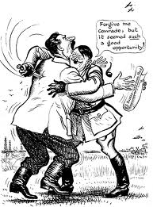
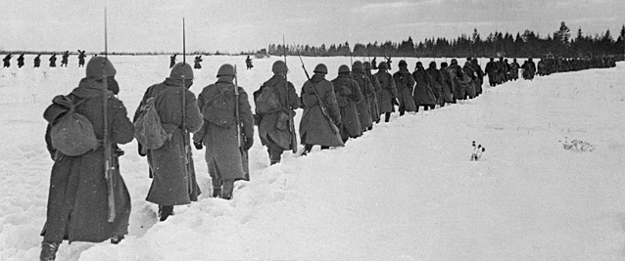
1. Hitler unprepared for lengthy invasion needed to win in the USSR
2. Nazi army refined its killing techniques in the USSR targeting Communist politicians & Jews.
Notes:
The GRs were prepared for the cold. They got stuck in a Russian winter, and it happened to be the coldest winter in 30 years. The temp dropped to 60 below zero.
GR army was far from home, and having a hard time getting supplies and food. GR soldiers froze and starved. So did Soviets, it was a disaster for both sides, but the Soviets were hat home and able to outlast the hungry, discourage GR army.
FDR sent his friend Harry Hopkins to USSR Stalin asked for weapons and said the Soviets could fight for 3-4 years more. Stalin was rights.
Hitler’s blitzkrieg tactics weren’t effective with the distances and terrain of the Soviet Union.
2. In 1939 20,000 children, all under 14 were in danger in GR. Hitler wished to get rid of them. He was willing to let them leave the country. Many were Jewish; some were not. Quakers, Jews, Catholics, and members of other American church groups agreed to take responsibility for them. It would not cost the gov’t any money. Surely America would accept them. This is the land of promise.
Some Americans were anti-Semitic is xenophobic.
Most Americans were hospitable, 85 newspapers wrote editorials urging Congress to pass a bill allowing those 20,000 children from GR into the U.S.
The head of a powerful group, the American Coalition of Patriotic Societies told Congress to, “protect the youth of American from foreign invasion.” He shouted the message of racists.
In 1939 the U.S. gave sanction to bigotry and assistance to persecution. Those children were not allowed into the United States.
Hitler now knew no one would rescue the children. He felt free to build death camps. That is where most of those 20,000 children ended their lives.

Slide 29
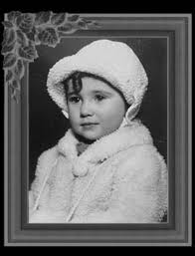
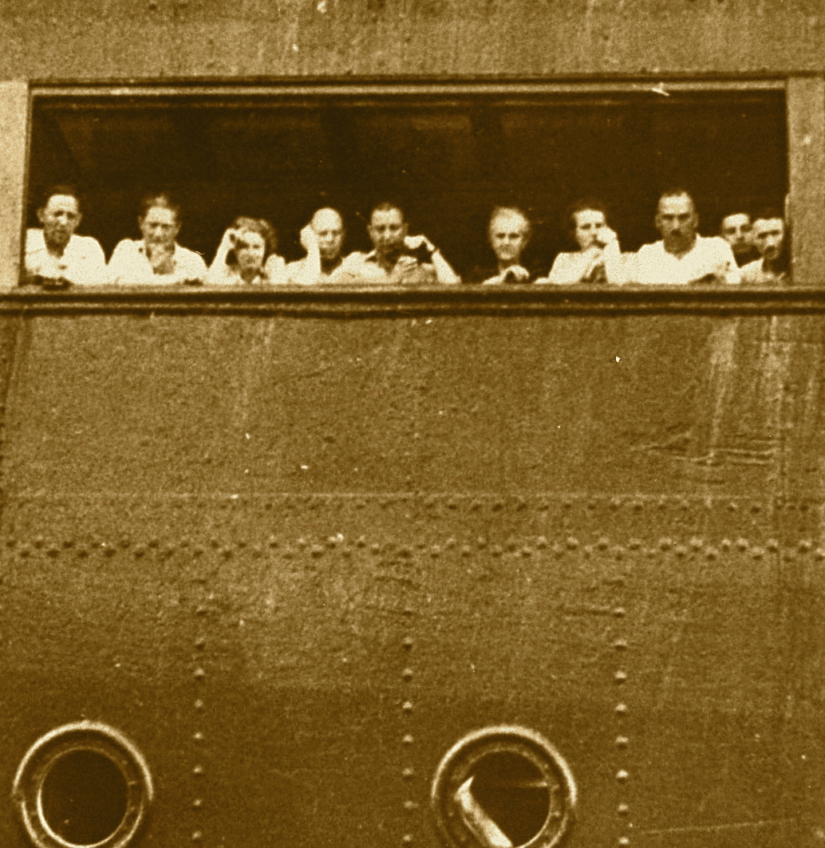
The St. Louis Turned Back
Notes:
Liane Reif-Lehrer pictured was born in Austria, in 1934.
I should have been a normal little girl, happy with my special doll, my big brother, and my doting parents. But the world around me was going mad, and the life I should have had was not to be.
Liane’s father was a dentist, but the Nazi’s would not let him work or other Jews work. One day he was found dead at the bottom of a stairwell. Liane has never known how this happened, murder, suicide, accident?
She was not 5 when she her mother, bother and 934 other Jewish passengers set sail for Cuba from the port of Hamburg, GR on the luxury liner St. Louis. The passengers all had Cuban entry permits, and most had quota numbers that would have let them into the U.S. eventually.
But while they were at sea, Cuba changed its immigration policy. Most of the passengers were not allowed off the ship.
After days of frantic negotiations, the St. Louis was forced to leave Cuba. The captain didn’t want to take the Jewish passengers back to GR; he knew what would happen to them there. He headed for Miami.
Telegrams were sent to FDR asking him to grant asylum to the refugees. The telegrams were not answered. A U.S. coast guard boat stayed close to the St. Louis to make sure no one jumped overboard and tried to swim ashore. Finally, the captain could do nothing; he headed back to Europe.
Liane said,
My mother and brother and I were among the passengers who survived about a fourth of those on the ship. We were sent back to Europe and given haven in FR, only to find the Nazis at our doorstep again a few months later. But somehow we managed to get to the U.S. in 1941. I was 7, a wide0eyed, bewildered girl, greeted by NY children playing street games to wartime hate ditties, “Whistle while you work, Hitler is a jerk, Mussolini is a meanies, and the Japs are the worst.”
I tried to explain that some GR were good and some were bad. On more than one occasion my “non-groupy” response earned me the wrath of the parents who did not hesitate to suggest I go back to where I came from.

Slide 30
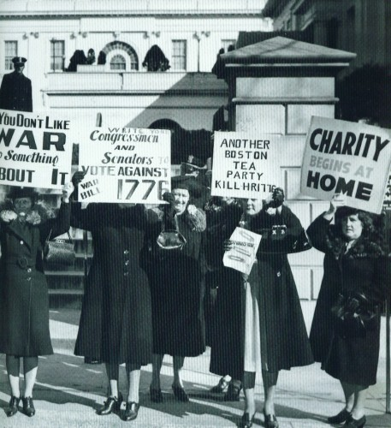
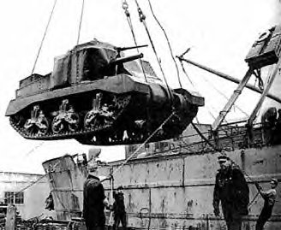
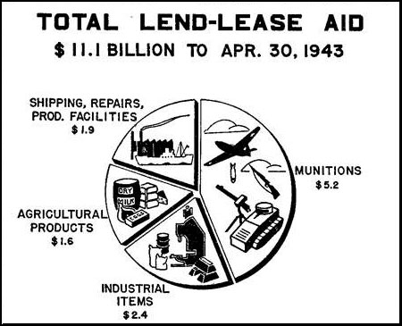
C. Despite strong isolationist sentiment at home, the US increasingly helped BR.
1. Lend-Lease Act
Notes:
http://www.theeasternfront.co.uk/lendlease.htm
We gave Britain war supplies and old naval warships in return for military bases in Bermuda and the Caribbean
FDR compared it to “lending a garden hose to a next-door neighbor whose house is on fire”
American mothers protest lend-lease, they feared a war might include their sons.

Slide 31
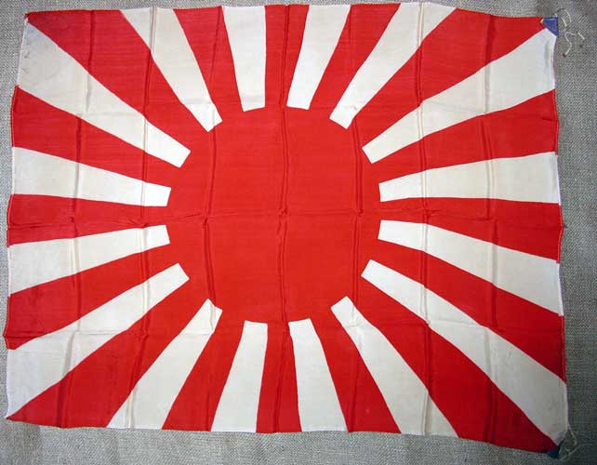
VI. War in Asia
A. During 1930s Japan sought military & economic domination over Asia.
B. U.S. refused to recognize Japanese conquests in Asia & imposed an embargo on exports of oil and steel to Japan.
Notes:
Tensions rose but both countries negotiated to avoid war.

Slide 32
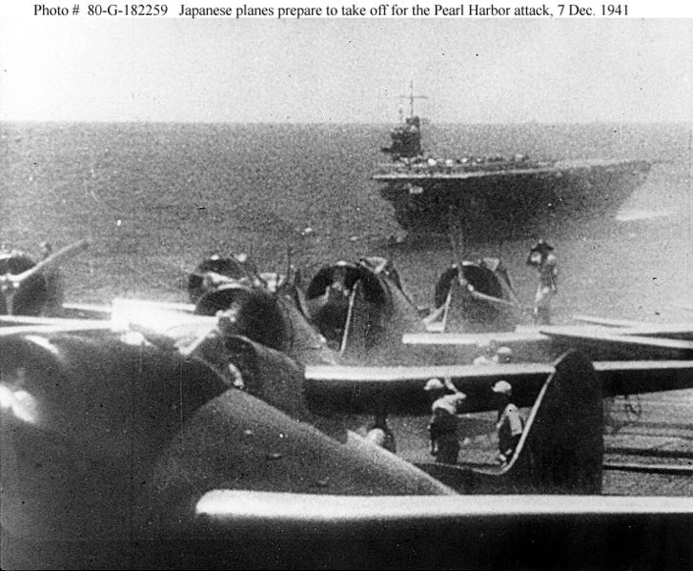
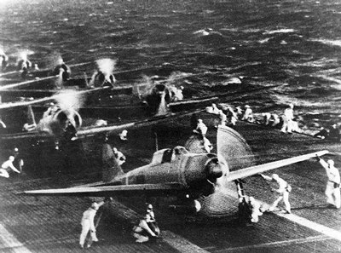
C. While negotiating with the US and w/o any warning, Japan carried out an air attack on the American naval base at Pearl Harbor, Hawaii, on December 7, 1941.
Notes:
Sec. of State Cordell Hull receives a call from two Japanese diplomats. They ask for an emergency meeting. Hull expects to be given the Japanese gov’ts answer to an American peace letter.
At the White House after lunch, the president works on his stamp collection, relaxing with his friend Harry Hopkins and his Scottie dog, Fala. They are relaxing. The phone rings. It is close to 2 PM Eastern Time.
Secretary of the Navy Frank Knox is on the line. His voice is quivering. He shares a message received from Hawaii AIR RAID ON PEARL HARBOR—THIS IS NOT A DRILL.
Japanese naval aircraft prepare to take off from an aircraft carrier (Shokaku) to attack Pearl Harbor during the morning of 7 December

Slide 33
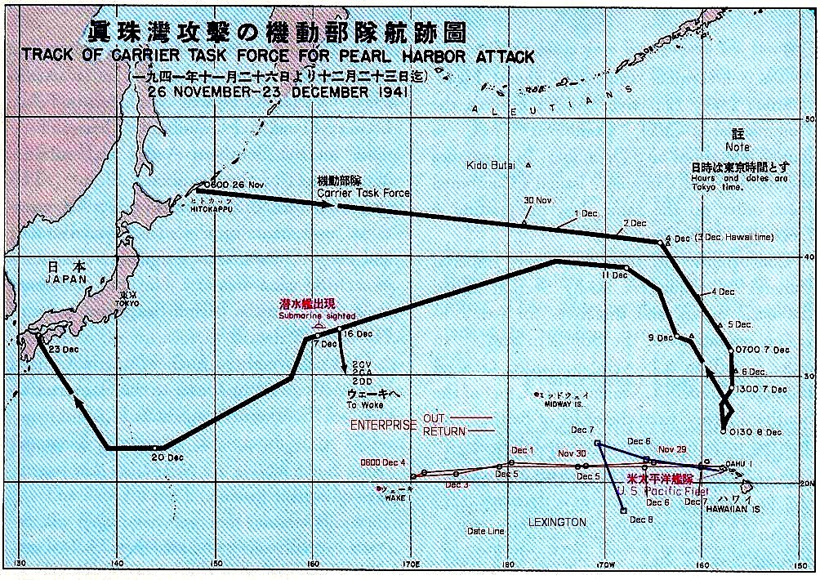

Slide 34
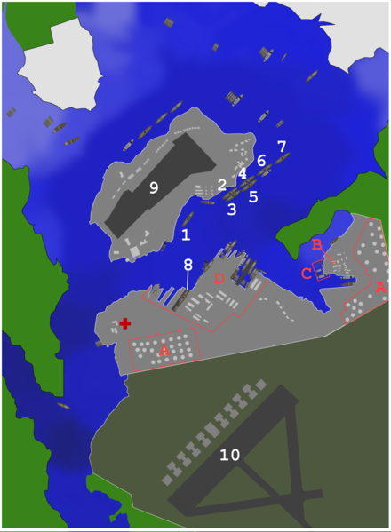
1: USS California 2: USS Maryland 3: USS Oklahoma 4: USS Tennessee 5: USS West Virginia 6: USS Arizona 7: USS Nevada 8: USS Pennsylvania 9: Ford Island NAS 10: Hickam field
Ignored: A: Oil storage tanks B:CINCPAC headquarters building C: Submarine base D: Navy Yard
Notes:
On Sunday morning ships were lined up in the harbor; their crews were having breakfast, or relaxing, or sleeping. At 7:02 AM Hawaiian time, a radar operator saw some blips on his screen. The operator didn’t pay attention to them. He thought they were bombers he was expecting from the West Coast.
By 7:55 he knew better. That was when the first dive bombers with the red Japanese sun painted on their sides—let their bombs loose on Battleship Row.

Slide 35
Notes:
The U.S.S. Arizona gave off a tremendous roar, split in two, and slipped to the bottom of the harbor. That was just the beginning. Almost all of the American planes on the island were damaged or destroyed.
Most warships were crippled or sunk.
More than 2,400 soldiers, sailors, and civilians were killed.

Slide 36
Notes:
At 2:05 PM (8:05 Hawaiian time) the Japanese envoys arrive at Secretary of State Cordell Hull’s door.
They are part of an elaborate Japanese deception, but their timing is off. Before the secretary can see them, his phone rings. It is the president, with the awful news of the Japanese attack.

Slide 37
Notes:
The same day the Japanese attacked American and BR bases at Midway, Wake Island, Guam, Hong Kong, Singapore, and the Philippines.

Slide 39
D. Attack destroyed much of the American Pacific Fleet & killed 2,000+ Americans.
1. Roosevelt called it “a date that will live in infamy”
Notes:
FDR asked Congress to declare war on Japan.
After Pearl Harbor, Hitler honored a pact with Japan and declared war on the United States. The debates over isolationism in the United States were over. World War II was now a true WORLD WAR and the United States was fully involved.

Slide 41
Profiling
Profiling is when someone targets you and labels you with a preconceived stereotype based on your race, religion, ethnicity, age, where you live, where you go to school, who your family is, etc.
Think of a time when you have done this to someone or it has happened to you. Explain in ½ page.

Slide 46
Gallup Poll: Chinese vs Japanese
Value | Chinese % | Japanese %
Hardworking | 69 | 46
Honest | 52 | 2
Brave | 48 | 24
Religious | 33 | 20
Warlike | 4 | 46
Treacherous | 4 | 73
Sly | 8 | 63
Intelligent | 24 | 39

Slide 47
VII. The Strategies of War
A. Allied Strategy
1. U.S. & its allies (BR & USSR), followed a “Defeat Hitler First” strategy.
Notes:
Most American military resources were targeted for Europe.

Slide 48
3. In the Pacific, American military strategy called for an “island hopping” campaign
Notes:
Seizing islands closer and closer to Japan and using them as bases for air attacks on Japan.
Following Pearl Harbor, Japan invaded the Philippines and Indonesia and planned to invade both Australia and Hawaii.
Its leaders hoped that America would then accept Japanese predominance in the Pacific, rather than conduct a costly war to reverse Japanese gains.

Slide 49
B. Axis Strategy
1. GR hoped to defeat the USSR quickly, gain control of Soviet oil fields, and force Britain out of the war
Notes:
Get BR out w/a bombing campaign and submarine warfare before America’s industrial and military strength could turn the tide.

