Slide 1
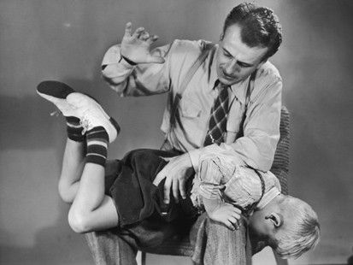
PUNISHMENT
How harsh should a person be punished for a crime?
What happens if the punishment is too harsh?
What if it is too lenient?
The Allied countries had to evaluate these questions as they created a punishment for Germany.

Slide 2
Scenarios
Corey, 6 years old, gets angry because his brother took away his toy. He runs up to his brother and hits him on the arm. How would you punish Corey if you were his parent?
Megan was caught cheating on her test in biology. The teacher gives her a zero on the assignment. Megan feels frustrated because other people were cheating too, but she was the only one to get caught. Failing the test also gives her an F in the class. She decides to talk to the teacher. From the perspective of the teacher, how would you handle this situation?

Slide 3
Your son, who just got his driver's license, wrecked the family car. He was driving carelessly and ran into another vehicle, totaling the car. What are you going to do as a parent to punish him and/or teach him a lesson?
You are on a jury trying a man who has committed murder. He has already served 10 years in prison and is trying to get out on early parole. He says he is sorry for what he did and wants to change his life. How will you vote? Will you make him serve his full term or help him start a new life?

Slide 4
Your girlfriend/boyfriend cheats on you. You trusted them and feel hurt and betrayed, but they want you back. What do you do? Do you forgive them or punish them for what they did?
Was the Treaty of Versailles fair to Germany?

