Slide 1
The Great Depression
Unit 3B

Slide 2
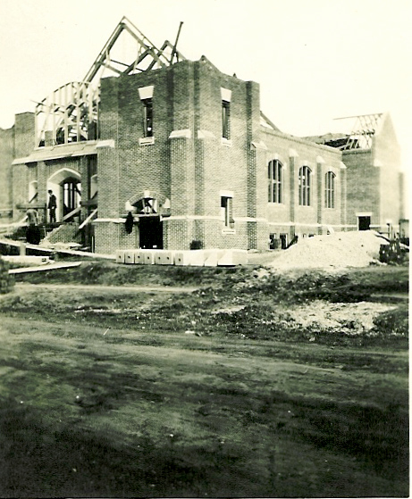
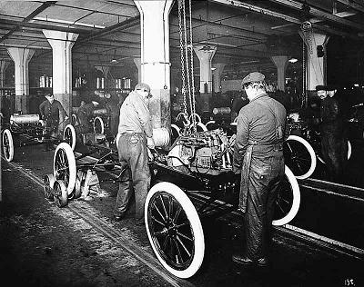
I. Causes of the Great Depression
A. American economy was based on the prosperity of two industries: construction and automobiles
Notes:
By 1932, at least 12 million people were out of work. That was 1 in 4 who normally would work. Count your friends, pretend that the parents of every 4th person are unemployed.
America had had depressions before. They were supposed to be a kind of self-regulating part of capitalism. All the early depressions had something in common: it was the poorest workers who were hurt. They lost their jobs and went hungry. The wealthy and middle class suffered only slightly.
The Great Depression hurt more people, rich and poor, than any previous depression.

Slide 3
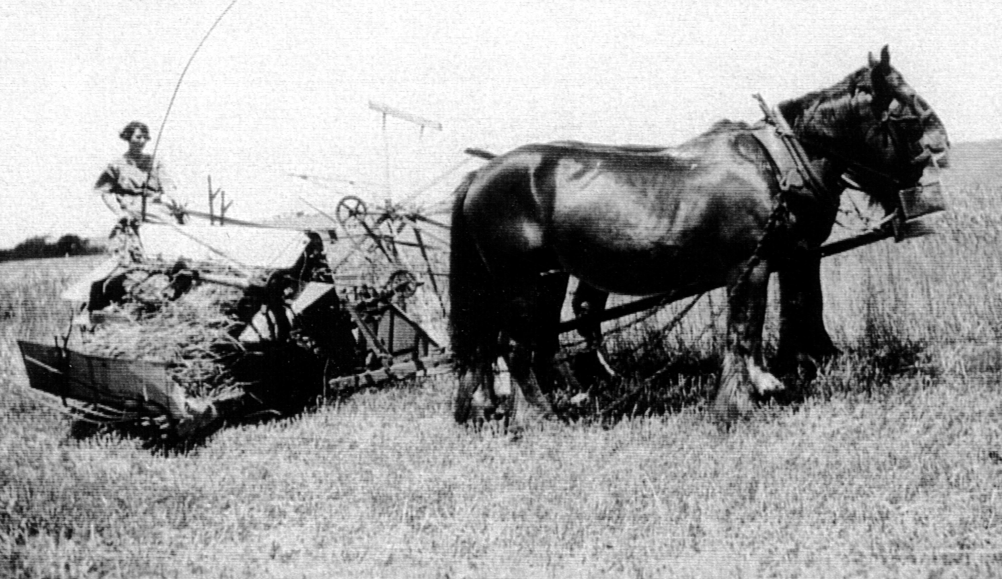
B. 1920’s→widening gap b/w the rich getting richer & poor consumers.
1. Many farmers and factory workers couldn’t purchase cars & houses.
Notes:
2. Farm income declined 66% from 1920 to 1929.
Farmers didn’t have any easy time of things, but usually they can feed themselves. Americas farmers did not prosper with the rest of the nation. Crop prices stayed low. So the farmer’s income was low, too.
In 1929 most farms still didn’t have electricity or indoor toilets. During the ‘30s things got worse. The price of wheat and other grains dropped so low that it was sometimes below what it cost to grow.
Dairy farmers dumped thousands of gallons of milk onto the land to protest the low price of milk. Other farmers destroyed their own crops. All this waste was happening at a time when city children were hungry. Clearly, something was terribly wrong with our economic system.

Slide 4
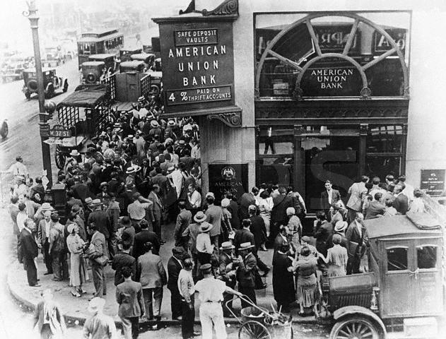
C. Huge credit problems
1. Steady stream of bank failures in late 1920s as customers couldn’t pay
mortgages
Notes:
(many of bank customers farmers)

Slide 5
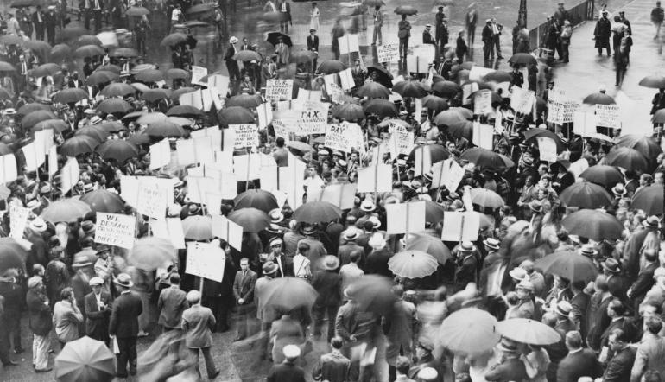
D. Decline in demand for U.S. goods overseas.
1. Unable to pay wartime debts, some European nations borrowed from U.S. banks, further increasing indebtedness.
Notes:
1. By the late 1920s some European countries had rebuilt their factories and farms.

Slide 6
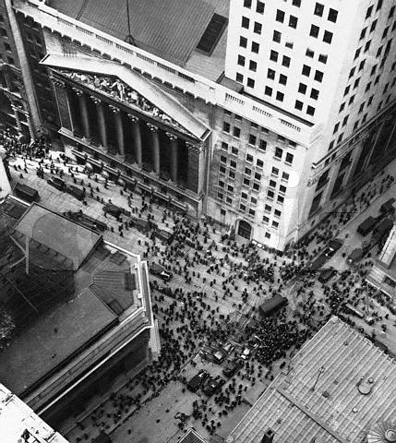
II. Stock Market Crash, 1929
A. By October 1929, margin buying had reached $8.5 billion in loans to stock purchasers

Slide 7
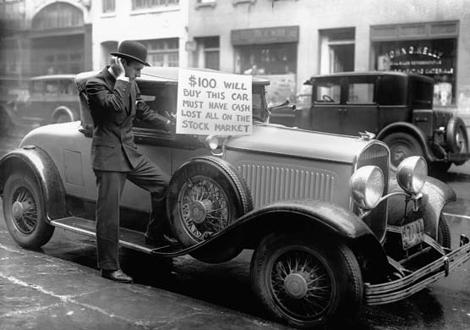
B. By December $40 billion in stock value had been lost
Notes:
Stock prices began to fall in September 1929. On October 24 (Black Thursday) and October 29 (Black Tuesday), prices fell drastically as sellers panicked.

Slide 8
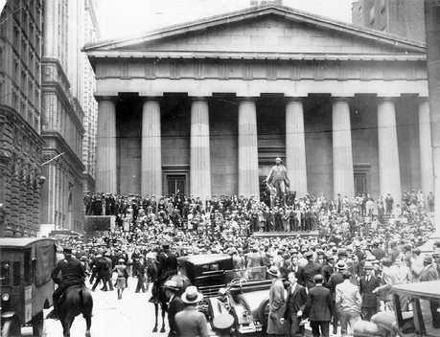
The New York Stock Exchange
Black Friday, October 24, 1929

Slide 9
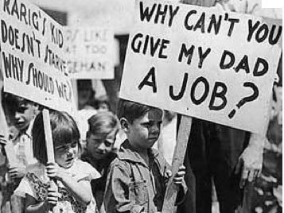
C. Hoover attempted to calm Americans, assuring that the country's economy was fundamentally sound
D. J.P. Morgan and other bankers bought $20 million of U.S. Steel to try to restore confidence
Notes:
President Hoover thought the Depression was over. He said the economy was fundamentally sound. He said no one was starving in America.
Well Hoover was wrong about all those things.
“We have now passed the worst and with continued unity of effort shall rapidly recover.” (Hoover, 1930).
“I do not believe that the power and duty of the general gov’t ought to be extended to the relief of individual suffering.” (Hoover, 1930)
“We shall soon with the help of God be w/in sight of the day when poverty will be banished from the nation.” (Hoover, 1932)

Slide 10
C. Hoover attempted to calm Americans, assuring that the country's economy was fundamentally sound
D. J.P. Morgan and other bankers bought $20 million of U.S. Steel to try to restore confidence
Notes:
President Hoover thought the Depression was over. He said the economy was fundamentally sound. He said no one was starving in America.
Well Hoover was wrong about all those things.
“We have now passed the worst and with continued unity of effort shall rapidly recover.” (Hoover, 1930).
“I do not believe that the power and duty of the general gov’t ought to be extended to the relief of individual suffering.” (Hoover, 1930)
“We shall soon with the help of God be w/in sight of the day when poverty will be banished from the nation.” (Hoover, 1932)

Slide 11
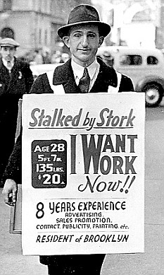
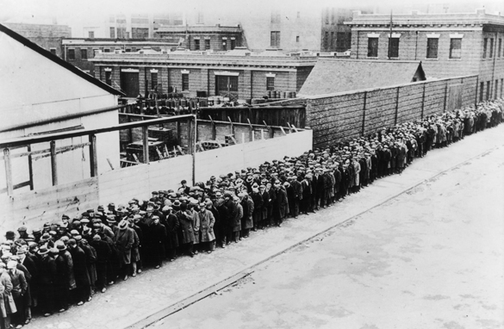
Mellon pulled the whistle
Hoover rang the bell,
Wall Street gave the signal,
And the country went to hell.
-Anonymous Ditty 1930s
Notes:
A long line of unemployed and homeless men wait in New York to get free dinner at the municipal lodging house during the Great Depression, circa 1930.

Slide 12
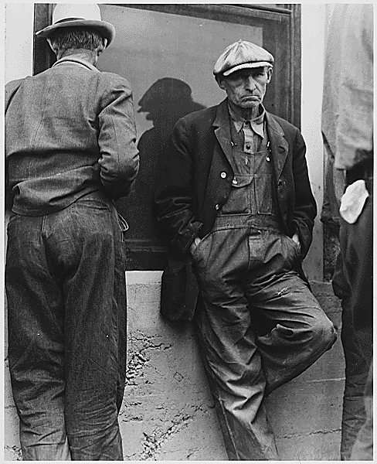
E. Economic downturn accelerated by market crash
1. Between 1929-1933, 100,000 businesses failed
2. Corporate profits fell from $10 billion to $1 billon.

Slide 13
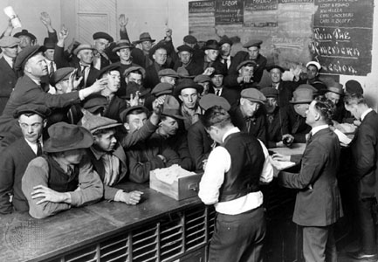
3. B/W 1929-1933, 6,000+ banks failed, wiping out over 9 million in savings accounts ($2.5 billion today).
4. By 1933, 15 million workers were unemployed (25% of the work force) many were underemployed
Notes:
Underemployed=(not working enough hours or being paid enough to subsist).

Slide 14
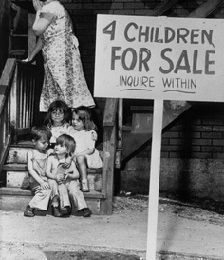
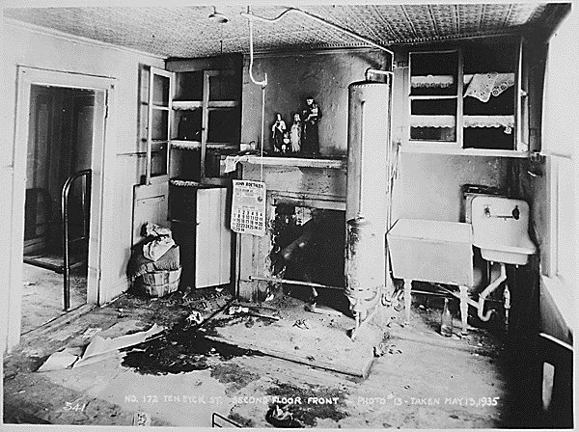
5. Diseases associated with poverty increased
a) In 1932, 95 people died in New York City from starvation.
Notes:
a) Diseases like malnutrition, tuberculosis, typhoid and dysentery.

Slide 15
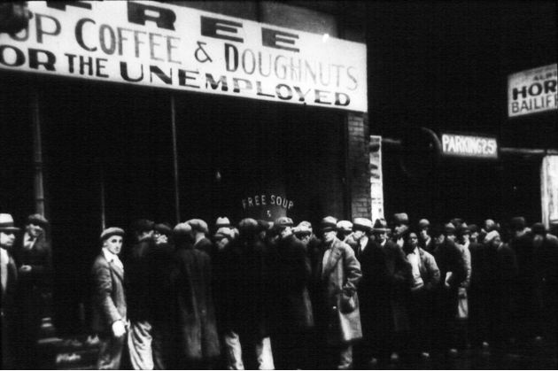
b) Many turned to soup kitchens and breadlines for food
Notes:
Hoover never understood. Each night he and Mrs. Hoover dressed formally for dinner—in tuxedo and long gown—and were served 7 course dinners by a large staff.
Soldiers stood at attention around the table.
Hoover thought about cutting down on White House expenditures, he said, but then decided that it would not be good for the people’s morale.

Slide 16
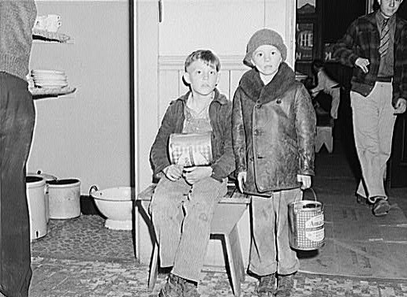
Young boys wait for their nightly soup in the kitchen of an Iowa mission. (John Vachon photographer)

Slide 17
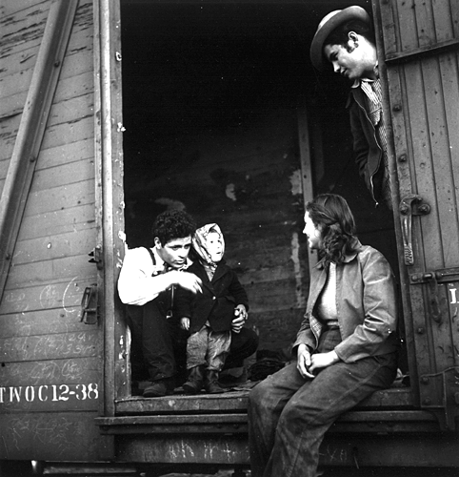
6. Large numbers of homeless workers roamed the U.S., particularly the Southwest, seeking work
Roseville, CA; Date: Apr 13, 1940; Credits: Rondal Partridge (Photographer) A family of Mexican agricultural workers heading for Utah to top sugar beets.

Slide 18
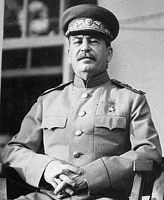
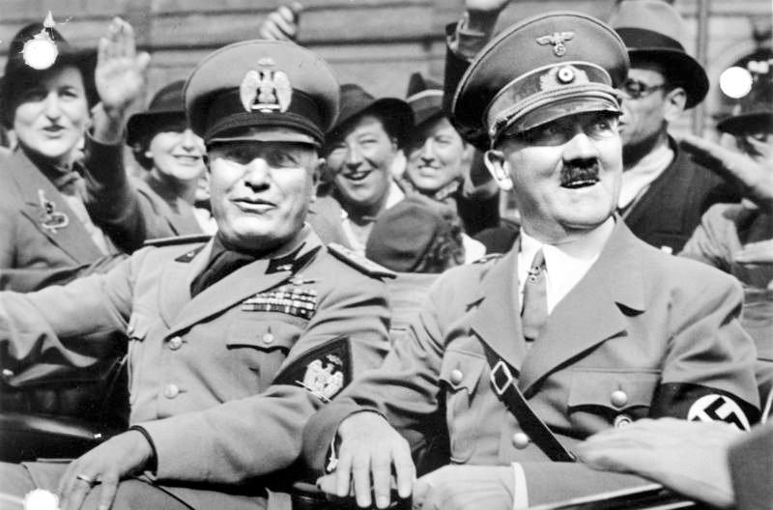
Notes:
Democracy and capitalism seemed to be failing.
All over the world the disruptions of war and depression were making people turn to dictators. Mussolini had taken control in Italy; Adolf Hitler was gaining power in Germany, and Joseph Stalin in Russia.
Charles Lindbergh went to GR and reported that Hitler was a fine leader.

Slide 19
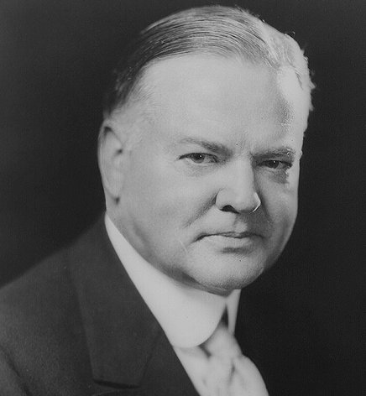
III. Hoover's Response
A. Rejected direct relief (the dole) as undermining to America’s character and rugged individualism.
Notes:
“The lesson should be constantly enforced that though the people support the gov’t, the gov’t should not support the people.”
Hoover meant no gov’t money should be spent on relief programs. He thought people could help themselves. If gov’t money was spent it should go to business. That would strengthen the economy, he said, and business money would “trickle down” to the people.

Slide 20
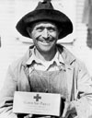
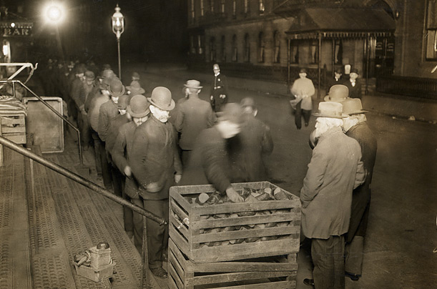
B. Hoover urged Americans to turn to community and church resources, 1. Many charities helped as much as they could, but the need was too great.
Notes:
Community/Church resources (Salvation Army, Community Chest, and Red Cross) to meet the needs of the poor.
Hoover didn’t realize there was a need for new thinking. People were starving in the land of plenty. The gap b/w rich and poor had grown big as a chasm.
Hoover believed in voluntarism; he thought individuals should help each other. It was a good idea, and there was a lot of neighborliness during the Depression, but it wasn’t enough. More needed to be done, much more.

Slide 21
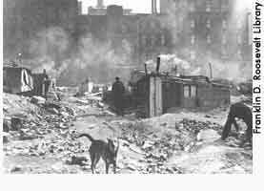
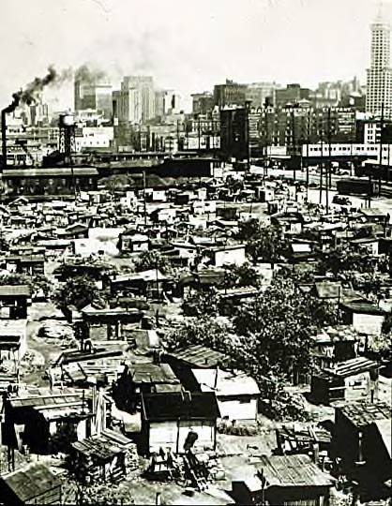
C. People who were homeless squatted in “Hoovervilles” outside of cities looking for work.
Above Hooverville outside of NYC, Right Hooverville outside of Seattle 1932
Notes:
Shacks built out of old boxes and boards on land near dumps or in parks. Hundreds camped in these unhealthy places.
Those shanty towns—where people keep warm around open fires—spring up all over the nation.
By 1933, a million people in America are living in Hoovervilles.

Slide 22
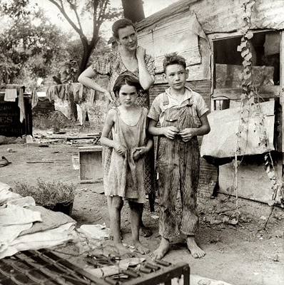
Dust Bowl Days
Notes:
Many bankers, brokers, and investors had been wild and irresponsible in the 20s. That irresponsibility caused great hardship in the decade that followed. The American farmer had been irresponsible for generations. Mostly, he hadn’t known better, although he should have. European farmers had been practicing crop rotations for over a century.
But beginning in Jamestown, American farmers abused the land. Farmers used up the fertile land and moved on. They cut down trees and cut up the sod.
For generations, there had seemed to be enough land that few people in America worried. They weren’t prepared for droughts and wind storms.

Slide 23
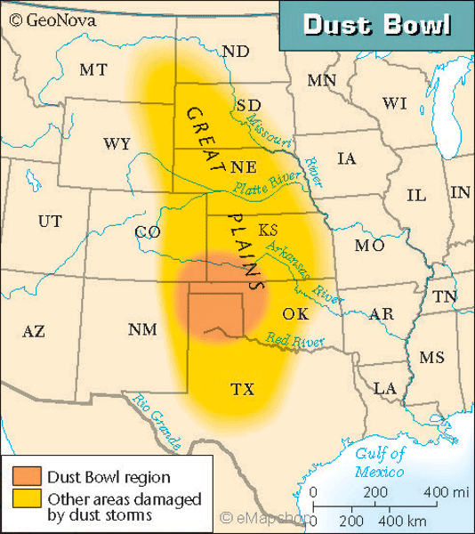

Slide 24
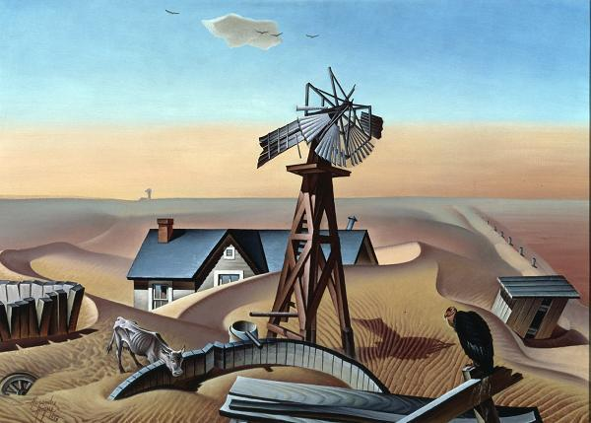

Slide 25
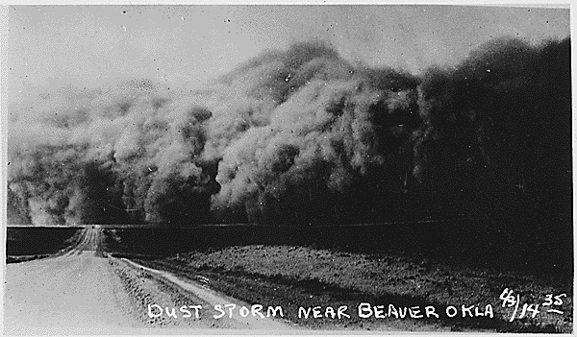
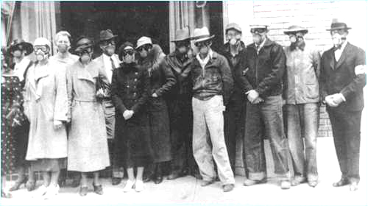
D. The droughts in the Midwest worsened the impact on the nation.
Notes:
1. The plains had been over plowed and there were no native grasses to hold the topsoil in place.

Slide 26
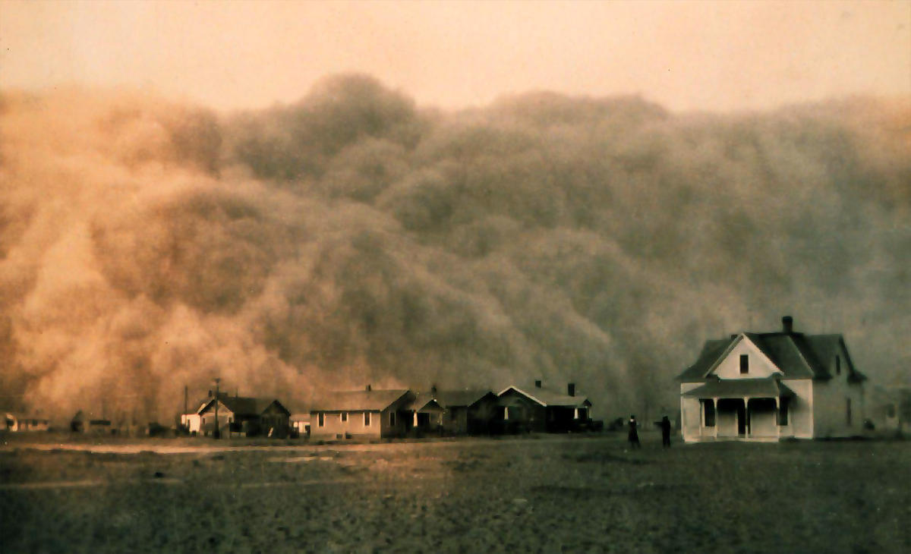
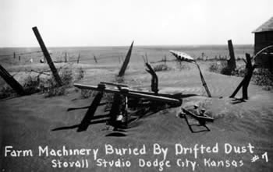
2. The rains stopped in 1931 & didn’t come back for 8 years.
3. The wind picked up the soil and blew it into huge dust storms around the country. The area became known as the “Dust Bowl”

Slide 27
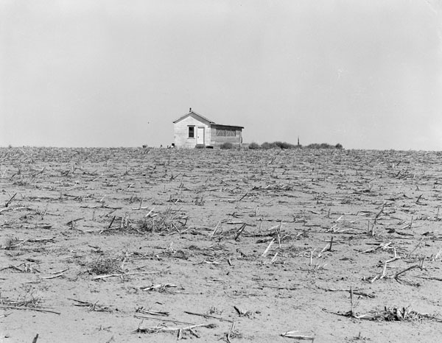
Abandoned House in Dust Bowl Kansas, 1941.

Slide 28
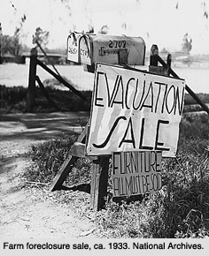
4. Farms foreclosed on by banks & people were forced to move on
a. Between 1930-34 almost 1 million farm loans were foreclosed on.
Notes:
there was no relief from the banks or the government.

Slide 29
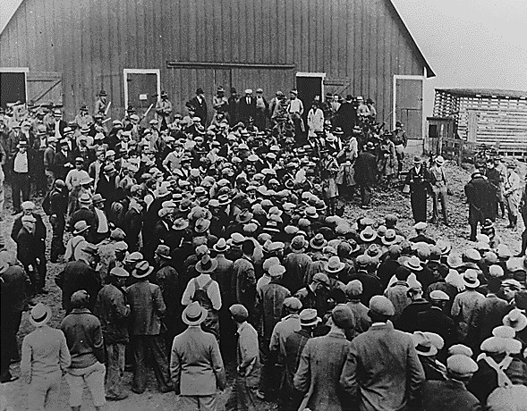
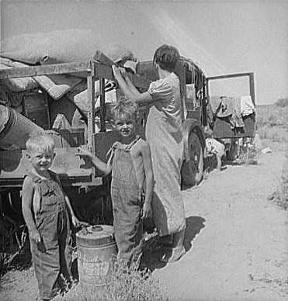
Iowa farm foreclosure sale Iowa farm family on the move

Slide 30
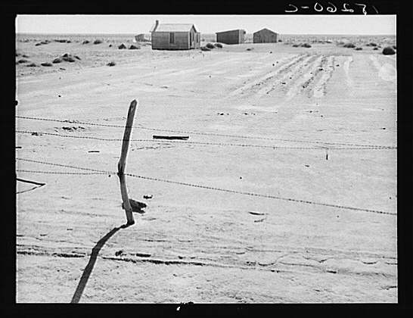
TITLE: Abandoned farm in the Dust Bowl. Coldwater District, near Dalhart, Texas
CREATED/PUBLISHED: 1938 June.
Lange, Dorothea, photographer.

Slide 31
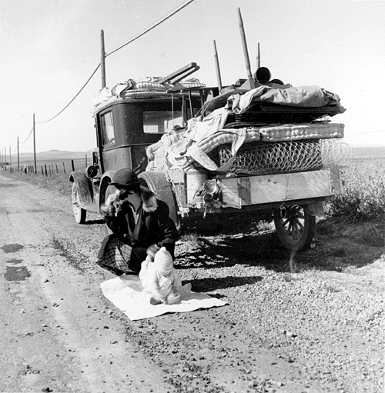
5. Many farmers left their lands looking for work & a way to support their families.

Slide 32
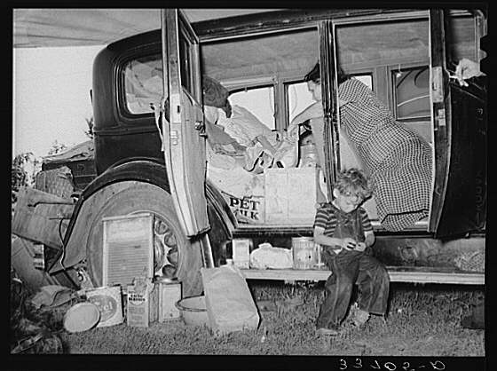
a. These farmers gave up and moved West, many to CA. They were know as “Okies.
Notes:
Many from ” Oklahoma.

Slide 33
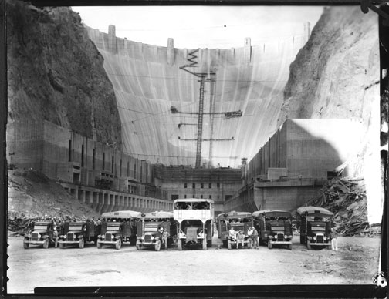
E. Hoover gradually used federal agencies
1. Financed federal work projects, such as massive dams in the West (Boulder, Hoover, and Grand Coulee)
Hoover Dam Construction

Slide 34
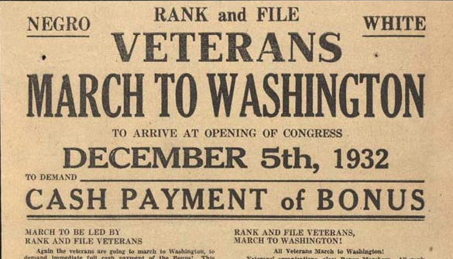
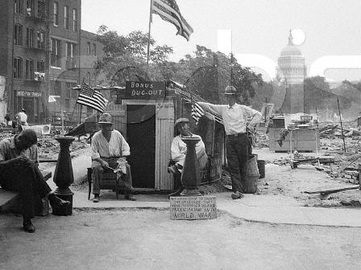
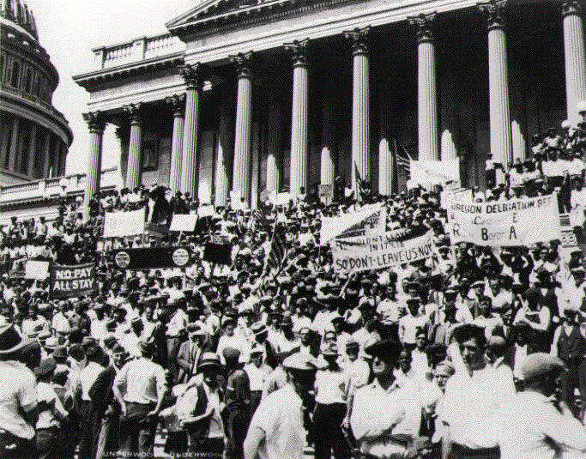
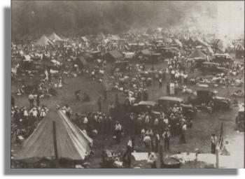
F. Bonus Army of 1932
1. In the summer of 1932, 25,000 WWI veterans marched to Washington D.C. to get a bonus they were promised in 1945.
Notes:
Thousands of veterans of the First World War were camped in the center of Washington, D.C. They were w/o jobs. Congress had voted them a bonus for their war service, but the bonus was not due to be paid until 1945, but these were difficult times. The men needed the bonuses now.
So they marched to Washington to see the president. Some brought their families. They built a Hooverville in Washington, D.C. They had no jobs or money, so they slept in tents. In empty buildings, in shacks on public grass. There were said to be 20,000 of them. Most carried American flags. Some were Medal of Honor winners; some had lost arms or legs in the services.
Hoover wouldn’t see any of them.

Slide 35
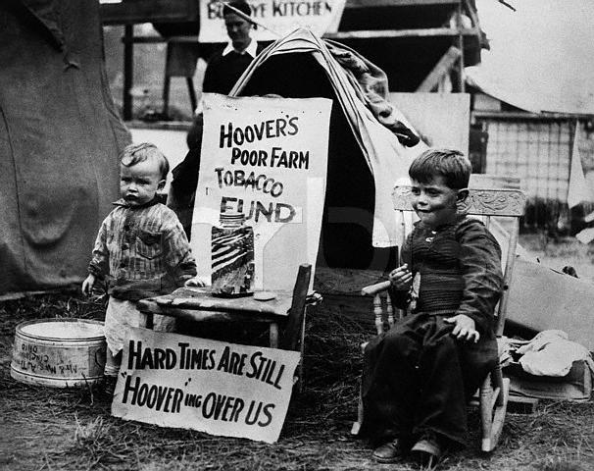
Children in one of the Bonus Army Camps

Slide 36
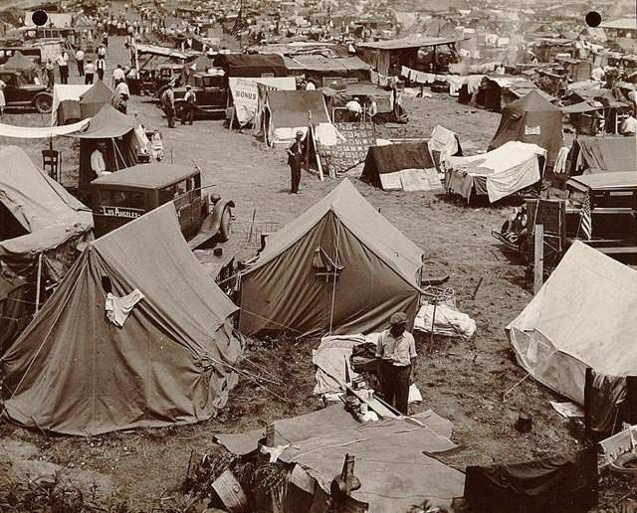
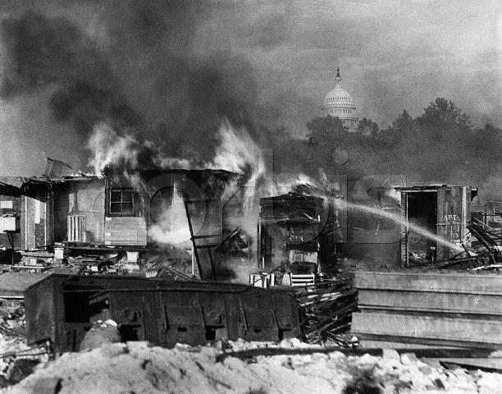
2. Hoover called out the troops and dispersed the Bonus army, and burned down the “Hoovervilles” they had built in the capital.
Notes:
The police asked them to leave. They wouldn’t go. So President Hoover sent the army. When former soldiers first saw the army patrols and tanks and cavalry, they cheered. They thought the troops were parading for them.
That was a mistake.
The troops came with tear gas, guns, and bayonets. Their leader, General Douglas MacArthur, went farther than the president wished. His troops tore down the shacks; they used tear gas and billy clubs.
People were hurt; a baby died. When it was over, Hoover said he saved the country from mob action. But many Americans hung their heads in shame.

Slide 37
IV. Election of 1932
A. Hoover refused to accept any responsibility for the economic downturn ("No president must ever admit he has been wrong") and was booed and jeered when he made his few campaign appearances outside Washington.

Slide 38
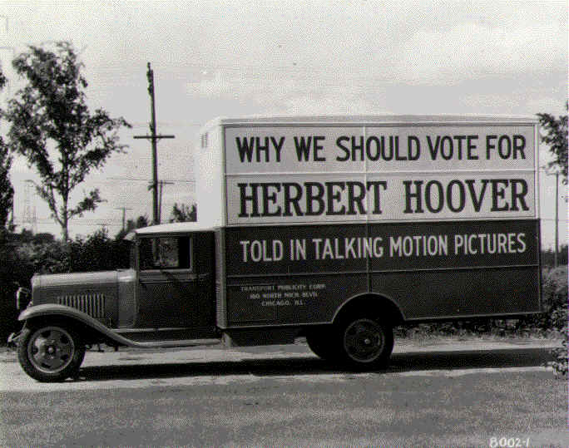
1. Campaign slogans: "The Worst is Past," "Prosperity is Just Around the Corner"

Slide 39
B. Franklin Roosevelt preached a brand of cautious liberalism, rejecting Hoover's conservatism and the radical approach of socialists and communists.
1. Offered a New Deal for the "forgotten man" and promised a balanced budget along with economic reforms

Slide 40
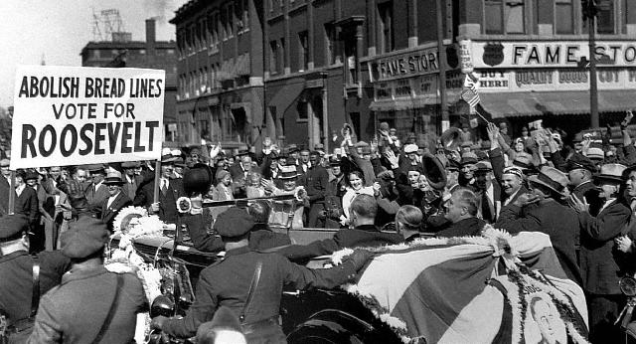
2. Campaign slogan: "Happy Days are Here Again" signaled Democratic optimism in face of economic problems

Slide 41
C. Though party platforms were remarkably similar, Democrats supported repeal of Prohibition and an increase in federal relief
D. FDR won 57% of the popular vote and Democrats took control of both the House and Senate

Slide 42
E. Following a long lame-duck period for Hoover and Republicans (November 1932-March 1933), FDR launched Hundred Days of legislative and administrative changes

Slide 43
The 3- R’s
1. Relief - help people out in the short term
2. Recovery - get the economy back on its feet
3. Reform - keep this from ever happening again

Slide 44
V. Critics of the New Deal
A. Critics came from both the conservative and liberal wings of the government.

Slide 45
B. They felt the New Deal was going too far and that the federal government was getting to large.
1. If Roosevelt was allowed to continue unchecked we would be living in a socialist country.

Slide 46
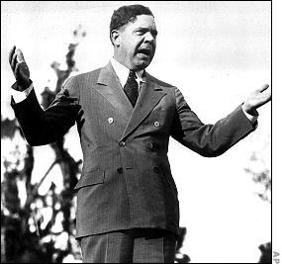
C. Huey Long came up with the most radical plan, “Share-Our-Wealth” which would seize money from the wealthy through taxes and give it to the poor.

Slide 47
VI. The Second New Deal
A. Democrats gained more support in Congress after the election of 1934 and could push through more reforms.
B. The Second New Deal was more focused on long term changes but still continued to support short term relief.

Slide 48
Franklin D. Roosevelt's Second Inaugural Address January 20, 1937
“But here is the challenge to our democracy: In this nation I see tens of millions of its citizens--a substantial part of its whole population--who at this very moment are denied the greater part of what the very lowest standards of today call the necessities of life.

Slide 49
I see millions of families trying to live on incomes so meager that the pall of family disaster hangs over them day by day.
I see millions whose daily lives in city and on farm continue under conditions labeled indecent by a so-called polite society half a century ago.

Slide 50
I see millions denied education, recreation, and the opportunity to better their lot and the lot of their children.
I see millions lacking the means to buy the products of farm and factory and by their poverty denying work and productiveness to many other millions.
I see one-third of a nation ill-housed, ill-clad, ill-nourished.

Slide 51
Franklin D. Roosevelt's Second Inaugural Address January 20, 1937
It is not in despair that I paint you that picture. I paint it for you in hope--because the Nation, seeing and understanding the injustice in it, proposes to paint it out. We are determined to make every American citizen the subject of his country's interest and concern; and we will never regard any faithful law-abiding group within our borders as superfluous. The test of our progress is not whether we add more to the abundance of those who have much; it is whether we provide enough for those who have too little.”

Slide 52
C. By the time he was reelected in 1936 Roosevelt was facing problems.
1. Several of his programs or laws had been declared unconstitutional.
2. He began to cut back on government spending, but the economy was too fragile and it caused a recession to occur.

Slide 53
D. The Supreme Court had declared unconstitutional a number of New Deal programs starting in 1935.
1. After the election in 1936, Roosevelt proposed an Amendment to the Constitution to add six new justices to the Supreme Court.

Slide 55
2. This would guarantee sympathetic judges to the New Deal.
3. Public opinion was against this idea and FDR was soundly defeated.
4. The American public upheld the importance of the balance of powers in the federal gov’t.

Slide 56
VII. Long Term Impact of the Depression and New Deal
A. The start of WW2 in Europe in 1939 spurred the U.S. economy.
1. We started exporting goods to Europe while remaining neutral for the next 2 ½ years.
2. The massive spending of the U.S. government when the U.S. entered war finally pulled the U.S. out of the Depression.

Slide 57
B. Many of the New Deal programs that Roosevelt started are still active today.
1. These programs expanded the size of the government and the number of social programs that the government funds.
2. The relationship between the American people and government changes. The people expect and accept a larger federal role in their lives and economy.

Slide 58
“Alphabet” Agencies at Work
Sgt. Burke of the US Army Briefs New Replacements on CCC Camp Rules

Slide 59
"CCC Boys at Work" Prince George County, Virginia

Slide 60
WPA Sewing Shop, New York City

Slide 61
"Reunion Day First Campers Join Second Campers" FERA Camps for Unemployed Women in Arcola, Pennsylvania

Slide 62
"Stringing rural TVA transmission line." Rural Electrification Administration (REA) - Tennessee Valley Administration (TVA)

Slide 63
Figures Silhouetted Against a Backdrop of the Constitution, WPA: Federal Theater Project

