Slide 1
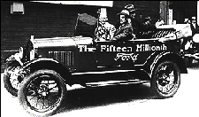
The Jazz Age
The Roarin’ 20s

Slide 2
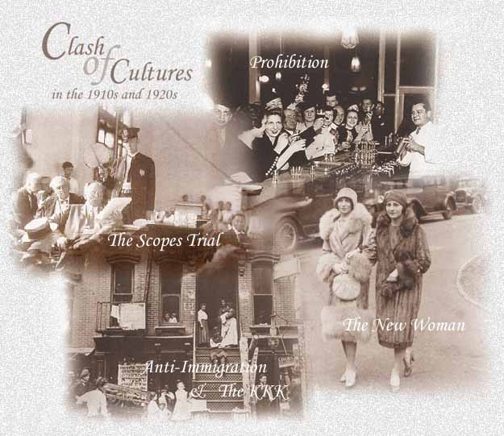

Slide 3
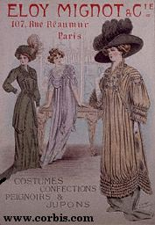
Turn of the century clothes

Slide 4
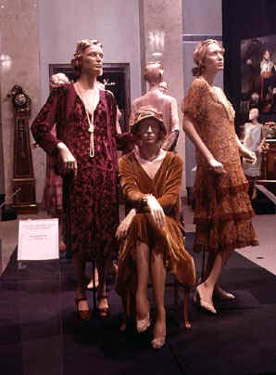
Fashion Fads

Slide 5
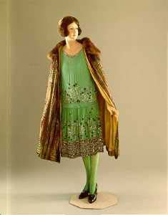
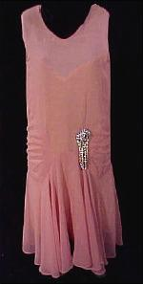
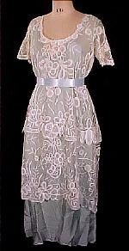
Flapper Dress
Wedding Dress

Slide 6
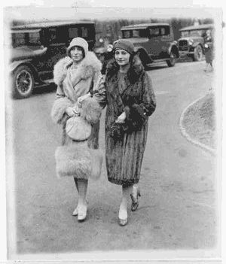

Slide 7
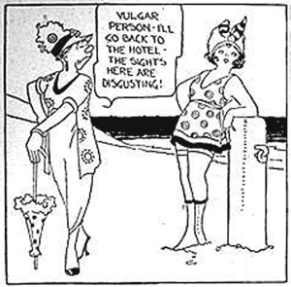

Slide 8
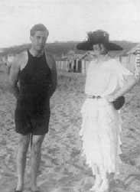
Beach Wear

Slide 9
The Flapper
Revolution in manners and morals
Flapper symbolized the revolution
Rebellious, energetic, fun-loving, and bold.
“Breezy, slangy, and informal in manner; slim and boyish in form; covered in silk and fur that clung to her as close as onion skin; with carmined cheeks and lips, plucked eyebrows and closefitting helmet of hair; gay, plucky and confident”
--Preseton Slosson

Slide 10
The Flapper Image
Shorter dresses
“American women are wearing dresses shorter than their mothers did, to the dismay of some guardians of decency”
Fabric yardage: 19.5 to 7
Bobbed hair
Close-fitting “cloche”
Heavy makeup

Slide 11
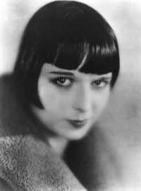
Manners changed
Drinking
Smoking
Businesses remained prejudiced
Pay scale
Advancement
Quit marriage/ pregnancy

Slide 12
Housing in the '20s

Slide 13
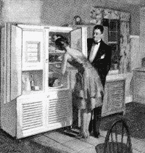
20s refrigerator

Slide 14
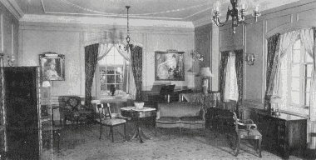
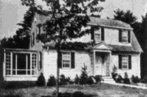
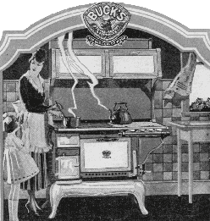
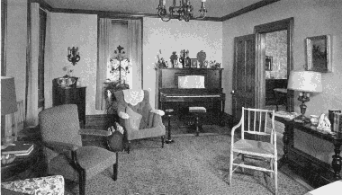
20s Houses

Slide 15
Major Events of the '20s

Slide 16
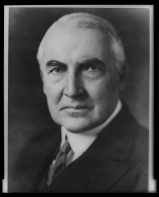
1913-1921
President Woodrow Wilson
1921 - 1923
Warren G. Harding

Slide 17
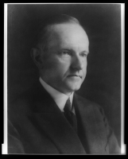
President Calvin Coolidge
1923-1929

Slide 18
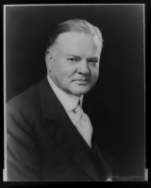
President Herbert Hoover
1929-1933

Slide 19
Charles Lindbergh Received The First Distinguished Flying Cross June 11, 1927 Today it may not seem very impressive to fly from New York to Paris, but the first time it happened, it was extraordinary!
The man who made that first solo trans-Atlantic flight was Charles Lindbergh. In May 1927, he flew his monoplane, Spirit of St. Louis, from New York to Paris, France. It took him thirty-three and a half hours to make the trip.

Slide 20
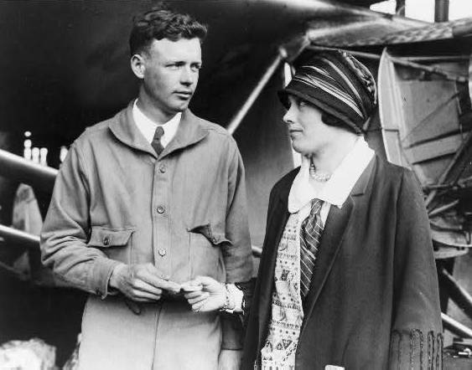
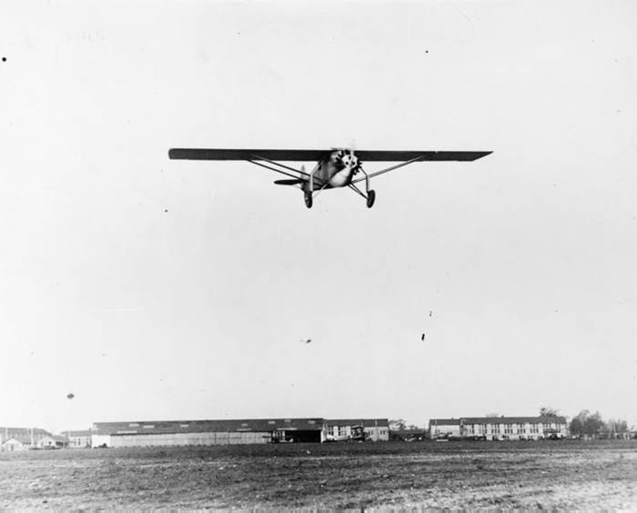
33 ½ hrs. from N.Y. to Paris
Charles Lindberg

Slide 21
Lots of people are fascinated by the idea of human flight. Did you know that eight years after Lindbergh's trip, Amelia Earhart became the first person to complete an even longer flight from Hawaii to California? (She later apparently died in a mysterious plane crash as she attempted to fly around the world in 1937.) Today, some people fly across the country for work and return home on the same day. Do you think that someday we'll make the same sort of trips into space?

Slide 22
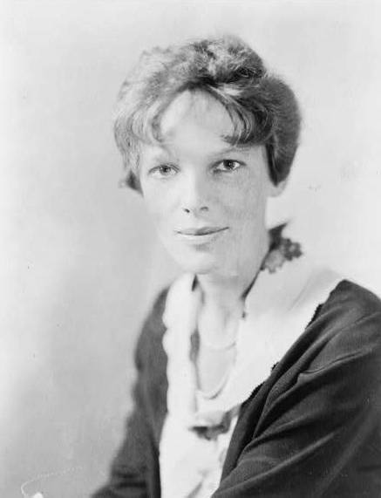
Amelia Earhart

Slide 23
Ten Suffragists Arrested While Picketing at the White House August 28, 1917 Between June and November 1917, 218 protestors from 26 states were arrested and charged with "obstructing sidewalk traffic" outside the White House gates. During that time, messages on the picket signs became more demanding. The women took advantage of the United States' entry into World War I on April 6. When Russian envoys came through Washington, posters proclaimed that the United States was a democracy in name only. Bystanders erupted in violence. What was the suffragists' next move?

Slide 24
Women take a stand

Slide 25
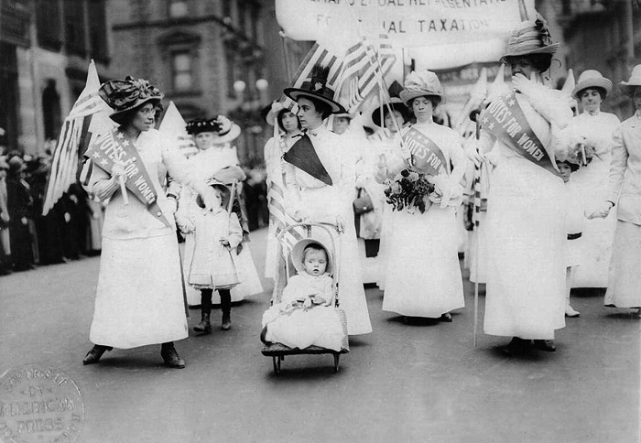

Slide 26
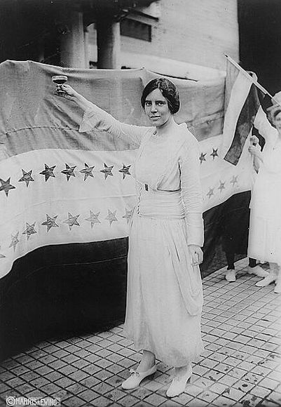

Slide 27
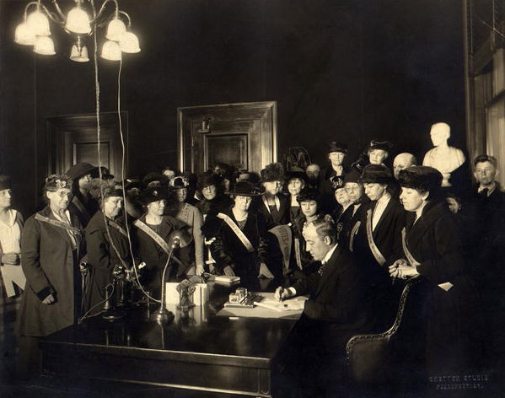
Signing the 19th Amendment for Women's Suffrage
1920

Slide 28
Women voted like men
Only 35% voted
Lack of interest
Family pressure
Support
Only in local elections women’s votes differed from men’s

Slide 29
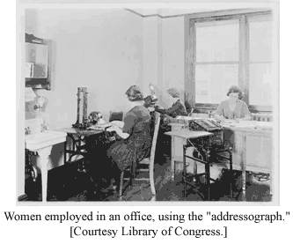
Women Went to Work

Slide 30
Sigmund Freud
Psychologist
Psychoanalysis

Slide 31
The Jazz Age
Growing radio audience & African American migration= popularity of jazz
Features improvisation
Nationwide craze
Some thought too suggestive

Slide 32
Jazz Clubs and Dance Halls
Harlem
500 jazz clubs
Cotton Club
Black musicians played for white audiences
Louis Armstrong: trumpet improv
Duke Ellington: composer
Danced the Charleston

Slide 35
Harlem Renaissance
Harlem cultural center of U.S. for African Americans
Literary awakening
James Weldon Johnson exec. Sec. for NAACP & writer

Slide 37
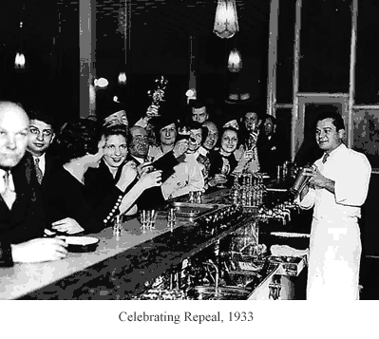
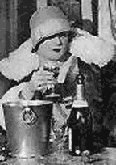
Prohibition: A Failure
1920 - 1933
Flapper
Drinking
Celebration of Repeal of Prohibition - 1933

Slide 38
Prohibition
Prohibition= 18th amendment January 16, 1920
Goals
Eliminate drunkeness and abuse of family
Get rid of saloons, prostitution, gambling, and vice
Prevent absenteeism and on-the-job accidents
95% of rural community obliged, but only 5% of NYC

Slide 41
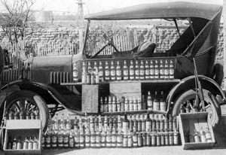
Bootlegging
Liquor, beer, and wine could not bee manufactured, sold or transported in the U.S.
Alcohol was allowed for sacramental wines
Huge increase in church attendance
Speakeasies were bars that operated illegally

Slide 42
Organized Crime
Bootlegging alcohol helped lead to the development of organized crime
Gang clashes w/sawed off shotguns
Moved to other illegal activities
Ideals bore evil fruit

Slide 43
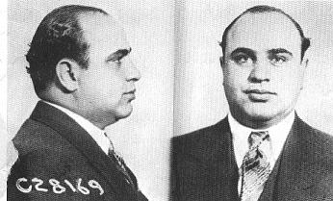
Al Capone

Slide 44
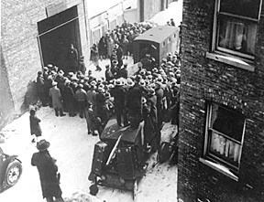
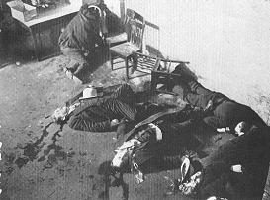
St. Valentine's Day Massacre
Al Capone vs. Bugs Moran

Slide 45
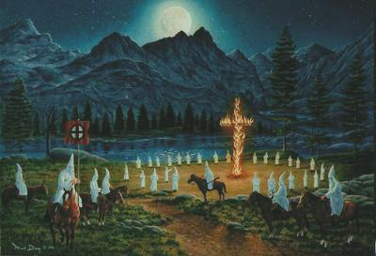
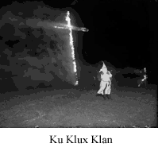
Ku Klux Klan

Slide 46
Issues of Religion
Evolution
Many thought it conflicted w/ religious beliefs
Science and technology were taking a larger role in life
War causing people to question God
Bible written by humans with errors.

Slide 47
Fundamentalism
Supported traditional Christian ideas about Jesus
God inspired Bible w/ no contradictions
Literally true, every story actually took place
Denounced evolution
Wanted to pass laws banning evolution being taught in schools.

Slide 48
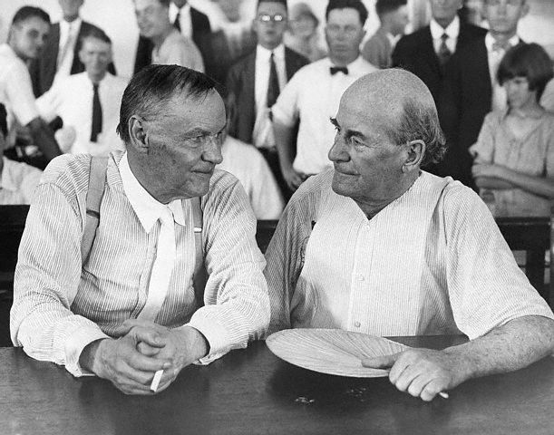
The Trial of the Century

Slide 49
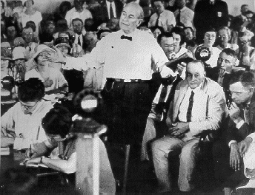
Tennessee banned teaching evolution in 1925.
Science teacher John T. Scopes challenged as unconstitutional.
Defied law-arrested

Slide 50
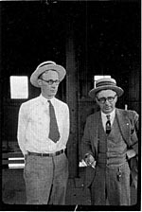
Battle b/w two of U.S.’s best lawyers
William Jennings Bryan- prosecution
Clarence Darrow-defense
Mass media swarmed
First trial broadcast over American radio
After 8 minutes jury found Scopes guilty of teaching evolution
$100 fine
Darrow put Bryan on the stand to testify as an expert of the Bible

Slide 51
(Darrow)Do you think the earth was made in six days?"
(Bryan) Not six days of 24 hours.
(Darrow)Did you ever discover where Cain got his wife?
(Bryan) No sir; I leave the agnostics to hunt for her.
(Darrow)Do you think the sun was made on the fourth day?
(Bryan)Yes.
(Darrow)And they had evening and morning without the sun?
(Bryan) I am simply saying it is a period.
(Darrow)The creation might have been going on for a very long time?
(Bryan)It might have continued for millions of years.
(Darrow)Yes, All right.

Slide 52
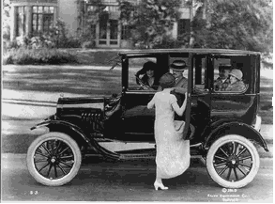
Cars Changed Life

Slide 53
Entertainment of the 20s

Slide 54
The Mass Media
Early 1920s Cecil B. DeMille & Hollywood barn
Created common nat’l culture
Mass Media=print, film, and broadcast methods of communication to large numbers of peoples.

Slide 55
Movies & Newspapers
1910-1930 22,500 movie theaters
1920 125 million
Popularity increased with “talkies”
Americans followed off-screen lives of stars
Newspapers were 50 pages long!
Tabloids

Slide 56
Tabloid of 1920s replaced serious news w/ fashion, sports, and sensational stories
“90 percent entertainment, 10 percent information--and the information w/o boring you”
--William Randolph Hearst
Magazine sales rose to 200 million copies
Information that people could easily digest
Advertisers ran full page ads

Slide 64
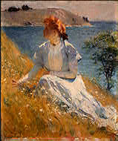
Art in the 20s
Impressionist Frank Benson

Slide 65
Georgia O’Keeffe painted natural objects
Edward Hopper showed the nation’s rougher side

Slide 67
Ty Cobb Made His 4,000th Hit July 18, 1927 Ty Cobb's nickname was the "Georgia Peach" because he was born in Narrows, Georgia. Besides being a great player, Cobb was a fierce competitor. He stole home 50 times, won 12 batting average titles, and managed the Detroit Tigers for six seasons while also playing centerfield. There's some debate about the exact figure for his lifetime batting average, but for 23 years he batted at least .300. In this photo, there are two of the greatest hitters in baseball--Ty Cobb and Joe Jackson. Traded to the White Sox in 1915, Jackson averaged .356. Both players were involved in scandal. Do you know what they did?

Slide 68
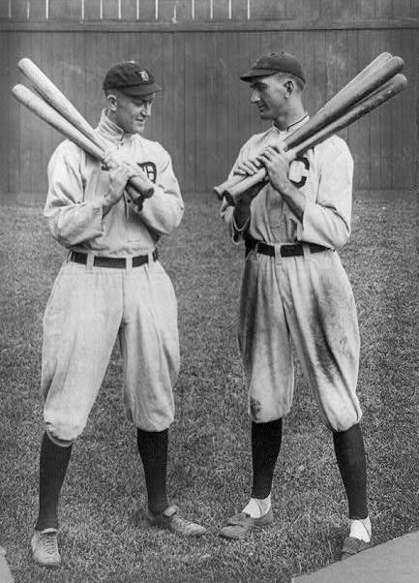

Slide 69
Ty Cobb Made His 4,000th Hit July 18, 1927 Joe Jackson was banned from baseball after being involved in a conspiracy to "throw" (fix the outcome of) the World Series in 1919, known as the Black Sox Scandal. Cobb was allowed to resign from professional baseball in 1926 after supposedly being involved in gambling violations. Later, baseball's first commissioner, Judge Kenesaw Mountain Landis, cleared Cobb of charges and allowed him to play again. Cobb, a left-handed batter who threw with his right hand, was elected to the Baseball Hall of Fame in 1936. Cobb's autobiography, titled My Life in Baseball, was published in 1961.

Slide 70
The Lost Generation
American society troubled one group of writers
Values that its members were being taught didn't fit the reality of life after the brutal and horrifying World War I.
Moved to Paris
Ernest Hemingway, F.Scott Fitzgerald, E.E. Cummings, Sherwood Anderson, Hart Crane

Slide 71
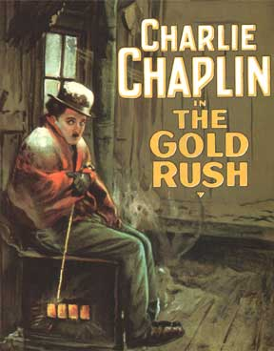
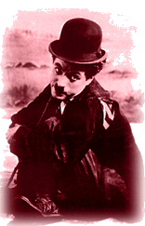
1925
Charlie Chaplin

Slide 72
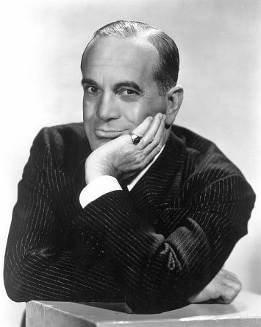
http://www.youtube.com/watch?v=G-WZRUIfHjo
http://www.youtube.com/watch?v=G-WZRUIfHjo
Al Jolson

Slide 73
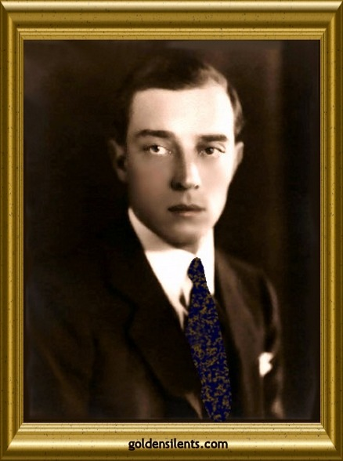
http://www.youtube.com/watch?v=LWEo4M8nZQQ
Buster Keaton

Slide 74
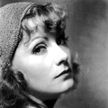
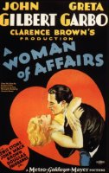
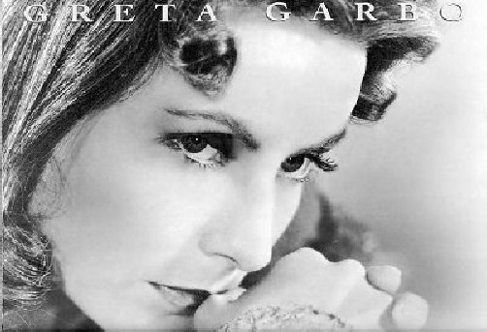
http://www.youtube.com/watch?v=ZAoEK_QvGhU
http://www.youtube.com/watch?v=ooj87vXO3_I
Greta Garbo

Slide 75
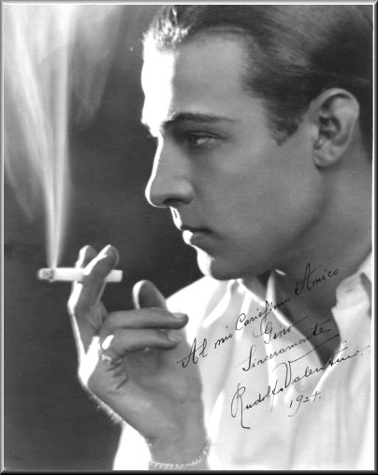
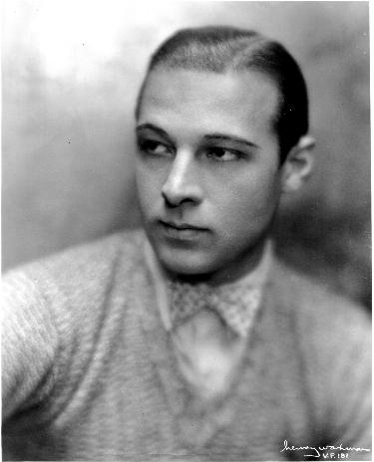
http://www.youtube.com/watch?v=PdSznRNCA7o
Rudy Valentino

Slide 76
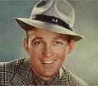
Bing Crosby
http://www.youtube.com/watch?v=9vPfOjAw5Z0

Slide 77
http://www.youtube.com/watch?v=hRyDB4RWJdw
Ella Fitzgerald

Slide 78
Duke Ellington
http://www.youtube.com/watch?v=SDDCzb3dv_Y

Slide 79
http://www.youtube.com/watch?v=vnRqYMTpXHc
Louis Armstrong

Slide 80
Listening to the radio

Slide 81
http://www.youtube.com/watch?v=3heCSPJrO70
http://www.youtube.com/watch?v=pElRiVQ7FXQ
Vaudeville

Slide 82
Ziegfield Follies

Slide 83
http://www.youtube.com/watch?v=EbvZZsYZmEY
The Great Houdini
http://www.youtube.com/watch?v=EbvZZsYZmEY
http://www.youtube.com/watch?v=lhepAvTCie4

Slide 84
Literature in the '20s

Slide 85
F. Scott Fitzgerald (1896 – 1940)
Born: 1896, St. Paul, Minnesota
Named after relative Francis Scott Key
Family: Wealthy mother (inherited money); unsuccessful father
Education:
Private Schools
Princeton – recognized for his writing
Not a successful student

Slide 86
A Young Man
W W I - Enlisted in army but war ended before he was sent overseas.
Advertising job
Dated Zelda Zayre, an Alabama beauty
Socially Prominent family
1920 – published This Side of Paradise
Making him one of America’s most popular and successful writers.

Slide 87
Zelda and Scott Fitzgerald
Married Zelda, his “Golden Girl”
Roaring Twenties Celebrities in the fast moving social set of the time
He called it:
The Jazz Age

Slide 88
1921 Home
Scottie born here

Slide 89
The Great Gatsby
Published 1925
Not financially successful at the time
Today it is considered his masterpiece
His life was full of problems:
Illness
Alcoholism
Zelda’s mental breakdown

Slide 90
1934 – Tender Is the Night
Died at age 44 of a heart attack in Hollywood
Working on The Last Tycoon at the time

Slide 91
Home where he died in Hollywood, California

Slide 92
About The Great Gatsby
An historical novel
Almost a biography of himself & Zelda
Point of view –Narrator :
Structure:
Setting: 1920s
1st person narrative
Nick Carraway
Series of Parties

Slide 93
Purpose:
1) to show the conflict between the romantic idealism of the 20s and the disappointments and disillusions that follow
2) To show the moral bankruptcy of upper-Class America and the corruption of the American dream
3) A study of success and its poisoning influence on character.

Slide 94
Characters:
Nick Carraway –
Tom and Daisy Buchanan
Jay Gatsby
Jordan Baker
Females are genteel romantic heroines
Narrator; upper middle class
Very “old” rich
New rich; mysterious
Professional golfer; rich; sophisticated

Slide 95
Symbolism
Cool vs. Sweat -White Clothing
Colors are symbols (watch for them)
Sip cool drinks and drive fast to avoid heat
Jordan and Gatsby – Cool
Nick – in-between
Wilsons – sweating, dirty people

Slide 96
Cars: Reveal status of character
Nick – conservative old Dodge
Buchanans – easy-going blue coupe
Gatsby – big, shiny, rich, powerful yellow roadster
House Furnishings – Rich (A cover-up)
Tom and Daisy hide behind wealth to cover-up a poor marriage.

Slide 97
Stock Market Crash
October 29, 1929

Slide 98
The days of the
golden girls
have come to an end

